Slide 1
EC (DG SANTE)
The eHealth DSI
2016-11-25, Solution Provider

Slide 2
Materials prepared by the eHDSI Solution Provider v1, updated 2016-11-24
Topics tackled
      CEF eHealth DSI (eHDSI)
      Use Cases: Patient Summary
      and ePrescription
      3. eHDSI System Architecture
      4. eHDSI Core Services
      5. eHDSI Timescales

Slide 3
eHealth DSI
1. CEF eHealth DSI (eHDSI)
Updated 2016-11-25, Solution Provider

Slide 4

What is CEF
HOW IS IT REGULATED?
CEF Regulation
The Connecting Europe Facility (CEF) is a regulation that defines how the Commission can finance support for the establishment of trans-European networks to reinforce an interconnected Europe.
TRANSPORT
€26.25bn
Digital
Service Infrastructures
€970 m *
CEF Telecom Guidelines
The CEF Telecom guidelines cover the specific objectives and priorities as well as eligibility criteria for funding of broadband networks and Digital Service Infrastructures (DSIs).
TELECOM
ENERGY
€5.85bn
Broadband
€170 m
CEF Work Programme
Translates the CEF Telecom Guidelines in general objectives and actions planned on a yearly basis.
* - 100 m Juncker Package

Slide 5
What is Digital Service Infrastructure (DSI)
TRANSPORT
€26.25bn
What is a DSI?
**DSI describe solutions that support the implementation of EU-wide projects. They provide trans-European interoperable services and which are composed of core service platforms and generic services.
Digital
Service Infrastructures
€970 m *
**Building Block DSI Building Blocks are basic digital service infrastructures, which are key enablers to be reused in more complex digital services.
TELECOM
ENERGY
€5.85bn
Broadband
€170 m
**Sector Specific DSI provide trans-European interoperable services for specific domains (e.g. eHealth, Cybersecurity, e-Justice, e-Procurement) using BB DSI
* - 100 m Juncker Package
**Source: Regulation (EU) No 283/2014

Slide 6

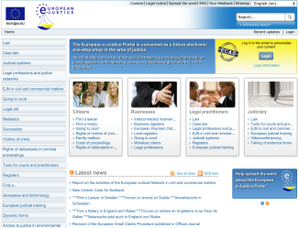


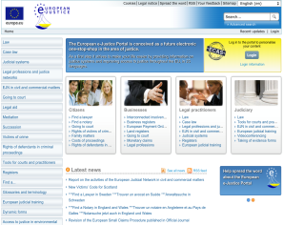
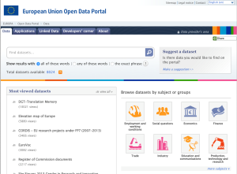






















CEF Telecom – what does it finance
DIGITAL SERVICE INFRASTRUCTURES (DSIs)
EUROPEAN COMMISSION
MEMBER STATES
CORE SERVICE PLATFORM
(Services offered by the European Commission)
GENERIC SERVICES
(Grants for projects in the Member States)
https://ec.europa.eu/cefdigital/wiki/x/QAFfAQ
https://ec.europa.eu/inea/connecting-europe-facility/cef-telecom

Slide 7
What are the CEF DSIs
CEF PRINCIPLES
# Cross-border use
# Deliver services by digital means
guide
# Have sufficient maturity
DIGITAL SERVICE INFRASTRUCTURE
# Contribute to EU policies
# Plan to become sustainable
A. Core Service Platforms
B. Grants (Generic Services)
# Comply, as much as possible, based on market-driven open standards and technical specifications|
Sectorial
must reuse
Building Block*
# Be reusable in different domains/ sectors
0… 6
# Be reusable by other DSIs
List of sector-specific projects funded by CEF
Europeana
eID
List of Building Block projects funded by CEF
Safer Internet
eSignature
Open Data
eDelivery
ODR
eTranslation
eHealth
eInvoicing
eProcurement
CyberSecurity
EESSI
eJustice Portal
(*) A Building Block is a package of technical specifications, services and sample software that can be reused in different policy domains:
BRIS
Source: CEF DOMAIN MODEL v1.01

Slide 8
CEF eHealth DSI (eHDSI)
eHDSI funded MS
What is the eHDSI challenge?
Many EU citizens travel to or work in another Member State.
  However, their healthcare information is not always accessible in the Member States where they need the treatment.
  The increased mobility of citizens coupled with the advancements of digital technologies requires both health policies and health systems across the European Union to be more and more interconnected.

Slide 9
CEF eHealth DSI (eHDSI)
eHDSI funded MS
What is the eHealth DSI?
Tools and services using ICTs that can improve prevention, diagnosis, treatment, monitoring and management in Healthcare.
Is planned to support different Business Cases:
  Patient Summary, unplanned cross-border healthcare visit to a health provider in the EU
  ePrescription, receive the equivalent medication treatment when abroad from patient home country

Slide 10
eHealth DSI
2. Use Cases: Patient Summary and ePrescription
Updated 2016-11-14, Solution Provider

Slide 11
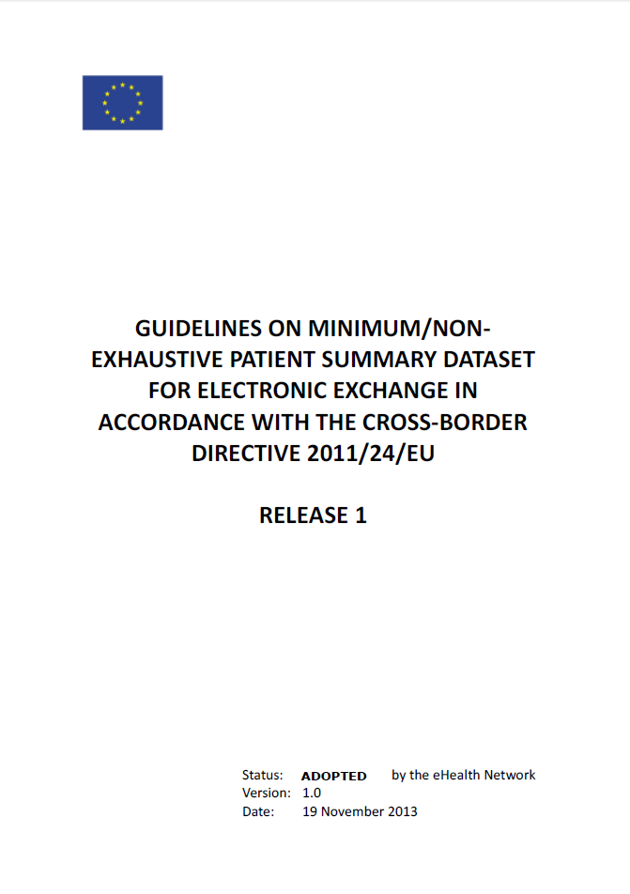
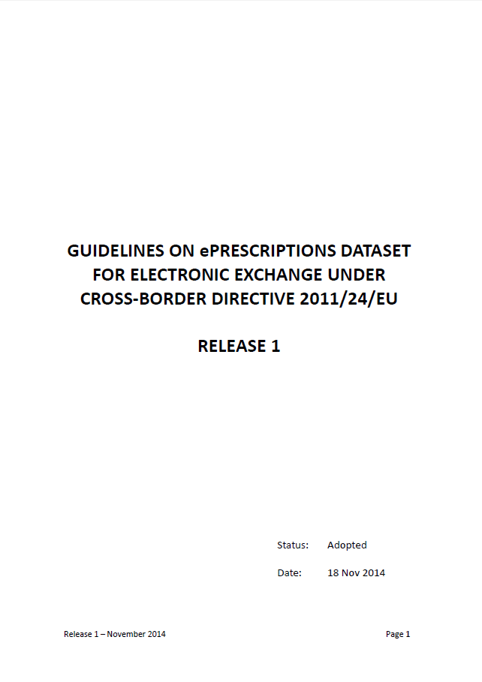
Use Cases: Patient Summary and ePrescription
RELEASE 2
2016-11-21
adopted during the last eHealth Network

Slide 12
eHealth DSI
3. eHDSI System Architecture
Updated 2016-11-14, Solution Provider

Slide 13
eHDSI System Architecture
CENTRAL SERVICES
Central Services
1 EU wide instance
Configuration
NCPeH – National contact Point for eHealth
1 per Country
Run-time
CONFIGURATION
Configuration services
Terminology services
DISTRIBUTED SERVICES
RUN-TIME
NCPeH
Country x
NCPeH
Country y
NCPeH
Country z
NCPeH
Country …

Slide 14



The interoperability challenge
Required component
NCPeH-B (Country of Treatment)
Portugal
NCPeH-A (Country of Affiliation)
Czech Republic
Optional component
Applications
National Infrastructure
Health Portal
Clinical Data Repository
National Infrastructure
- Patient Summary
- ePrescription
Connector
Connector
REQUESTER
PROVIDER
Messaging and Transport
NCPeH
NCPeH
Networking
Internet

Slide 15
eHealth DSI
4. eHDSI Core Services
Updated 2016-11-14, Solution Provider

Slide 16
eHDSI Core Services (1 of 2)
SERVICE | PURPOSE
Services REQUIREMENTS | Provide a clear set of policy and business requirements elicit from Regulation, Directives, Implementing acts, policies and guidelines, that drive the specification, implementation and operation
Services SPECIFICATION | Provide eHDSI Interoperability specifications that enable the building of NCPeH and the Service Network
CONFIGURATION services | Enable NCPeH Service Network establishment and trust bootstrap through automated configuration management
TERMINOLOGY services | Enable MVC distribution and support MTC management
TEST AND AUDIT services | Establish the Tests and Audit requirements that must be fulfilled to enter in the NCPeH Operational Network
Provided by:
eHDSI
  Owner (DG SANTE)
  Solution Provider (DG SANTE)

Slide 17
eHDSI Core Services (2 of 2)
SERVICE | PURPOSE
COMMUNICATION services | Multistakeholder dissemination
SERVICE DESK services | Resolve End-Users issues (of CORE SERVICES)
COLLABORATION services | Streamline stakeholders interaction and joint work
NCPeH Reference Implementation | Ease MS effort by providing a jointly build NCPeH reference implementation
MONITORING services | Gather evidence about core and generic services performance
Provided by:
eHDSI
  Owner (DG SANTE)
  Solution Provider (DG SANTE)

Slide 18
CORE Services: CONFIGURATION services
    Dynamic Discovery models
1. enables the sender to dynamically discover the endpoint address and other capabilities of the receiver (e.g., certificates and digital identities of services).
2. Enable Trust Bootstrap in the defined Direct Brokered Trust
3. Instead of looking at a static list of IP addresses, the sender consults a Service Metadata Publisher (SMP) where information about every participant in the data exchange network is kept up to date
4. The correct URL of the SMP service is obtained by performing a Domain Name System (DNS) lookup in the Service Metadata Locator (SML)
5. By knowing this URL, the sender is able to dynamically locate the right SMP and therefore the right receiver.
Notes:
The picture shows how the TSL is mapped into SignedServiceMetadata (SMP records). The idea of that piucture is that the TSL is mapped to various SignedServiceMetadata, and that the TSL is represented as a SMP ServiceGroup.

Slide 19
Dynamic discovery in detail
Phase 1: Registration
SML
The role of the SML (Service Metadata Locator) is to manage the resource records of the participants and SMPs (Service Metadata Publisher) in the DNS (Domain Name System). The SML is usually a centralised component in an eDelivery Messaging Infrastructure.
SMP
Once the sender discovers the address of the receiver’s SMP, it is able to retrieve the needed information (i.e. metadata) about the receiver. With such information, the message can be sent. The SMP is usually a distributed component in an eDelivery Messaging Infrastructure.
ORIGINAL SENDER
FINAL RECIPIENT
National Infrastructure B
CORNER
C1
C4
CORNER
National Infrastructure A
Health Portal
Clinical Document Repository
STEP3. REGISTER PARTICIPANT
SML
(centralised)
CORNER
C2
C3
CORNER
DNS
Connector
NCPeH
NCPeH
Connector
STEP2. CREATE PARTICIPANT
Internet
ADMINISTRATOR
SMP
STEP1. SUBMIT METADATA
SMP
SMP

Slide 20
Dynamic discovery in detail
Phase 2: Operations
SML
The role of the SML (Service Metadata Locator) is to manage the resource records of the participants and SMPs (Service Metadata Publisher) in the DNS (Domain Name System). The SML is usually a centralised component in an eDelivery Messaging Infrastructure.
SMP
Once the sender discovers the address of the receiver’s SMP, it is able to retrieve the needed information (i.e. metadata) about the receiver. With such information, the message can be sent. The SMP is usually a distributed component in an eDelivery Messaging Infrastructure.
ORIGINAL SENDER
FINAL RECIPIENT
National Infrastructure B
CORNER
C1
C4
CORNER
National Infrastructure A
STEP5. Obtain Documents
STEP1.
Query
Health Portal
Clinical Document Repository
SML
(centralised)
CORNER
C2
C3
CORNER
STEP2. LOOKUP
DNS
STEP4. eHealth Operation
Connector
NCPeH
SEND
RECEIVE
NCPeH
Connector
IHE XCA/XCF (XCPD)
ACKNOWLEDGE
Internet
SMP
SMP
STEP3. RETRIEVE METADATA
SMP

Slide 21
CORE Services: CONFIGURATION services
NCP Trust Service Status List (NSL)
SML & SMP solution
+
Piloted during epSOS Large Scale Pilot, but with security relaxations
+
Mutualized solution (reuse of CEF BB)
PROS & CONS
+
High speed as there is no overhead processing
+
More automated and flexible
-
Less flexible, change of irrelevant references
+
Auto configuration of NCPs with no human interaction
-
Less secure
+
Can work in a centralised or distributed architecture
-
Ad hoc solution
+
Standards based solution (e.g. BDX-SM*)
-
Centralised architecture
+
Improved the NCPeH operations efficiency
-
Non-standard solution
-
Slower speed, as some overhead processing is required
-
Piloted in e-SENS eHealth Pilot (but with few NCPeH nodes)
*BDX-SMP: OASIS-OPEN Business Document Exchange Service Metadata Publishing,

Slide 22
Non Repudiation Services
    Evidence Emitter
1. Non-repudiation was an epSOS requirement, relaxed during pilot, aiming at,
  Generate, collect, validate and make available evidence concerning a claimed event;
  to resolve disputes about the occurrence or non-occurrence of the event;
2. Evidence Emitter ABB provides an horizontal framework to
  produce cross-border, cross sectorial, non-repudiation tokens, named “evidence”,
  mapping ISO 13888 tokens to ETSI REM through execution of XACML policies.
3. Evidence Emitter ABB for eHDSI defines tokens for non-repudiation of origin, and non-repudiation of receipt, linked to the audit-trails enabling traceability amongst the NCPeH.
  Formally proves answer to “who did what, from where, using which server, and when?”

Slide 23
eHDSI next steps towards eDelivery
    Next Steps
1. Approve e-SENS submitted Change Proposal, formalizing it in the eHDSI Interoperability Specifications (in progress)
2. Learn with e-SENS pilot and deploy an operation ready services

Slide 24
eHealth DSI
7. eHDSI Timescales
Updated 2016-11-14, Solution Provider

Slide 25
eHDSI Timescales: Core Services
CEF eHealth DSI
Patient Summary
and ePrescription
2016
2017
2018
2019
2020
MS GO LIVE
Today
Feb
Feb
Feb
Communication & Collaboration
Requirements and Specifications
Configuration services
Terminology services
Test and Audit services
NCPeH Reference Implementation
Operations Orchestration
Jan
Nov
Jul
Mar
Mar
Mar
Jan
Mar
Mar
Mar
Jan
Mar
Mar
Mar
Jul
Mar
Mar
Mar
Mar
Jan
Dec
Mar
Jun
Mar
Set
Mar
Set
Mar
Set
Jan
Dec
PLANNED
IN PROGRESS
COMPLETED

Slide 26

Be part and make it Yours
Web Presence
https://ec.europa.eu/cefdigital/wiki/display/CEFDIGITAL/eHealth
Communities
Operations https://ec.europa.eu/cefdigital/wiki/x/iT4ZAg
Semantic https://ec.europa.eu/cefdigital/wiki/x/hj4ZAg
Technical https://ec.europa.eu/cefdigital/wiki/x/8CEZAg
https://ec.europa.eu/cefdigital
These materials have been crafted to provide a comprehensive summary on the issues at stake.
For further clarifications, please:
SANTE-EHEALTH-DSI@ec.europa.eu

