Slide 1
Introduction to INEA, the CEF Telecom evaluation process and eInvoicing call 2016-3
Kara Baptista – Evaluation Manager, CEF Telecom - INEA
CEF eInvoicing Stakeholder Day – 1 December 2016

Slide 2
Content
For newcomers to the eInvoicing/CEF calls:
Background on INEA
CEF Telecom 2016 calls for proposals + eInvoicing call
Evaluation process
For those currently working on their applications:
How to apply: READ, REFLECT and REMEMBER
For everyone:
Future planning 2017

Slide 3
For newcomers to the eInvoicing/CEF calls

Slide 4
Background on INEA

Slide 5
Partnership with the Commission
European Commission Defines the policy Defines strategy, objectives and priority areas/work programmes Selects projects for co-financing Makes programme decisions Evaluates the programme and the Agency's performance | INEA (Executive Agency) Turns policy into action Organises calls for proposals Monitors the technical and financial implementation of projects Manages project lifecycle Ensures sound financial management

Slide 6




INEA's delegated programmes
CEF Transport (incl. Cohesion Fund allocation)
CEF Energy
CEF Telecom
H2020 Transport
H2020 Energy
Marco Polo legacy from
2007-2013 period
(previously managed by EACI (EASME))
TEN-T legacy from
2007-2013 period
Management of some or all of the phases of programme implementation and stages in the project lifecycle

Slide 7
Budget managed by INEA
Total: €34.1 billion

Slide 8
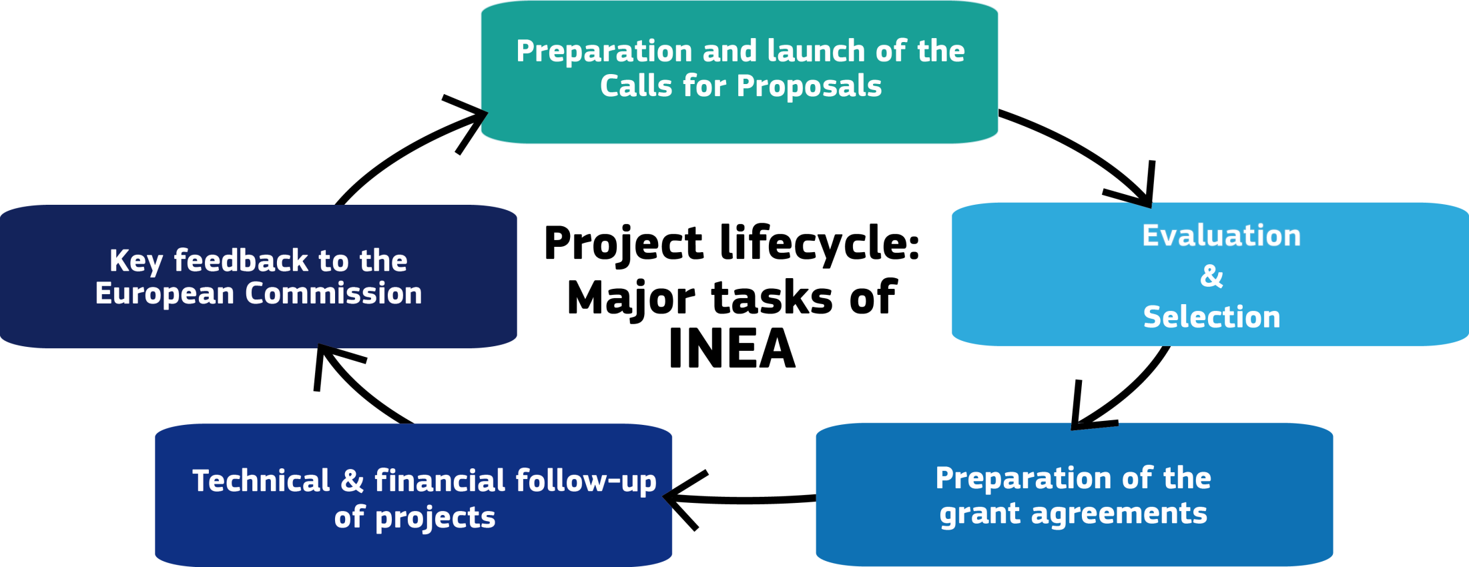
INEA's tasks

Slide 9
CEF Telecom 2016 calls

Slide 10
How do the calls work?
Legal basis:
  CEF Regulation (Regulation No 1316/2013)
  Telecom Guidelines (Regulation No 283/2014)
  EU Financial Regulation and Rules of Application
2016 Annual Work Programme (as amended):
  Adopted 3 March (available on call webpages on INEA website), amended 14 September
  Outlines general CEF Telecom objectives and priorities for actions to be funded in a specific year
Specific call:
  Launched by INEA together with application forms and various guidance documents
  Outlines all conditions of call

Slide 11
2016 CEF Telecom calls
Call | Indicative budget | Launch date | Deadline
CEF-TC-2016-1 BRIS EESSI eProcurement | €3 million €24.5 million €4.5 million | 3 March 2016 | 19 May 2016
CEF-TC-2016-2 eDelivery eID & eSignature European e-Justice Portal Public Open Data | €0.5 million €4.5 million €2 million €3.5 million | 12 May 2016 | 15 September 2016
CEF-TC-2016-3 Automated Translation Cyber Security eInvoicing Europeana | €6.5 million €12 million €7 million €2 million | 20 September 2016 | 15 December 2016
CEF-TC-2016-4 Safer Internet | €1.1 million | 20 September 2016 | 18 October 2016

Slide 12
eInvoicing

Slide 13
2016-3 eInvoicing call:
Scope
Proposals must meet objective 1 or 2:
1. Uptake of eInvoicing solutions by public authorities
Put in place the appropriate technical solutions and organisational set up so public (especially regional/local) authorities can receive and process eInvoices from economic operators.
- preference for solutions already on the market and which allow cross-border exchanges of eInvoices
Technical solution should foresee compliance (by the project completion) with the future European standard (EN) on electronic invoicing

Slide 14
2016-3 eInvoicing call:
Scope
Proposals must meet objective 1 or 2:
2. Support the implementation of the EN in existing eInvoicing solutions:
Contribute to achieving the objective of the eInvoicing Directive
Priority for applications from solution providers for integrating the EN in their existing eInvoicing solutions and procuring authorities already using eInvoicing solutions for integrating the EN
_________________________________________________
Promotion of eDelivery:
Deployment of the eDelivery Building Block or use of eDelivery through a service provider
Support for the integration of eDelivery services will only be awarded if carried out in conjunction with objective 1 or 2 above

Slide 15
2016-3 eInvoicing call:
Expected outcomes
Increase the uptake and use of eInvoicing by public authorities (especially regional/local) in meeting the requirements of the eInvoicing Directive
Support service providers in making their existing solutions compliant with the requirements of the eInvoicing Directive

Slide 16
2016-3 eInvoicing:
Key conditions
Who can apply?
  One or more Member States + EEA countries (Norway/Iceland)
  International organisations, joint undertakings, or public or private undertakings or bodies established in Member States - ith the agreement of the Member States/EEA countries concerned
Consortium composition:
  minimum of 4 applicants from one or more Member States
Co-financing:
  75% of the eligible costs of the action
Indicative duration:
  12 months

Slide 17
Call evaluation process

Slide 18
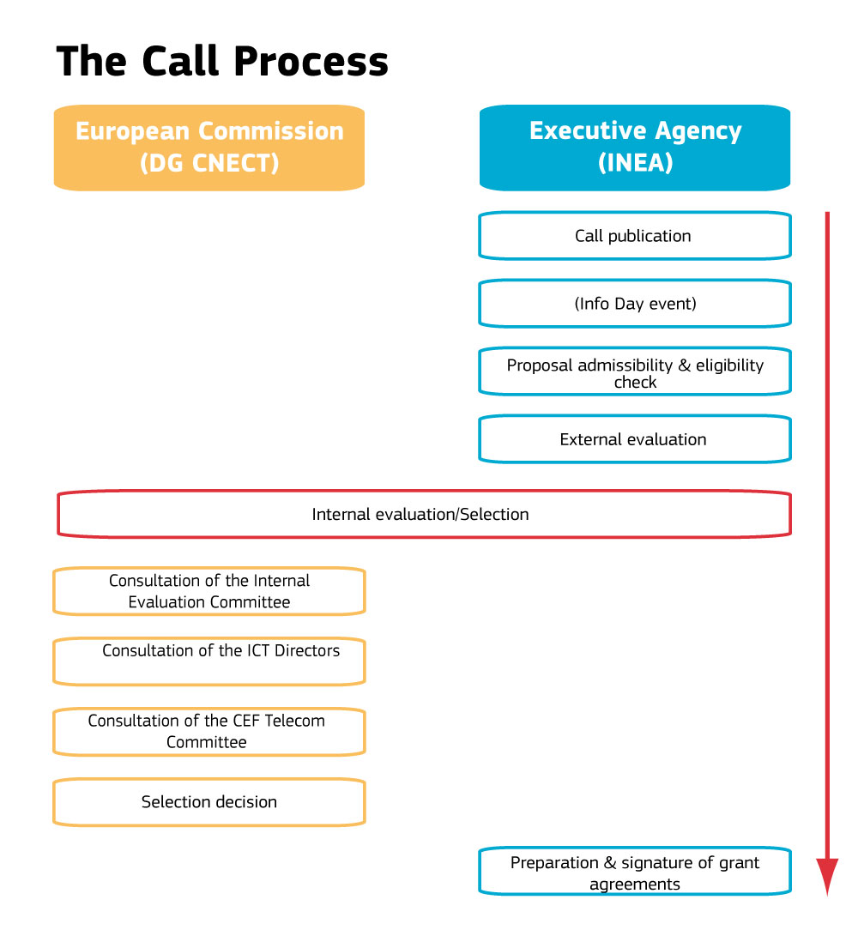

Slide 19
Principles for the evaluation and selection process
Basis: eligibility, selection and award criteria of the work programme and the call for proposals
Equal treatment: all proposals evaluated against the same criteria; no preferential treatment to any applicant
Transparency: adequate feedback to applicants on the outcomes of the evaluation

Slide 20
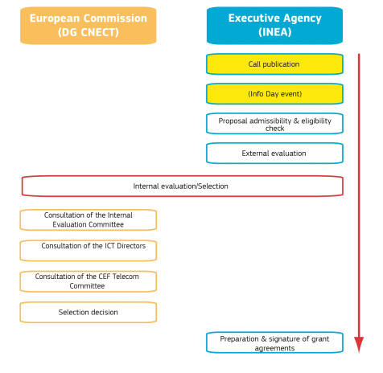
Call publication & application support
Call published in Official Journal and announced on specific call page on INEA website
Call texts, Guide for Applicants, application forms prepared by INEA and available on call page at publication
Helpdesk operational as of call publication: FAQs made available on call page
Virtual Info Day: 22 September 2016

Slide 21
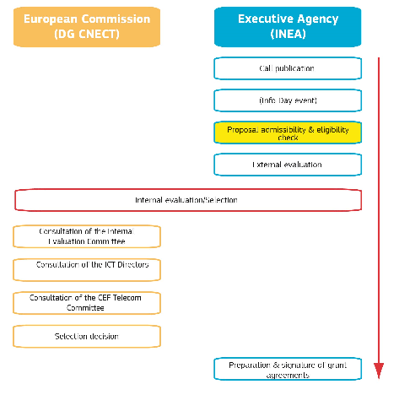
Admissibility/Eligibility
Committee (INEA)
Checks compliance with admissibility conditions, eligibility and selection criteria
  Proposal submitted on time, complete, signed by the applicant
  Applicants demonstrate the support of the concerned Member State and are not in an exclusion situation
  Proposal addresses the DSI in question and has the right consortium composition
  Applicant has the financial and technical capacity to carry out the action
  Proposal complies with relevant EU legislation (public procurement)

Slide 22
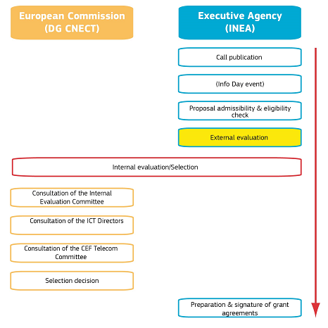
Technical Evaluation: overview
External experts provide technical assessment on the basis
of the information submitted in a proposal in a two-step
process:
  1. Individual reading of proposals
  2. Consensus meeting for each proposal
Experts:
Are selected from the database used by several EU funding programmes (EMPP/EMI) & chosen on the basis of their experience, gender and geographic balance
Sign a contract, confidentiality and absence of conflict of interest declaration
Evaluate in their personal capacity - not as representatives of a country or employer
An independent observer may also be contracted to give recommendations on the process as a whole

Slide 23
Technical Evaluation: individual assessment
Done remotely or centrally at INEA
Each proposal assessed independently by at least three experts
Each expert completes the evaluation form, comments and scores award criteria on a scale from 0 to 5 points
Scores must be in line with comments

Slide 24
Technical Evaluation: consensus meeting
Done centrally at INEA
Experts and an INEA moderator meet to agree on comments and scores for the award criteria
The proposal must have at least 3 points for each criterion to be considered for funding.
Overall threshold = 10 points (applying to the sum of the three individual scores)

Slide 25
Award criteria
Relevance
Quality & efficiency of implementation
Maturity
Impact & sustainability
Alignment to DSI implementation objectives & activities (WP)
Quality of the approach to facilitate wider deployment/take-up of the proposed actions
Coherence/effectiveness with work plan
Quality of consortium/consortium members
Support from national authorities/industry/NGOs
Attention to security/privacy/
inclusiveness/accessibility
Alignment to EU/national policies, strategies and activities
Capability of long-term sustainability without EU funding

Slide 26
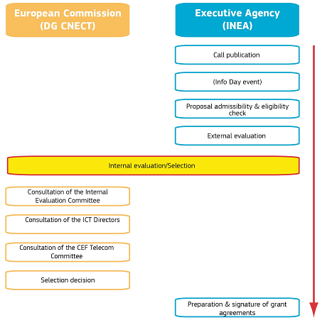
Internal Evaluation
(Commission)
  Does not re-evaluate the proposals but uses the experts recommendations to prepare a ranking list (and any reserve lists)
  Where specific conditions exist on the number of proposals or funding level per Member State, ensures these conditions correctly applied
  Identifies potential double funding and/or any other issues that would influence the proposed funding decision
  Discusses where appropriate any potential transfer of budget from one call to another
  Approves proposed funding Decision

Slide 27
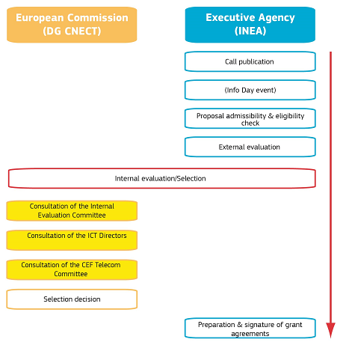
Subsequent steps
Consultation of the CEF Coordination Committee (Telecom configuration)
European Parliament is informed on the list of proposed projects selected
Commission selection Decision formally adopting the list of proposals selected for funding (and any reserve list)
Publicity actions (i.e. press release) carried out after adoption of Selection Decision

Slide 28
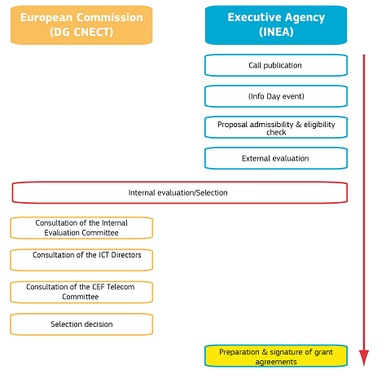
Grant agreement preparation
& signature (INEA)
Once Selection Decision is adopted, successful applicants are invited to by INEA to prepare the individual grant agreement
Grant agreement is signed between the beneficiaries (applicants) and INEA and covers the technical, legal and financial aspects of the proposal based on evaluation results
Model grant agreement is published on INEA website on the call page
Project management carried out by INEA

Slide 29
For current applicants

Slide 30
How to apply:
READ, REFLECT, REMEMBER

Slide 31
How to apply:
READ all call documentation, forms, Guide for Applicants, FAQs, call webpage
REFLECT on the call content & requirements
REMEMBER that successful applications take time and effort, but guidance is available!

Slide 32
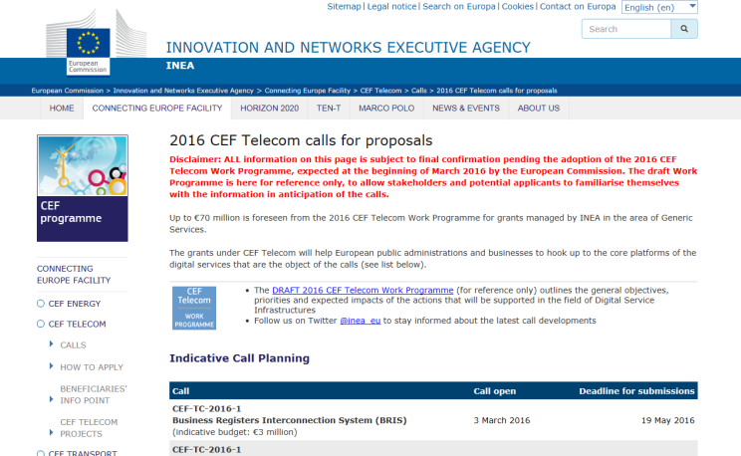
READ: get to know the call documents
First familiarise yourself
with all of the call documents
on the call webpage, especially:
  Work Programme (Annex)
  Call text
    Take special note of the Priorities (section 3) and Results (section 4) which provide specific information on what is expected in the proposals
    Carefully read the Award Criteria (section 10) which explain on what the proposal will be evaluated
  Guide for Applicants
  Application forms
  FAQs

Slide 33
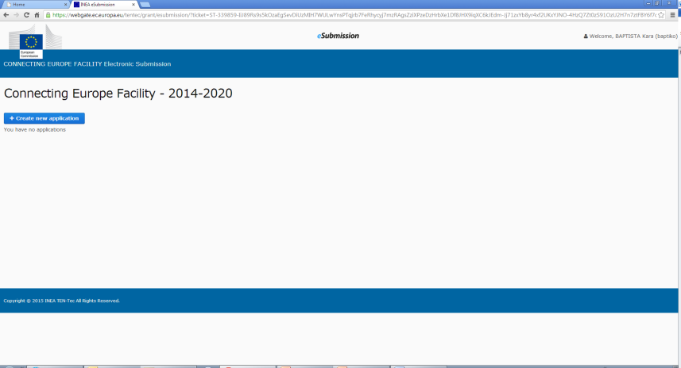
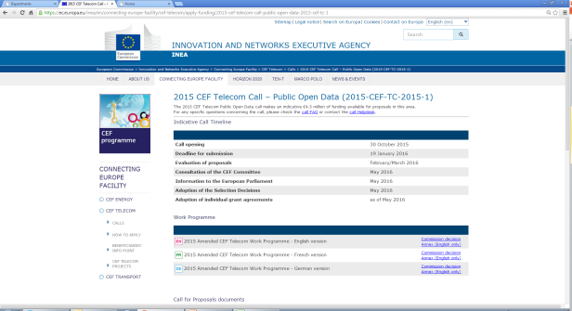
READ: how to use TENtec electronic proposal submission
TENtec: system used to manage the CEF projects during their entire lifecycle and which enables the electronic submission of proposals under the CEF calls
All application forms and access to TENtec eSubmission module available via call page on INEA website
Step-by-step instructions for TENtec in the Guide for Applicants

Slide 34
READ: Application forms
Application Form
Part A
Main characteristics of the proposal
Part B
Administrative information
Part C
Information on compliance with EU law
Part D
Technical and financial information

Slide 35
Application form A
Essential administrative information on the applicants and on the proposal (summary of the action, timing, activities and milestones, budget and requested funding)
Must be completed in the TENtec eSubmission module (Word version provided for reference on call webpage)
Includes forms that require signature of the applicants (A2.2) and Member State validation (A2.3)
The descriptions of the proposed Action and activities will also be used for the grant agreement: be complete, informative and precise!

Slide 36
Application form B
Further administrative information on applicants and info use to demonstrate compliance with the financial & operational capacity (required by Financial Regulation)
Financial capacity check
Financial analysis based on a set of ratios, carried out as same time as evaluation – applicants to supply information based on amount of grant requested
Operational capacity check
Proof of technical and operational capacity of applicant to complete the proposed Action
  Complements information from application form D2.3
  Proof: activity report, CVs, reports on similar projects, etc

Slide 37
Financial and operational capacity check
Application form B
Legal entity form, financial identification form, additional supporting documents
Certain types of applicants DO NOT need to demonstrate financial and operational capacity – check the forms for more details
Annexes B-I, B-II, B-III, B-IV to be completed, signed, and uploaded to TENtec (if applicable)

Slide 38
Application form C
Information on compliance with EU law on public procurement
Information on other sources of EU financing that may be received by the proposal (cannot receive grants from two EU funding sources)

Slide 39
Application form D
Detailed, technical information describing the proposed Action and its activities – i.e. the heart of the proposal
Order of the questions reflects the award criteria
  address each point and subpoint in your application to ensure that your proposal contains all of the relevant information on which it will be assessed
Don't forget the Gantt chart/other annexes

Slide 40
REFLECT: call content and requirements
CEF Telecom funding is a competitive process based on defined award criteria in the Work Programme and call text.
  Do you understand the priorities, objectives and intended results as defined in the call text?
  Does your proposed Action address the priorities, meet the objectives and deliver these results?
  Can you justify why YOUR proposal should ultimately be selected for funding?
Preparing a good application requires time and effort – as does the resulting project management.
  Do you have both the time and resources to prepare a good application?
  Will you be able to carry out the proposed Action if is selected for funding?

Slide 41
REFLECT: call content and requirements
Some calls have strict consortium requirements.
  Do you have enough partners lined up at the outset?
  Who will serve as the consortium coordinator?
  Does this organisation understand the requirements of this role?
Member State approval is necessary for all applications to be eligible.
  Do you understand how this approval process is done in your Member State?
  Have you taken into consideration the time it will take to obtain the approval(s)?
  If you are a Member State, do you fully understand the responsibility this requires and do the applicants recognise this?

Slide 42
REFLECT: call content and requirements
A good proposal:
  uses simple language
  is well-structured
  addresses the award criteria
  provides clear descriptions on how the proposed solutions will be implemented

Slide 43
REFLECT: call content and requirements
Can you effectively organise the information in your proposal/application forms?
  Financial: provide a business and/or financial plan to
    justify your costs
    explain financial sustainability
    assess your proposed budget in general
  Technical: give explanations/clear diagrams on IT solutions used, architecture, standards, etc
    explain the work you will be undertaking
    provide ample descriptions of your activities and milestones
  Operational: show concrete evidence on how your proposed Action
    supports the objectives/aims of the call
    addresses the award criteria
    mitigates any possible risks and delays
    incorporates a clear timetable and planning overview

Slide 44
REMEMBER: time flies…
Start early and don't forget about the deadline
  Completing an application is time consuming, especially for first time applicants
  Member State endorsement and multi-applicant proposals take time
Save your proposal often in TENtec
Visit your call webpage regularly to check for updates, sign up for our Twitter feed and FAQ notifications
  Use all of the documentation and information available (21 September Info Day presentations, proposal checklists, FAQs)

Slide 45
REMEMBER: help is available
INEA is here to support you through the entire application process:
  Helpdesk: INEA-CEF-Telecom-calls@ec.europa.eu
  FAQs (general and DSI specific) and FAQ notification service
  Where relevant for all applicants: answers published in FAQs (no individual responses!)
  Where too specific to a proposal and would provide a comparative advantage: not answered
  FAQ deadline: Thursday 1 December - last FAQ update online
  Thursday 8 December
  Individual responses will be provided until the deadline on technical questions related to TENtec eSubmission module

Slide 46
REMEMBER: when submitting your application
  Do not wait until the last minute!
  Follow the steps as detailed in the Guide for Applicants
    Part A: must be filled in the TENtec eSubmission module
    Parts B, C and D: complete in native applications and upload as attachments
  Upload all forms/annexes requiring signatures + make them clearly identifiable by their file name in English
  Don't forget any supporting documents
  Keep your originals – they may be requested later
Submit in TENtec before the deadline:
Thursday, 15 December 2016, 17:00.00 (Brussels time)

Slide 47
REMEMBER: last minute guidance…
  Do not wait until the last minute!
  Make sure that you fulfil the minimum consortium requirements for the call
  Follow the steps as detailed in the Guide for Applicants
    Part A: must be filled in the TENtec eSubmission module
    Parts B, C and D: complete in native applications and upload as attachments
  Upload all forms/annexes requiring signatures + make them clearly identifiable by their file name in English
  Don't forget any supporting documents
  Use the 'Submit your application' tab in TENtec to see what information is still missing from your proposal
  missing information = proposal incomplete and cannot be submitted!

Slide 48
REMEMBER: last minute guidance…
  Once submitted, a proposal cannot be modified!
  Successful submissions receive automatic notifications
  Helpdesk now closed, but TENtec technical issues will be addressed up until the last second
Submit your application in TENtec before the deadline:
Thursday, 15 December 2016, 17:00.00 (Brussels time)

Slide 49
Next steps (indicative)
January-February 2017 : evaluation
March 2017: legislative process and adoption of the Selection Decision
Starting from April 2017: announcement of results and negotiation of individual grant agreements for the successful proposals
Best of luck!

Slide 50
For everyone

Slide 51
2017 CEF Telecom calls
Basis: 2017 Work Programme, currently under preparation
Planning: Expected to model itself after 2016: three sets of calls grouped by DSI area in similar timeframe
Content: Information to be available February-March on adoption of work programme/exact launch date of 2017-1 calls
More info: via INEA website/Twitter feed

Slide 52

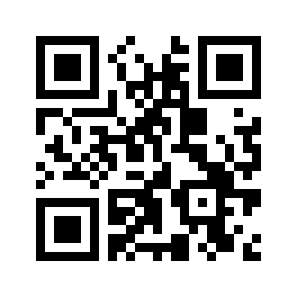


For more information
inea-cef-telecom-calls@ec.europa.eu
inea@ec.europa.eu
http://ec.europa.eu/inea
https://ec.europa.eu/inea/en/connecting-europe-facility/cef-telecom/apply-funding/2016-cef-telecom-calls-proposals
@inea_eu

