Slide 1
CEF eInvoicing Stakeholder Day 2016
Brussels, 1 December
Irena Riviere-Osipov, Policy Officer in charge of eInvoicing, Innovative and e-Procurement unit (G4)
DG GROW

Slide 2

CEF DIGITAL
What resources and collaborative spaces exist?

Slide 3
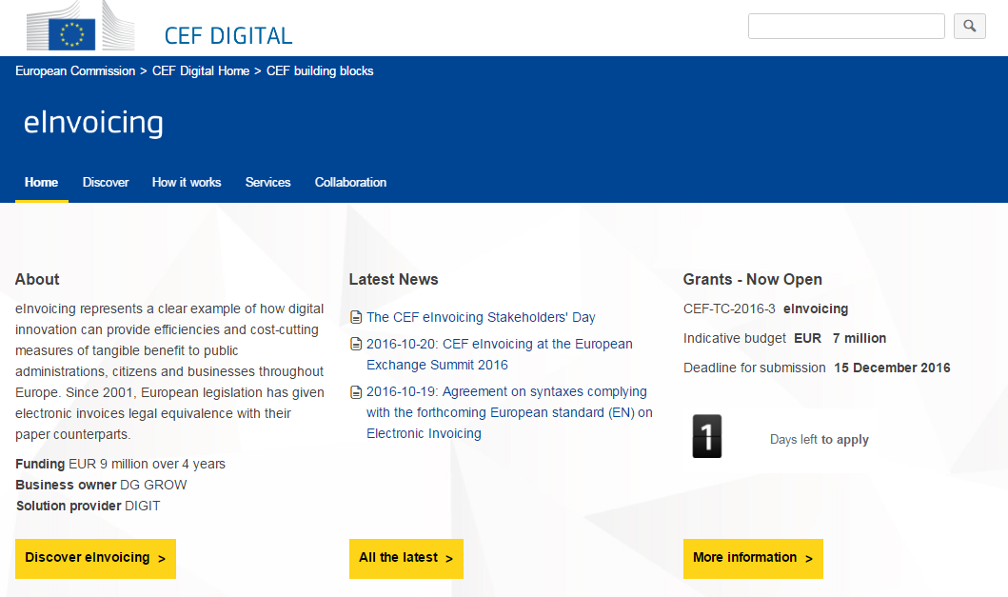
eInvoicing: CEF DIGITAL page
Visit: https://ec.europa.eu/cefdigital/

Slide 4
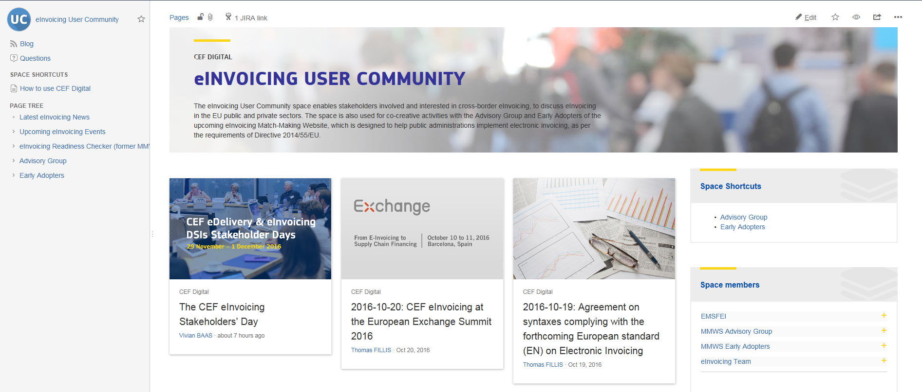
eInvoicing User Community: Get active now!

Slide 5

How you can be involved in 2017
CEF programme activities & next steps

Slide 6
Next steps – your role in the months ahead
Dec
2016
    eInvoicing readiness: Provide feedback on country sheets & engage in the second pilot phase
    Community: Provide feedback on CEF Digital (v4)
    2017 state of play report (pre-activity): Provide appropriate national contacts (public entities & representative organisations)
January 2017
    eInvoicing readiness: Start using the self-assessment tool & knowledge base (to prepare to comply with Directive 2014/55/EU & upcoming Standard)
    2017 state of play report: Engage your network; Bring your contribution
Spring 2017*
    Community: Promote CEF organised national webinars in your countries & networks to promote information on the Directive, the upcoming Standard and the resources available
* = approximate timeline

Slide 7
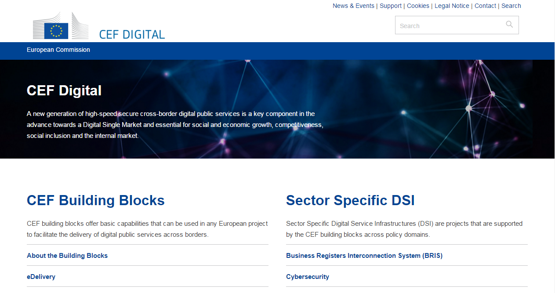
Interested to find out more?
DG GROW
Internal Market, Industry, Entrepreneurship and SMEs
DIGIT
Directorate-General for Informatics
DG CONNECT
Directorate-General for Communications Networks, Content and Technology
CEF-BUILDING-BLOCKS@ec.europa.eu
Visit the CEF Digital Single Web Portal
https://ec.europa.eu/cefdigital/

