Slide 1
State of play of B2G eInvoicing in public procurement
CEF eInvoicing Stakeholders’ day
Brussels, 1 December 2016
Debora Di Giacomo

Slide 2
Agenda
State of play of B2G eInvoicing in public procurement
Study approach and topics covered
Key findings of the study
Next steps – eInvoicing study 2017

Slide 3
Study approach and topics covered
1

Slide 4






Topics covered by the study
The study aimed at answering the following questions:
Legal Landscape
Organisation
Responsibility
Is there any legal basis regarding eInvoicing (mandatory use) in the different European countries?
How is eInvoicing organised in each country (at national, regional and local level)?
Which organisations are responsible for the implementation of eInvoicing in each country?
Standards in use
Platforms
Support
Which eInvoicing standards are used in each country?
Is there any eInvoicing platform provided to public entities?
How can the Commission support each country in the implementation of the eInvoicing Directive?
Notes:
Objectives
Illustrate how B2G eInvoicing is organised across different levels of administrations. This includes an analysis of:
The current situation in each surveyed European country with regard to eInvoicing in public procurement;
The eInvoicing legal landscape;
The standards in use; and
The platform(s) used to support eInvoicing in public procurement.
Explain the measures that could be taken by the European Commission to support European countries to comply with the eInvoicing Directive.

Slide 5



Methodological approach
Step 03
Step
Step 01
Step 02
Description
Inception
Definition of study’s scope, data collection strategy and involved stakeholders.
Data Collection
Collection of secondary data (desk research) and primary data via interview and survey.
Data Analysis and Reporting
Analysis of data collected and presentation of key findings per country participating in the survey and summary views on the business questions.
5

Slide 6

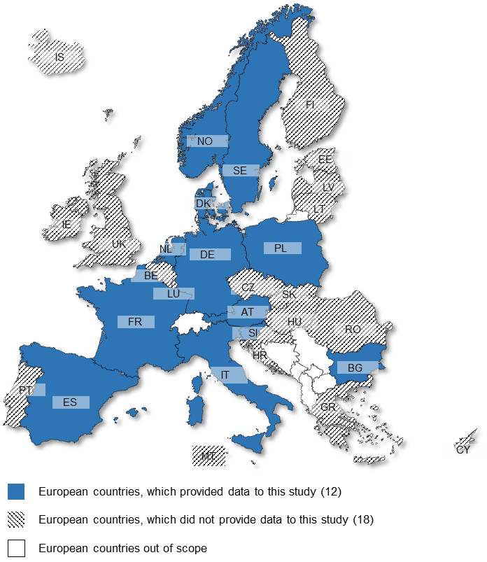
Data collection
13th country sheet was provided by the UK after the finalisation of the study. It is now available in the eInvoicing readiness checker.
Desk Research
    In-depth analysis of studies, policy documents, market reports, official statistics and academic literature
    In-depth analysis of data already collected by the CEF SMO and eInvoicing team
Interviews
    With eInvoicing experts and policy officers to gather preliminary views and shape the study.
    With survey respondents to verify the answers of the online survey to ensure consistency.
Online Survey
    Addressed to the members of the EMSFEI, between 6 April and 13 May 2016.
    16 respondents from 12 countries participated in the study.

Slide 7
Data analysis and reporting
Country sheets template
Findings of the study are presented concerning the 12 countries participating in the study.
    Country sheets detailing the state of play of B2G eInvoicing in public procurement per participant country.
    Comparative views on the state of play of B2G eInvoicing in public procurement regarding eInvoicing legislation, eInvoicing standards and eInvoicing platforms provided to public entities.
    Suggestions on how the European Commission could support European countries to comply with the eInvoicing Directive.
Notes:
Suggested text:
All findings presented in this study concerning the 12 countries that participated in the study, which*:
Detail the state of play of B2G eInvoicing in public procurement in each participant country.
Provide comparative views on the state of play of B2G eInvoicing in public procurement regarding eInvoicing legislation, eInvoicing standards and eInvoicing platforms provided to public entities.
Provide suggestions on how the European Commission could support European countries to comply with the eInvoicing Directive.
*The UK provided its updated country sheet after the closure of the data collection period.

Slide 8
Key findings of the study
2

Slide 9
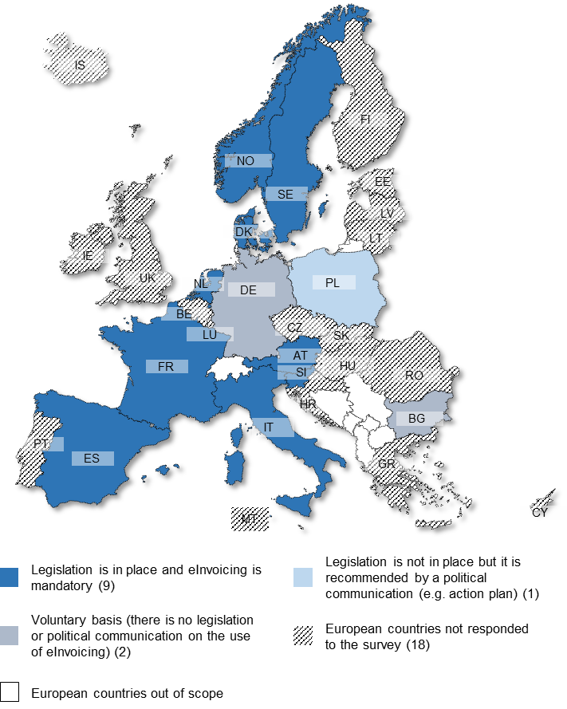
eInvoicing legal landscape
Receiving and processing eInvoicing is mandatory:
  In Denmark, France, Italy, Spain and Slovenia for all levels of public entities;
  In Austria, Sweden, Norway and the Netherlands for central authorities.
In Bulgaria, Germany and Poland, currently there is no legislation in place with regard to B2G eInvoicing in public procurement.

Slide 10
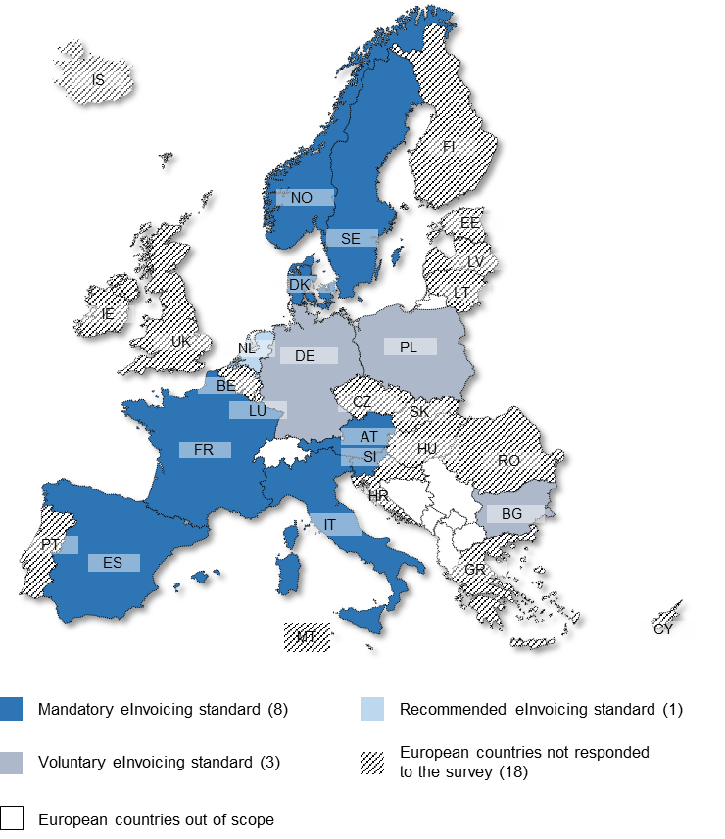
eInvoicing standards in use
The majority of countries use their own national eInvoicing standard in public procurement.
  All countries with mandatory eInvoicing standards uses XML standards.
  The XML standards used are either based on UBL or nationally developed.
Countries with no mandatory eInvoice standard also indicated the use of ISO 20022 and EDIFACT.

Slide 11
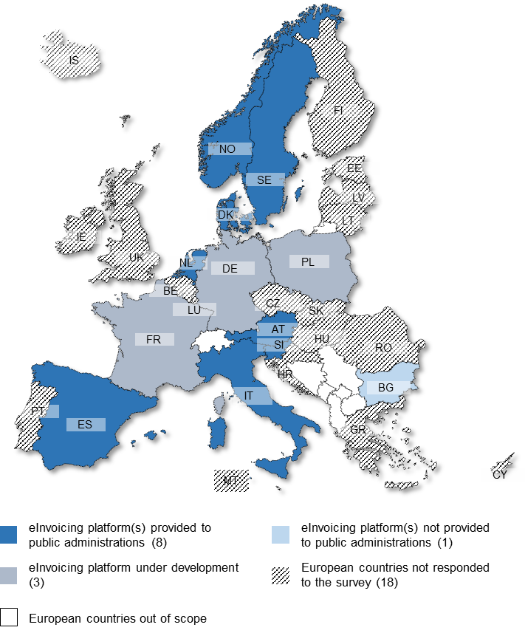
eInvoicing platforms
eInvoicing platforms are information systems that facilitate the process of creating, submitting, transferring, receiving and/or processing eInvoices.
The majority of countries (Austria, Denmark, Italy, Netherlands, Slovenia, Spain, Sweden and Norway) provide eInvoicing platforms to public entities to receive and/or process eInvoices.
France, Poland and Germany are currently developing an eInvoicing platform.
Notes:
eInvoicing platforms are information systems that facilitate the process of creating, submitting, transferring, receiving and/or processing eInvoices.
This study investigated whether European countries made available eInvoicing platforms to support public entities to receive and/or process eInvoices Past or present tense? Check throughout the document.

Slide 12

Country sheets – Example Sweden

Slide 13

Country sheets – Example Germany

Slide 14
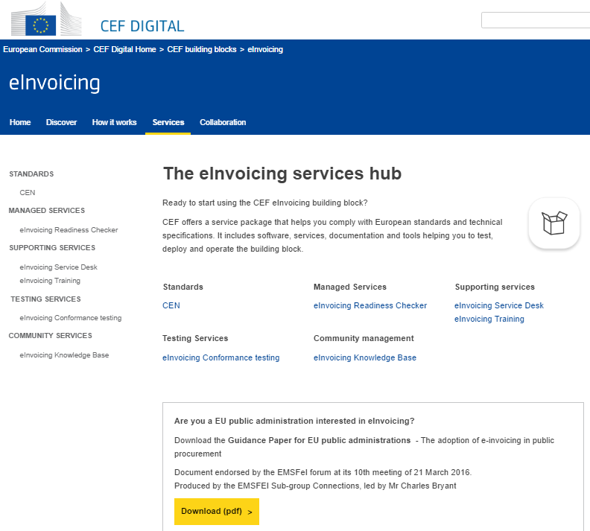
Supporting European countries to comply with the eInvoicing Directive
The services, currently offered by the European Commission; the CEF Digital portal, the eInvoicing readiness checker and the Testing Platform, were all highly rated as valuable by the survey respondents.
Additional services include suggested by the survey respondents are:
  Validation and conversion services (e.g. converting invoices from EDIFACT to UBL and CII).
  A repository of best practices and information on eInvoicing requirements and procedures in other European countries.

Slide 15
Next steps – eInvoicing study 2017
3

Slide 16
Timeline - state of play of B2G eInvoicing in public procurement
Initiation of the study ‘State of Play of B2G eInvoicing in Public Procurement‘.
Data collection finalised in May 2016
Workshop to collect ideas & sources for the 2017 eInvoicing state of play.
Consolidation of lessons learned and feedback from stakeholders.
You are here
2016
2017
2018
Publication and validation of country sheets by the members of the EMSFEI (Nov 2016)
Publication of the complete study
(Dec 2016)
Review the study methodology based on lessons learned and feedback from stakeholders
2nd update of the ‘State of Play of B2G eInvoicing in Public Procurement‘ (Q1-Q2 2017)
Review and 3rd update of the State of Play of B2G eInvoicing in Public Procurement Report (Q1-Q2 2018)

Slide 17


Which questions should be answered in the 2017 eInvoicing study?
Question addressed in 2016
What questions would you suggest to address in the 2017 State of play of B2G eInvoicing in public procurement study?
Who should be invited to answer the online survey for the 2017 State of play of B2G eInvoicing in public procurement?
Legal Landscape
Organisation
Responsibility
Is there any legal basis regarding eInvoicing (mandatory use) in the different European countries?
How is eInvoicing organised in each country (at national, regional and local level)?
Which organisations are responsible for the implementation of eInvoicing in each country?
Standards in use
Platforms
Support
Which eInvoicing standards are used in each country?
Is there any eInvoicing platform provided to public entities?
How can the Commission support each country in the implementation of the eInvoicing Directive?
Notes:
Who could we talk to
What else should we collect

Slide 18
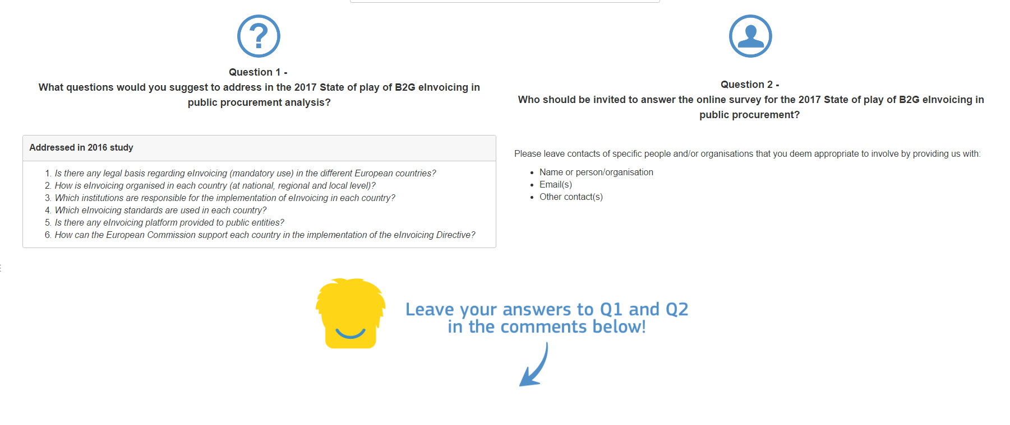
Your feedback matters!
https://ec.europa.eu/cefdigital/wiki/x/bFYZAg

Slide 19






Débora DI GIACOMO
Manager
debora.digiacomo@wavestone.com
DIGIT
Directorate-General for Informatics
DG CONNECT
Directorate-General for Communications Networks, Content and Technology
Michael SCANLON
Manager
michael.scanlon@wavestone.com
Rositsa BONEVA
Consultant
rositsa.boneva@wavestone.com
CEF-BUILDING-BLOCKS@ec.europa.eu
Ines COSTA
Consultant
ines.dacosta@wavestone.com

