Slide 1
EC Power library
Graphic elements and layouts to save time when creating your presentation

Slide 2
Purpose of this document
This document contains example layouts, graphic elements, charts and icons which you can use to copy and paste into your PowerPoint presentations
it will save you time, ensure consistency, and result in a more polished and powerful end-product
it can serve as inspiration for new layouts and graphics
All charts are fully consistent with the EC PowerPoint template and visual identity
be sure you are using the template before pasting charts from this file into your presentation
The template can be found here
A presentation on how to make better presentation can be found here

Slide 3
Table of contents
Tip! To select one of the chapters right click on the respective hyperlink and select “Open Hyperlink”
Colour palette
Trouble shooting
Example layouts
Layouts with pictures
Map,flags and logos
Charts, graphs and tables
Timelines
Icons
Graphic components

Slide 4
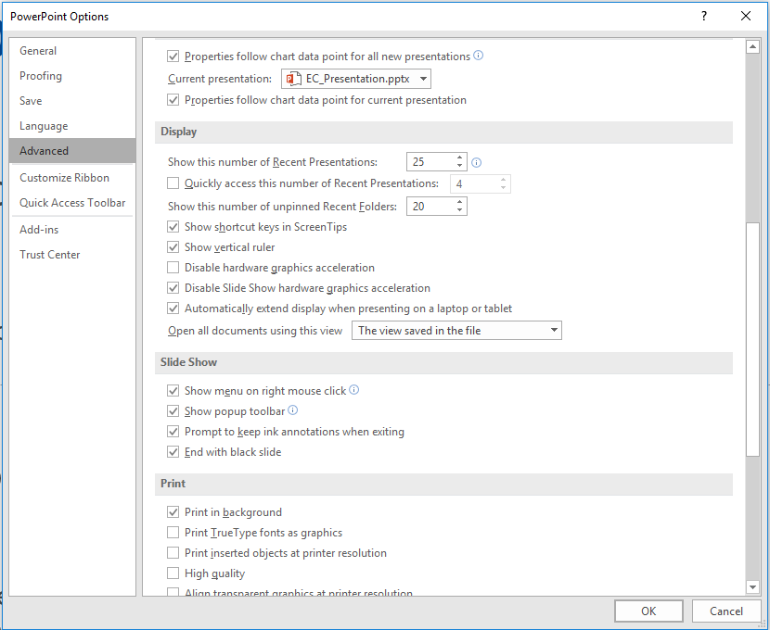
Trouble shooting
My video is not playing (in presentation mode) – what do I do?
Step
In PowerPoint, click on the File menu and then “Options“
Step
On the Options menu, select “Advanced” and scroll down until to reach “Display” settings
Step
In the Display settings section tick the box labelled “Disable Hardware Graphics Acceleration” and “Disable Slide Show hardware graphics acceleration”
Step
Click OK to confirm. Now your video should be playing fine.

Slide 5
Colour palette
A specific colour palette has been designed for EC PPT template. Please stick to the colours as much as possible for cohesion.
You do not have to use all colours you can also only pick a few.
Primary colour palette
head-line
text
R:3
G:78
B:162
#06509F
R:30
G:133
B:139
#1E858B
R:75
G:197
B:222
#4BC5DE
R:30
G:192
B:138
#34B888
R:237
G:141
B:47
#EC8C2D
R:255
G:192
B:0
#FEC010
R:231
G:108
B:83
#E76C53
R:77
G:77
B:77
#4D4D4E
R:211
G:232
B:249
#D2E7F8
R:255
G:255
B:255
#FFFFFF
These colours are mainly used for text and backgrounds.

Slide 6
Layout examples

Slide 8
Layout with one picture (1)
Tip! Change the picture for one that illustrates your topic and adjust size and fit with the crop tool.
Even if some pictures are copyright free it is good practice to credit the photographers in the slide notes.
If pictures have copyright protected, it needs to be mentioned on the slide.
Some text
More text
Notes:
Photo by Rae Tian on Unsplash

Slide 9
This is an example for a quote slide. Copy the quote inside this text box.
This slide is based on a Master Slide layout. Replace the image by simply deleting it and then placing a new one in the place holder frame.

Slide 10
Layout with one picture (2)
Some text
More text

