Slide 1
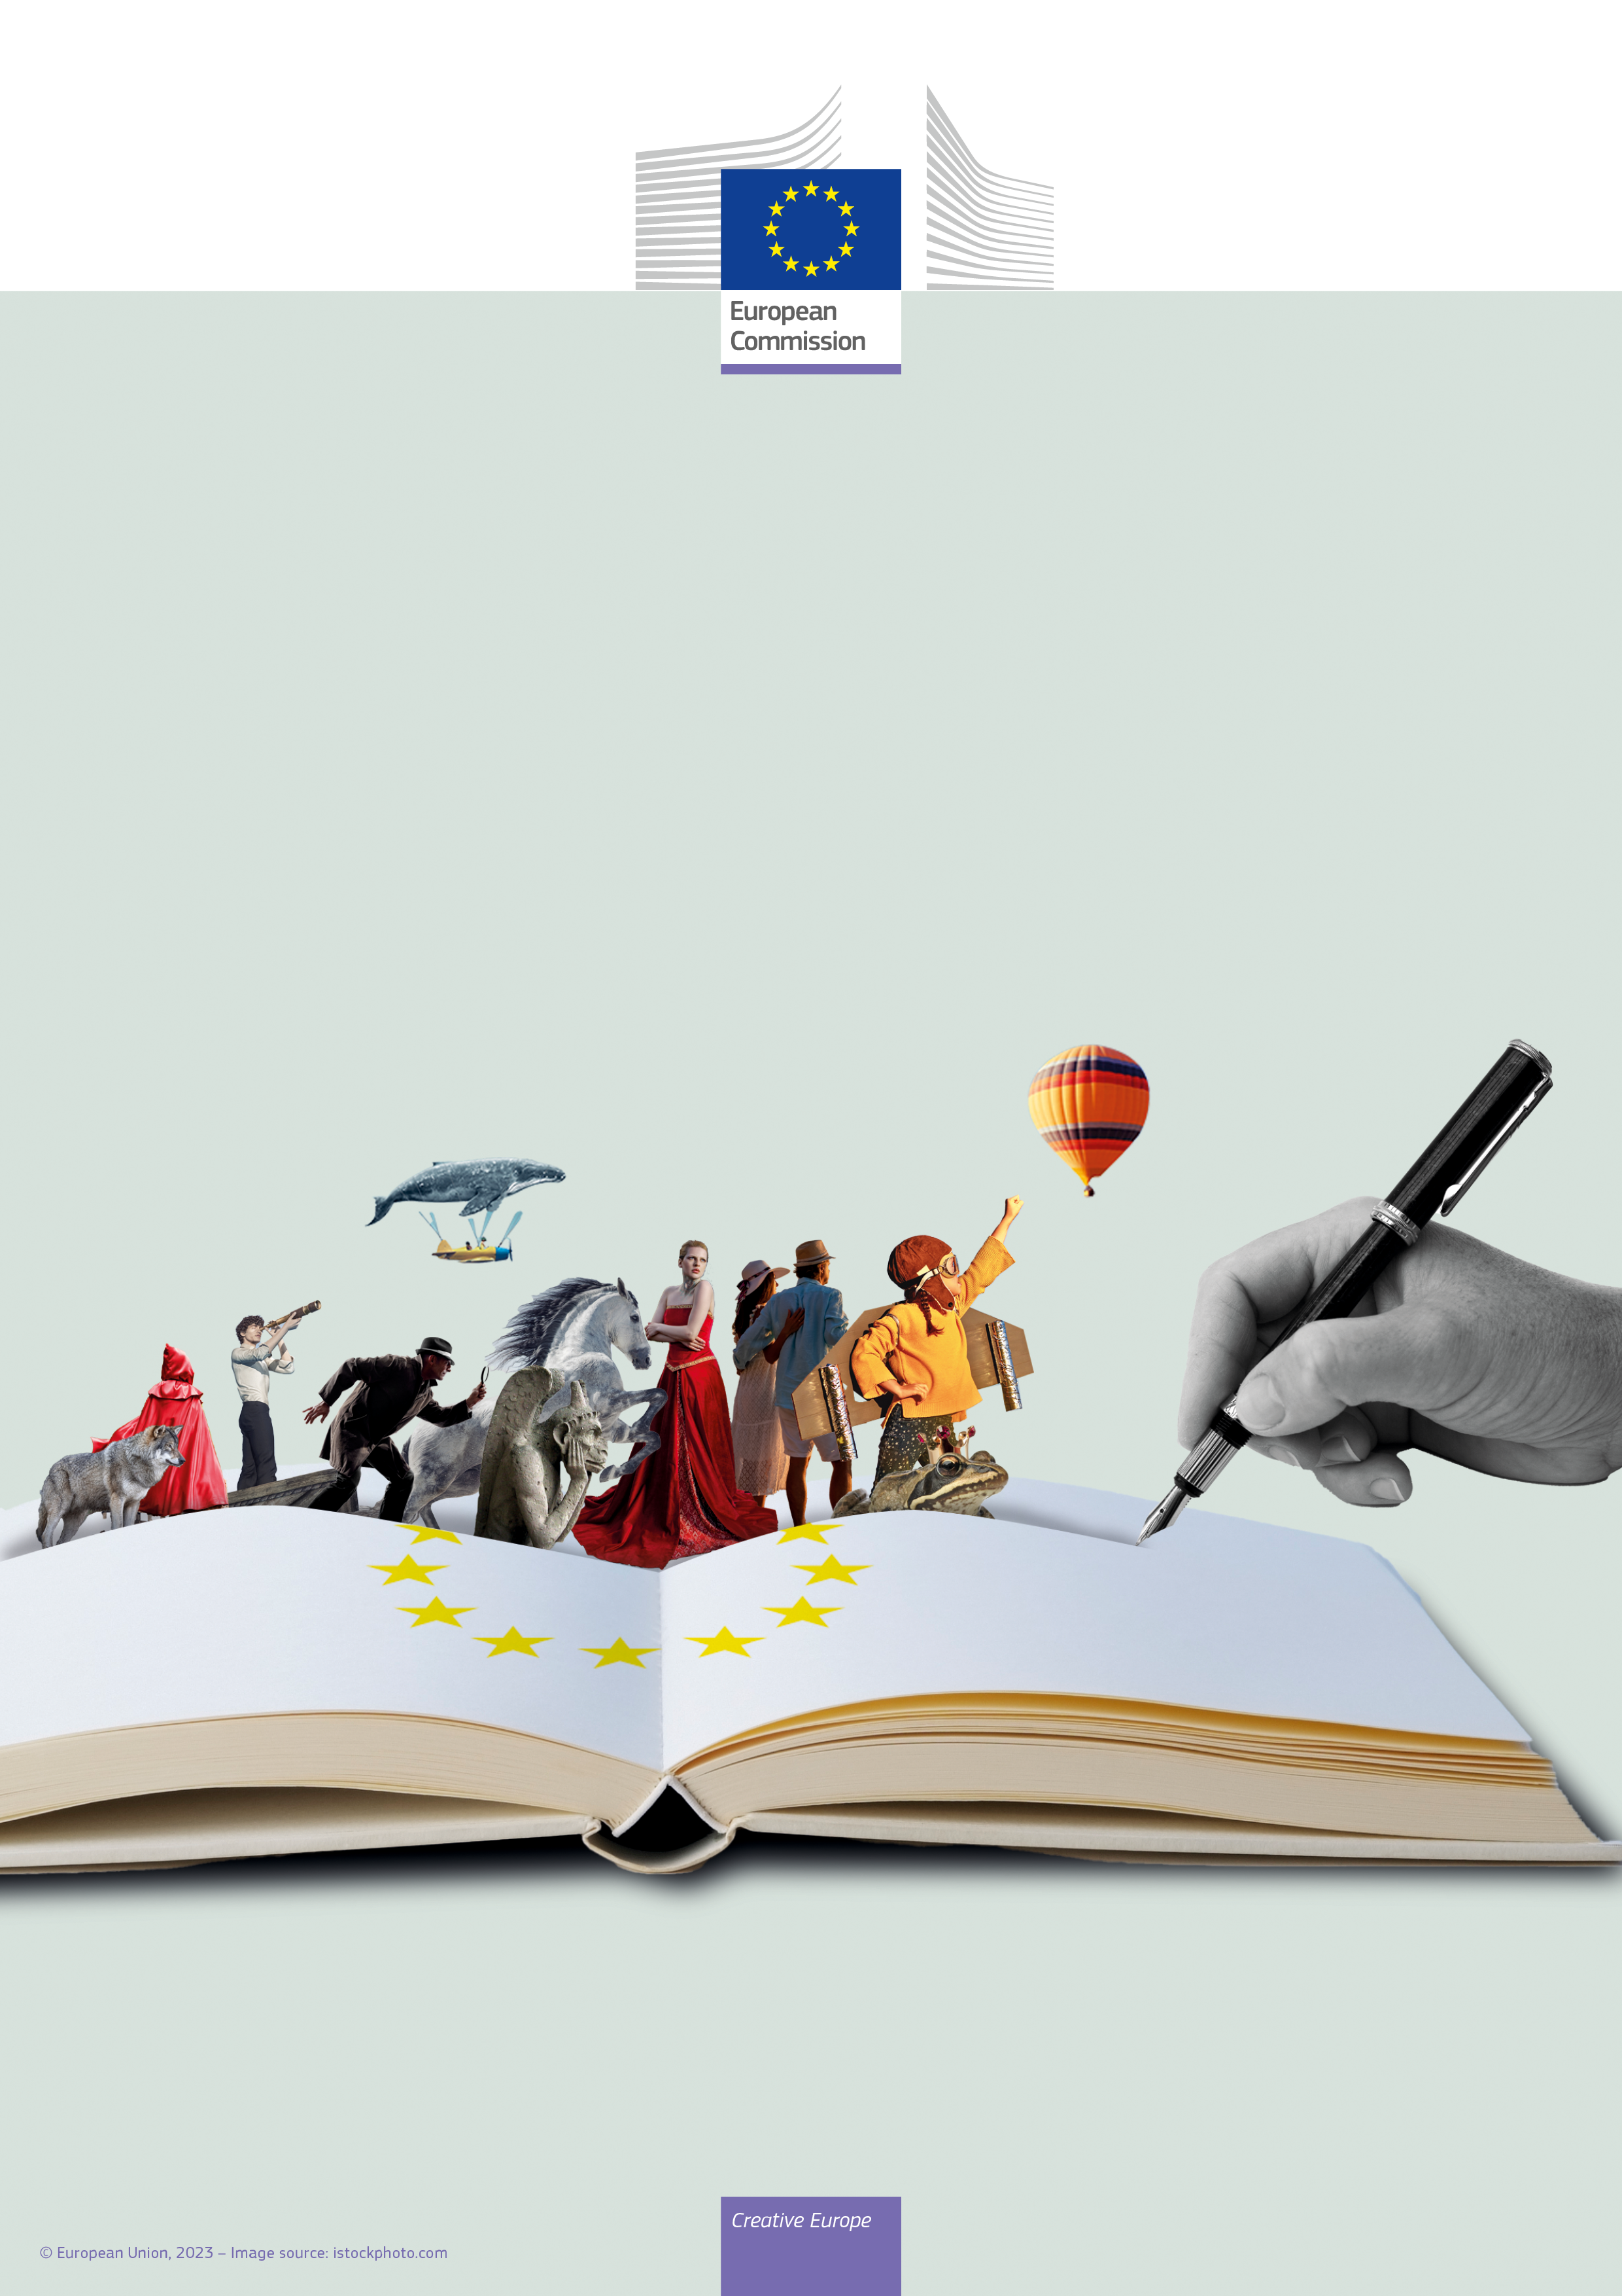
Day of European Authors
25 March 2024

