Slide 1
EU Cohesion Policy and Europe‘s Shifting Economic Landscape - Comments
Gunther Maier, WU

Slide 2
Comments
How reliable are the results?
The „city“, a moving target
Size and volatility of ratios and growth rates depend upon the size of the initial value
Potentially regression to the means issues: random influences may seem systematic – high growth followed by low growth

Slide 3
Comments
Can we identify a „shifting economic landscape“?
Place matters; spatial activities are interdependent
Agglomeration economies and dis-economies
Complex dynamics of interdependent non-linear systems
Stability, instability, bifurcation points, chaotic phases
Many parameters are constantly changing (e.g., due to innovation and competition) – always facing a new situation

Slide 4
Comments
Does that help us design policies?
Do we perfectly understand the mechanisms?
difficult in a constantly changing environment
in a complex non-linear system small causes may have large effects (butterfly effect) – concentration on the main forces may be completely misleading
Can we learn from the past?
The evolution of the system continuously creates new situations
Policy that worked before may not work any longer
Can we learn from other regions?
Regions develop interdependently – the success of the other region changes the starting conditions for our region
Identical starting conditions are impossible

Slide 6
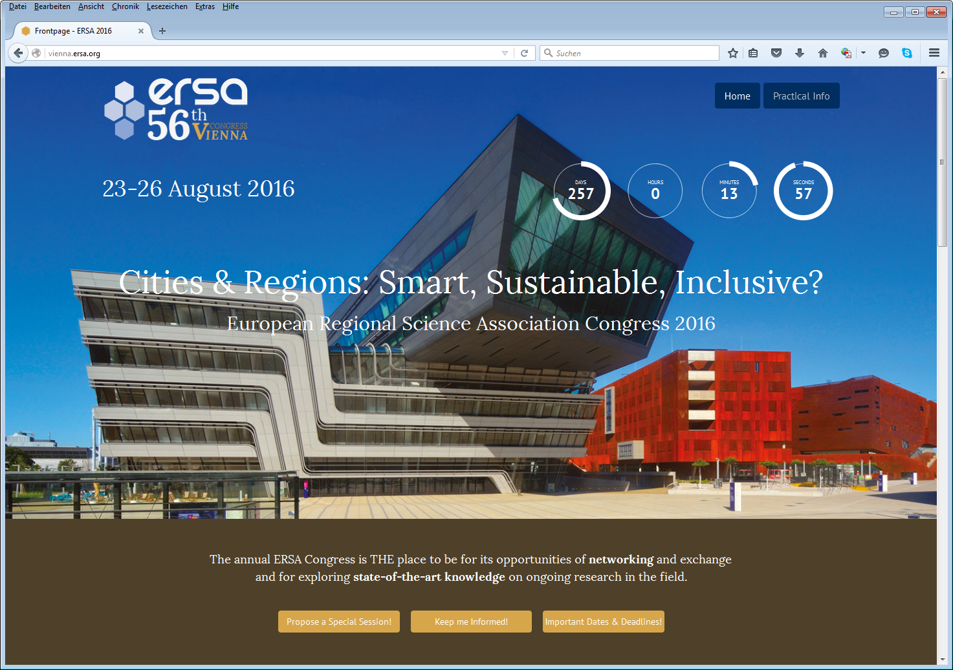

Slide 7
