Slide 1









Probabilistic TSUnami Hazard MAPS for the NEAM Region
Coordinated by
Istituto Nazionale di Geofisica e Vulcanologia (INGV)
Roberto Basili, PhD
roberto.basili@ingv.it
with the following partners
NGI | IPMA | GFZ | METU | UB | NOA | CNRST | INM
ECHO/SUB/2015/718568/PREV26
Prevention Project, Priority 3, External Budget Item

Slide 2
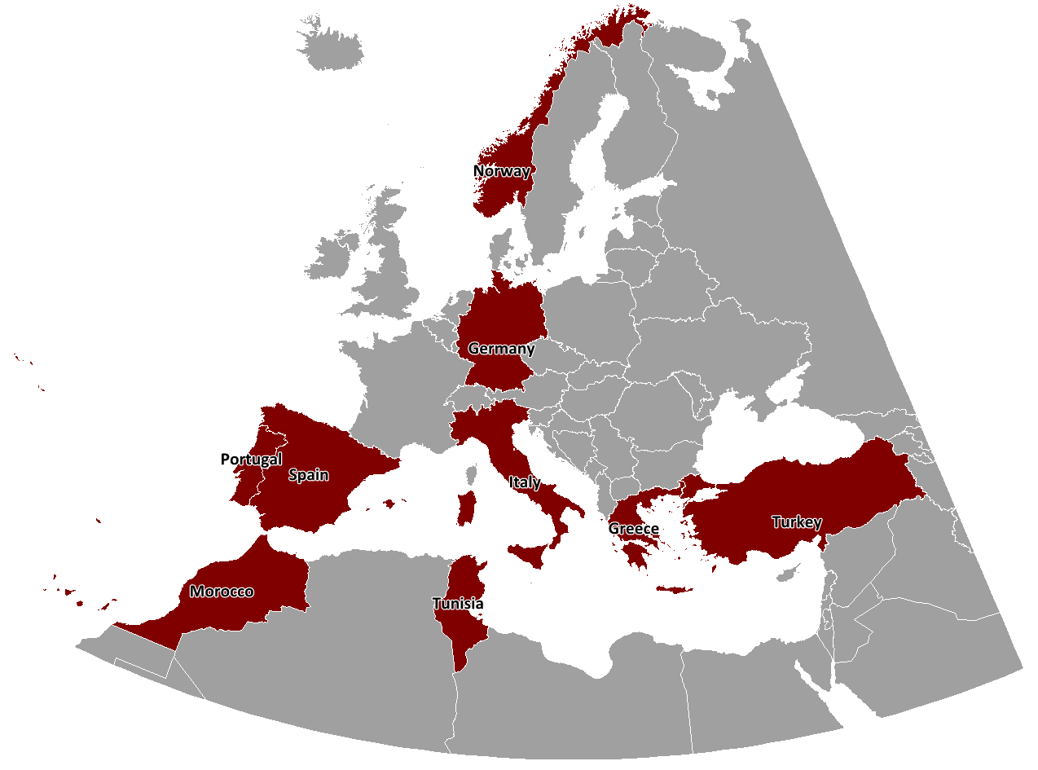
Project funding and consortium
Total eligible cost: € 884,822.00
EC contribution: € 663,616.00 (75%)
Duration: 18 months
(01/01/2016 - 30/06/2017)
INGV | NGI | IPMA | GFZ | METU | UB | NOA | CNRST | INM
Basili R. Lorito S. Selva J. | Harbitz C.B. Løvholt F. | Baptista M. A. Matias L. Omira R. | Babeyko A. | Yalciner A. | Canals M. Lastras G. | Papadopoulos G. | El Mouraouah A. Ibenbrahim A. | Ben Abdallah S. Nmiri A.
Italy | Norway | Portugal | Germany | Turkey | Spain | Greece | Morocco | Tunisia
Member Sate | Participating State | Member Sate | Member Sate | Enlargement | Member Sate | Member Sate | Neighborhood Policy | Neighborhood Policy

Slide 3
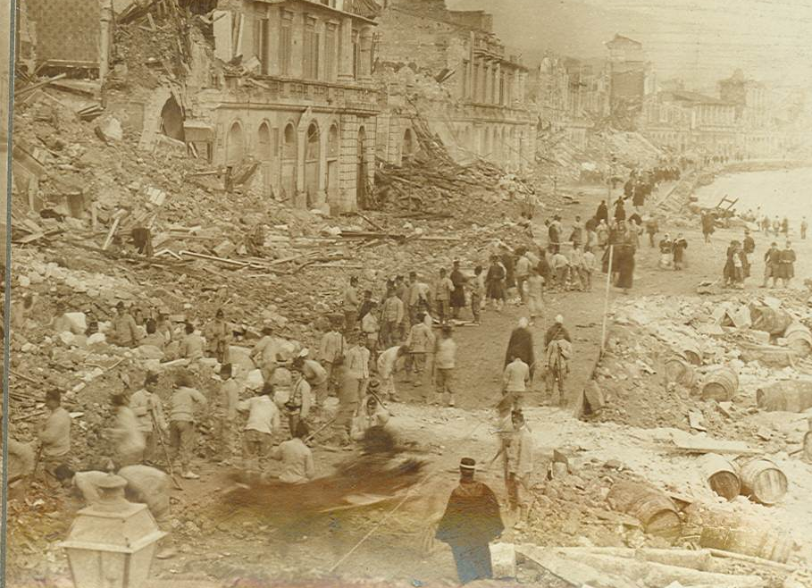
Area of activity: Tsunami hazard
Subject: Probabilistic tsunami hazard assessment (PTHA) and mapping
Tsunamis are low-frequency high-consequence events.
Probabilistic assessment of tsunami hazard is a strategic tool for tsunami and multi-risk mitigation.
earthquake and tsunami damage in the coastal area of Messina in 1908
Selection of dreadful historical earthquake-induced tsunamis in the NEAM region
Jul 21, 365 AD | Crete, Greece | M 8+ | largest destructive tsunami in the history of the Eastern Mediterranean Sea
Nov 1, 1755 | Lisbon, Portugal | M 8+ | large destructive tsunami in history of the Eastern Atlantic Sea
Dec 28, 1908 | Messina, Italy | M 7.1 | deadliest tsunami of the instrumental era in the central Mediterranean Sea
May 21, 2003 | Boumerdès, Algeria | M 6.8 | first tsunami of the new millennium in the Western Mediterranean Sea: a wake-up call?

Slide 4
What will the project do?
The project will develop the first homogeneous region-wide long-term Probabilistic earthquake-induced Tsunami Hazard Assessment (PTHA) for the coastlines of the North East Atlantic, the Mediterranean, and connected seas, and trigger a common tsunami-risk management strategy in the region.
These results will be achieved through:
realization of state-of-the-art PTHA with full uncertainty treatment;
review process with international experts;
production of the PTHA database and maps;
publicity of results through an awareness raising and education phase, and a capacity building phase.
The PTHA products can serve as a basis for future local and national PTHA efforts and be the first step to include tsunamis in multi-hazard risk assessments.

Slide 5
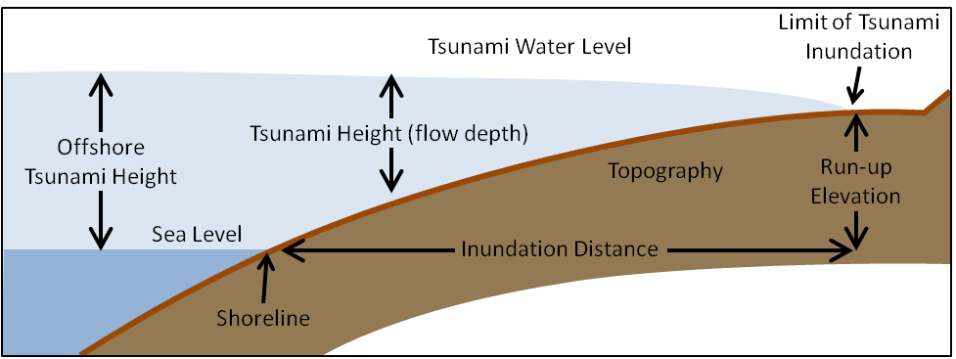
What will the project do?
Typical hazard curve at a site with uncertainty
Examples of tsunami intensity metrics
Circled intensity metrics will be calculated by TSUMAPS-NEAM
Typical hazard maps representing the probability of exceedance of a given tsunami intensity threshold and average return period
Hmax
Runup

Slide 6



How will the project work?
TSUMAPS-NEAM
UN-ISDR GAR15
National PTHAs
knowledge base
methods and data
EC
TASKS
Actions
OB
Products
End Users
Stakeholders
CPAs
General public
...
ASTARTE
knowledge base
methods and data
SC
ASTARTE: Assessment, STrategy And Risk Reduction for Tsunamis in Europe, EU FP7 project
SC: Steering Committee, formed by the TSUMAPS-NEAM Coordinator and all task leaders, plus ASTARTE PMB
OB: Observers’ Board, formed by end users and advisors

Slide 7








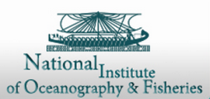
End Users and Advisors
NEAMTWS candidate Tsunami Service Providers (embedded):
NOA (G. Papadopoulos)
IPMA (M.Miranda)
INGV (A. Michelini)
(A. Borrelli)
IOC/UNESCO
(T. Aarup)
SRB-RAS
(A. Zaytsev,
and E. Pelinovsky)
EWS-CARIBE
(C. von Hillebrandt-Andrade)
(M. Cocco)
NEAMTWS
cTSP (M. Erdik)
NEAMTWS-TNC
(M. Said)
(E. Geist)
(A. Annunziato)
All these entities have formalized their expression of interest in the project.

Slide 8
Deliverables and deadlines
Task ID | Task Title | Start Date | End Date | Actions | Deliverables | Task leaders
A | Management and Reporting to the Commission | 1 | 18 | A.1 Coordination A.2 Management and Reporting | D1. Six-Month Progress Report (M6) D2. Twelve-Month Progress Report (M12) D3. Final Report (M18) | INGV
B | Hazard Assessment | 1 | 11 | B.1 Earthquake Model B.2 Tsunami Modelling B.3 Probabilistic Model B.4 Hazard Analysis | D4. Online Tsunami Hazard Database (M11) D5. Tsunami Hazard and Probability Maps (M11) | INGV + IPMA
C | Review and Sanity Check | 4 | 16 | C.1 Best Practices C.2 Expert’s Review and Sanity Check C.3 Documentation | D6. Experts’ Review and Sanity Check (M9) D7. Methods and data Documentation (M16) | GFZ + NOA
D | Publicity | 1 | 18 | D.1 Awareness and Education D.2 Capacity Building | D8. Project Website (M1) D9. Awareness and Education Materials (M12) D10. Guidelines and Training Tools (M15) D11. Layman’s Report (M18) | METU

Slide 9
Tentative dates and places for Major Events
Jan 1st, 2016 official start of the project
Jan 20th, 2016 KoM @Brussels
Feb, 2016 Technical KoM @Rome
17-22 Apr, 2016 join ASTARTE/GTM splinter meeting at EGU? @Vienna
Jun, 2016 technical review meeting @Athens
26-28 Sep, 2016 IOC-UNESCO ICG/NEAMTWS XIII @Bucharest
Oct, 2016 back-to-back meeting with ASTARTE @Lisbon
Dec, 2016 propose or join PTHA session at AGU? @San Francisco
Apr, 2017 propose or join PTHA session at EGU? @Vienna
Jun, 2017 final project meeting @Tunis

Slide 10
Follow up
Activities:
  Monitoring the actual usage of hazard products (online database, dissemination material, capacity building web tools).
  Maintenance, improvement, and update of the project website front-end, and the back-end database and software based on usage analysis and statistics, including feedback from end users.
Resources:
  Acquired equipment will be integrated with the existing institutional infrastructures to carry out review and update of hazard products.
  Permanent staff in participating institutions is already involved in long-term institutional programs devoted at tectonic and tsunami science, hazard analysis, and knowledge transfer to CPAs, the society, and educational programs for the general public.
  Support from entities that have expressed their interest in TSUMAPS-NEAM products (Italian NEAMTWS cTSP; EPOS; JRC; IOC/UNESCO).

