Slide 1
REcheck
Project overview –
Austrian Red Cross

Slide 2
Administrative Overview
Grant Agreement No. ECHO/SUB/2015/713842/PREV 22
Total eligible costs: EUR 474.211
EC co-financing: EUR 355.658 (75%)
Project duration: 24 months - 1.4.2016 – 31.3.2018
Headquaters
2

Slide 3
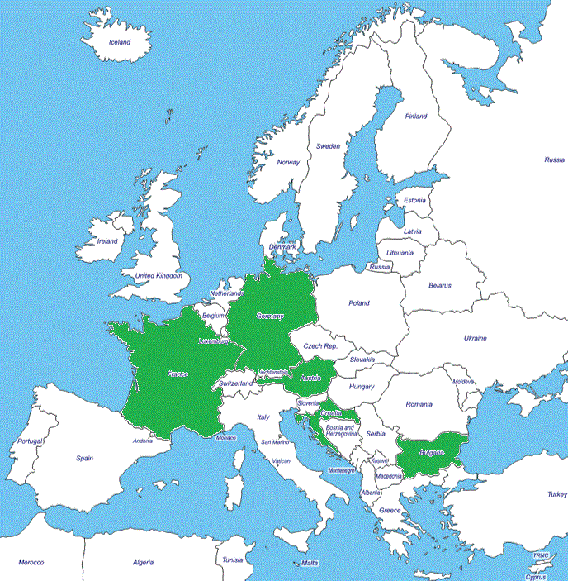
Regional Scope Project countries
Partner Name | Role
Austrian Red Cross | CO
French Red Cross | BE1
Croatian Red Cross | BE2
Bulgarian Red Cross | BE3
German Red Cross | BE4
ISIS GmbH | BE5
Headquaters

Slide 4
Challenges
Population as consumers: shift of responsibility for DRR to public actors. Less interest in preparedness of households and families.
Social cohesion declining: networks are of outmost importance for resilience, but social networks are weakened (in urban areas).
Missing target groups: individual and community level much targeted, but household and neighborhood level are often out of focus.

Slide 5
Objective
REcheck project will develop a interactive REcheck (resilience check) which will assess the preparedness of individuals and groups. Different types for accessing different groups (households, neighbours, subject related groups) on grassroots level – the so called REcheck events (incl. assessment, training and networking) will be developed and tailored to fit target group, urban setting and cultural context.

Slide 6
Project aims:
Strengthening resilience of urban households and neighbourhoods by developing a resilience check & using and adapting available awareness raising tools
Testing different formats for accessing neighbourhood networks
Testing the resilience-check in different urban settings
Strengthening local networks to support help amongst neighbours and resilience in emergencies
Establishing a methodology for assessing and mapping preparedness

Slide 7
Actions and deliverables

Slide 8
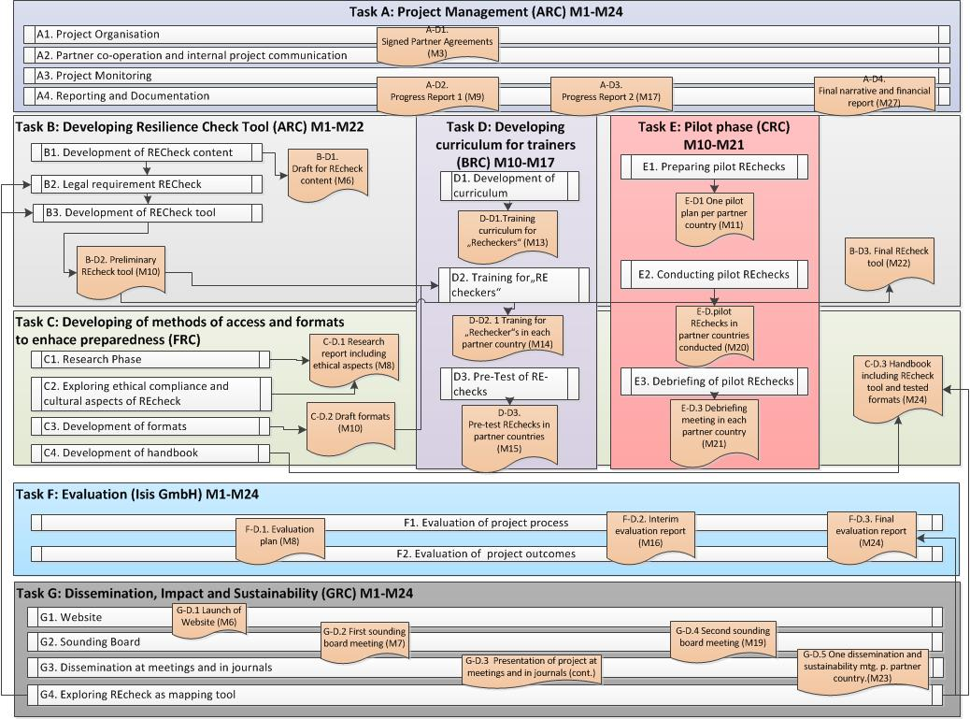

Slide 9
Task ID | Task Title | Start Date | End Date | Actions | Deliverables
A | Project management | 1.4.2016 | 31.3.2018 | A.1 Project Organisation A.2 Partner co-operation and internal project communication A.3 Project monitoring A.4 Reporting and documentation | A-D.1 Signed Partner Agreements A-D.2 Progress report 1 A-D.3 Progress report 2 A.D.4 Final narrative and financial report
B | Developing resilience check tool | 1.4.2016 | 31.3.2018 | B.1 Development of REcheck content B.2 Legal requirements of REcheck B.3 Development of REcheck tool | B-D.1 Draft for REcheck content B-D.2 Preliminary REcheck tool B-D.3 Final REcheck tool
C | Developing methods of access and formats to enhance preparedness | 1.4.2016 | 31.3.2018 | C.1 Research phase C.2 Exploring ethical compliance and cultural aspects of REcheck C.3 Development of REcheck events C.4 Development of handbook | C-D.1 Research report including ethical aspects C-D.2 Draft formats C-D.3 Handbook including REcheck tool and format
D | Developing curriculum for trainers | 1.1.2017 | 31.8.2017 | D.1 Development of curriculum D.2 Training for ‘REcheckers’ D.3 Pre-test of REchecks | D-D.1 Draft training curriculum for REcheckers in partner languages D-D.2 Training for REcheckers in each partner country D-D.3 Pre-test Rechecks in partner countries
E | Pilot phase | 1.1.2017 | 31.12.2017 | E.1 Preparing pilot REchecks E.2 Conducting pilot REchecks E.3 De-briefing of pilot REchecks | E-D.1 One piloting plan per partner country E-D.2 Pilot REchecks in partner countries conducted E-D.3 De-briefing meeting in each partner country
F | Evaluation | 1.4.2016 | 31.3.2018 | F.1 Evaluation of project process F.2 Evaluation of project outcomes | F-D.1 Evaluation plan F-D.2 Interim evaluation report F-D.3 Final evaluation report
G | Dissemination, Impact and Sustainability | 1.4.2016 | 31.3.2018 | G.1 Website G.2 Sounding board G.3 Dissemination at meetings and in journals G.4 Exploring REcheck as mapping tool | G-D.1 Launch of Website G-D.2 First sounding board meeting G-D.3 Presentation of project at meetings and in journals G-D.4 Second sounding board meeting G-D.5 One dissemination and sustainability meeting per partner country

Slide 10
Outcome - expected results
The REcheck tool, an electronic tool (questionnaire/app) deployed on tablets, which will help to assess the preparedness of individuals and groups in a structured way.
A curriculum for training REcheckers in applying the the REcheck tool
Different types of REcheck events, which are tailored for accessing specific groups (neighbours, subject related groups such as clubs, co-workers,…) in specific urban settings and cultural contexts are developed. They will include the REcheck assessment, practical steps for strengthening resilience an individual level and practical advice on strengthening preparedness and networks in neighbourhoods.
These three components will piloted at REcheck events in and together with cities in the five partner countries.
Headquaters
10

Slide 11
Follow up
Trained trainers will continue to deliver the training within partner organisations and in communities
Online training will stay available on website and social media networks. Since it covers three disaster scenarios in five languages it will be an important „on demand“ tool it case of increased media coverage following a disaster
Dissemination in thematic Red Cross and relevant Civil Protection networks

