Slide 1
MARINER Enhancing HNS preparedness through training and exercising
Coordinator: Marisa Fernández. mfernandez@cetmar.org
Centro Tecnológico del Mar – Fundación CETMAR (Spain)
MARINER is co-funded by the European Union in the framework of the Union Civil Protection Mechanism. DG-ECHO, European Commission.

Slide 2
General overview
Objective:
Improve regional cooperation in planning, preparedness and response to HNS spills by improving training and exercise, by increasing awareness and information exchange and by capitalization and translation of HNS relevant R & D projects' outcomes into operational products.
Policy area of activity: Preparedness.
Priority: Improving marine pollution cooperation, including regional cooperation, regarding interoperability and preparedness for direct response to and reducing impacts of manmade disasters. Specific focus area: better planning and preparing for spills of hazardous and noxious substances into the marine environment.
Start date: 1st January 2016
End date: 31st December 2017
Total budget: 998.547 EUR
European Commission contribution: 748.910 EUR (75 %)
MARINER is co-funded by the European Union in the framework of the Union Civil Protection Mechanism . DG-ECHO, European Commission.

Slide 3
Partnership
Centro Tecnológico del Mar – Fundación CETMAR Link Coordinator
INTECMAR - Instituto Tecnológico para el Control del Medio Marino de Galicia Link
Universidade de Vigo Link
Action Modulers Link
CIIMAR: Interdisciplinary Centre of Marine and Environmental Research Link
Public Health England Link
Cedre - Centre of Documentation, Research and Experimentation on Accidental Water Pollution Link
MARINER is co-funded by the European Union in the framework of the Union Civil Protection Mechanism . DG-ECHO, European Commission.

Slide 4
Background tips
Approximately 2,000 different chemicals are transported by sea (source);
The transportation of chemicals has grown considerably in the recent years (estimated 215 Million tonnes in 2015 (source));
Accidents involving chemicals happen: Around 100 incidents happened in European waters between 1987 and 2006). (EMSA, Source).
HNS spills pose risks to the environment and human health;
Fragmented research on HNS Preparedness and Response;
MARINER aims to improve the preparedness to respond to HNS maritime spills by:
Translating relevant knowledge into operational products
Improving exercise and training capabilities and resources
MARINER is co-funded by the European Union in the framework of the Union Civil Protection Mechanism . DG-ECHO, European Commission.

Slide 5
MARINER: organizational chart
Task A
COORDINATION
Task A
COORDINATION & MANAGEMENT
Task B
KNOWLEDGE CAPTURE
Task C
MODELLING & IMPACT
Task D
RESPONSE PROTOCOLS
Task E
TRAINING & EXERCISING
Task A
COORDINATION
Task F
COMMUNICATION & DISSEMINATION
MARINER is co-funded by the European Union in the framework of the Union Civil Protection Mechanism . DG-ECHO, European Commission.

Slide 6
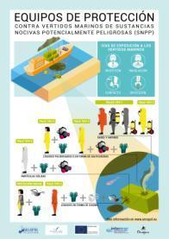
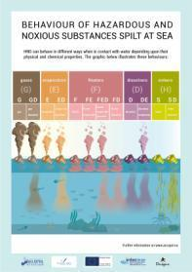
Task B: HNS knowledge compilation and facilitation
Specific objective:
Identify and compile existing HNS preparedness and response knowledge generated by EU funded public research as well as existing resources and make them easy available to end users through a user friendly tool connected to existing platforms and by targeted transfer actions.
Main results and estimated delivery date:
A user friendly visualization and knowledge management tool gathering all relevant information addressing key issues on HNS. June 2017.
Set of graphical materials. June 2017.
Key outputs transferred. December 2017
MARINER is co-funded by the European Union in the framework of the Union Civil Protection Mechanism . DG-ECHO, European Commission.

Slide 7
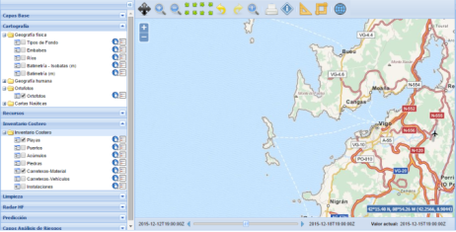
Task C: HNS modelling and environmental impact
Specific objective:
1. Improve the interoperability and the operational use of tools for modelling HNS transport, behaviour and biological impact;
2. Definition of protocols and guidelines for environmental impact assessment of HNS spills.
Main results and estimated delivery date:
Improved HNS spill model integrated into a Common Operational Picture. Includes a module on environmental effects at population level. February 2017.
Cross border guidelines and protocols for HNS environmental impact assessment. July 2017.
MARINER is co-funded by the European Union in the framework of the Union Civil Protection Mechanism . DG-ECHO, European Commission.

Slide 8
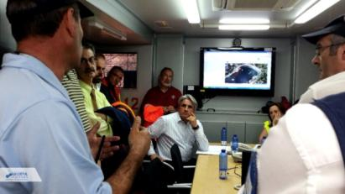
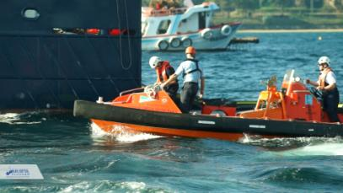
Task D: HNS response – seeking synergies with experts
Specific objective:
Identification of existing expertise from chemical industry, civil protection mechanisms and fire's crews and their main response protocols and equipment to be adapted for marine events.
Development of guidance documents for Good Practices and training for specialized antipollution vessels operating in coastal areas.
Main results and estimated delivery date:
Adapted response protocols to be included in contingency plans. June 2017.
Training and exercise events to test the adapted protocols in specialized antipollution vessels. October 2017.
Multilingual video on training. December 2017.
MARINER is co-funded by the European Union in the framework of the Union Civil Protection Mechanism . DG-ECHO, European Commission.

Slide 9
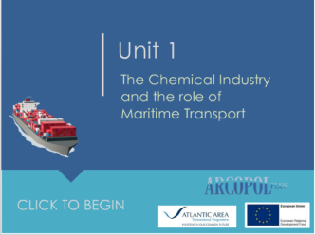
Task E: HNS training and exercising
Specific objective:
Develop and trial an innovative training and exercise process and bespoke software tool aimed at shoreline maritime HNS incident preparedness for public health protection.
Apply and incorporate EU and international cross-border preparedness protocols within exercise scenarios.
Develop training materials packages and delivery of courses addressed to cover key issues of HNS preparedness and response.
Main results and estimated delivery date:
Web based database exercise tool. September 2017.
E-learning materials on exercises and risk assessment. September 2017.
Training package on HNS spill management. October 2017.
Training package on HNS modelling. April 2017.
MARINER is co-funded by the European Union in the framework of the Union Civil Protection Mechanism . DG-ECHO, European Commission.

Slide 10
MARINER’s major events
A total of 4 events will be organised with the aim of transferring MARINER tools to the end users.
Date | Location | Event
February 2017 | Cardiff, United Kingdom | Workshop
April 2017 | Porto or Lisbon, Portugal | Workshop
September 2017 | Brest, France | Workshop
December 2017 | Galicia, Spain | Final conference
Keep updated on project website: www.mariner-project.eu (from May 2016)
MARINER is co-funded by the European Union in the framework of the Union Civil Protection Mechanism . DG-ECHO, European Commission.

Slide 11
Follow up
The key to sustainability is the effective transfer of results to end users
MARINER results will be transferred to end users through targeted actions:
Integrating end users into the project structure: The MARINER Advisory Board is made up of representatives of national competent authorities (UK, FR, SP, PT);
Organising project events aiming at national, regional and local authorities:
Training sessions,
Workshops,
Exercises.
Sharing results through different vias:
MARINER website,
ARCOPOL Platform (Atlantic Technological Platform for oil and HNS spill preparedness, response and mitigation)
Participation in conferences and meetings in the scope of MARINER (meetings with EMSA, Bonn Agreement, etc.)
Results integrated into end users’ operational protocols

