Slide 1
EMETNET
European Multiple Environmental Threats Emergency Network
Lisbeth Hall M.Sc.
Centre for Environmental Safety and Security, RIVM

Slide 2
Project partners and costs
Coordinator
National Institute for Public Health and the Environment (RIVM), Netherlands
Partners
Public Health England (PHE), United Kingdom
Swedish Defence Research Agency (FOI), Sweden
Total eligible costs: € 573,534
EC contribution: € 430,150
Duration: 24 months, starting 01-03-2016

Slide 3
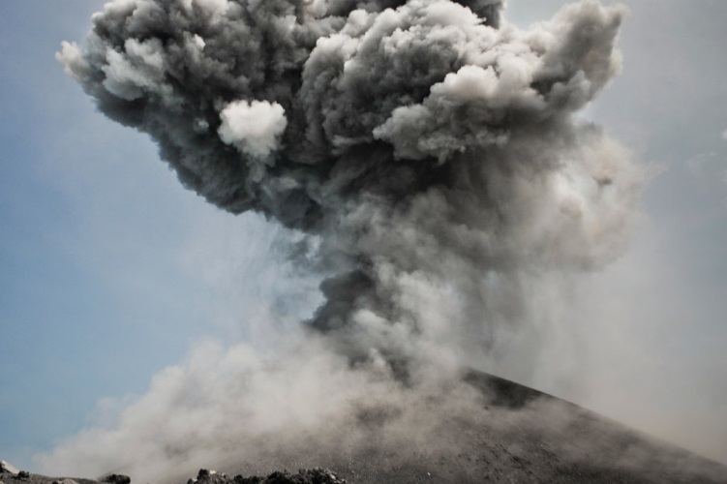
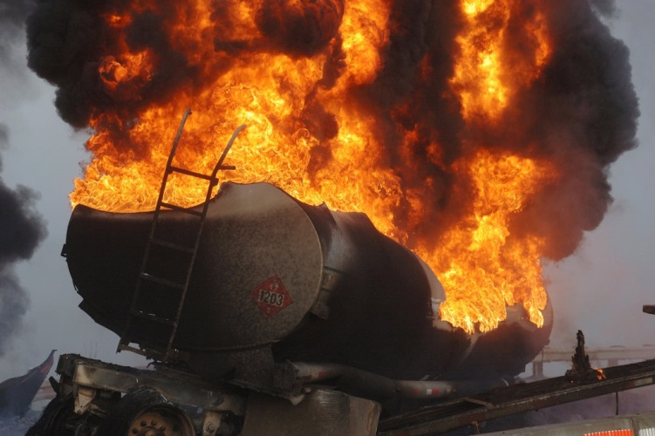
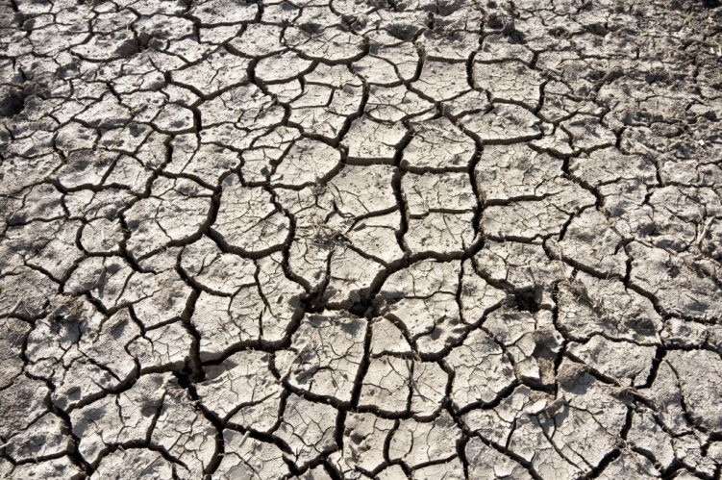
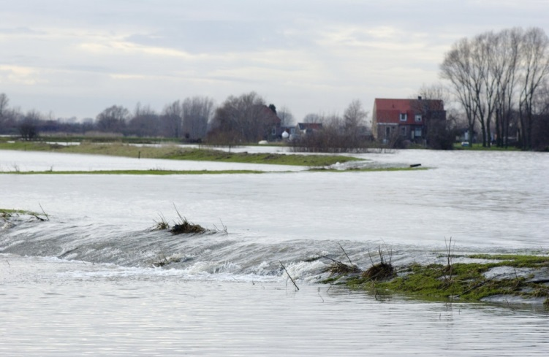
Area of activity: Environmental threats

Slide 4
Main objectives
Strengthen the rapid risk assessment of emerging natural and man-made disaster risks, building on methods for cross-border chemical and biological threats
Extend the IMPEL ‘European scale of industrial accidents’ to enable direct comparison of impacts of multiple environmental hazard types
Expand ECHEMNET ‘Network of Experts’ to cover multiple hazards to aid rapid risk assessment of emerging environmental hazards
Enhance sharing and cooperation in assessment of emerging threats and potential disaster scenarios between EU Member States and expert risk assessors, through international workshops
Assess operational benefits of back-office risk and impact assessment for teams deployed via ERCC, through exercises
Operate in ‘pilot-mode’ to support DG ECHO and DG SANTE in assessing multiple impacts of emerging environmental threats

Slide 5
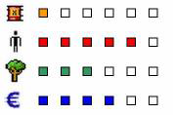
Project tasks
Work Package 1:
Project coordination
Work Package 2:
Impact Assessment Scale, Rapid Risk Assessment Methodology and Guidance for Risk Assessors
Work Package 3:
Network of Experts and Engagement
Work Package 4:
Exercises and Lessons Learnt
Work Package 5:
Project Dissemination & evaluation

Slide 6
Key deliverables
Technical deliverables:
WP2 Report on the rapid risk assessment methodology, mechanism and disaster impact assessment scale (M24)
WP3 Report with recommendations for improvement and sustainability of the network, highlighting lessons learnt in developing the network and in engaging with European and MS authorities (M24)
WP4 Report on lessons learnt from past incidents and EU projects for rapid risk and impact assessment (M18)
WP4 Exercises report (M24)
Project coordination deliverables (WP1):
Progress Report 1 – including coordination, interim results and update of ongoing and planned activities and outputs (M9)
Progress Report 2 – including coordination, interim results and update of ongoing and planned activities and outputs (M18)
Final Report – including coordination, technical results, dissemination and evaluation (M26)

Slide 7
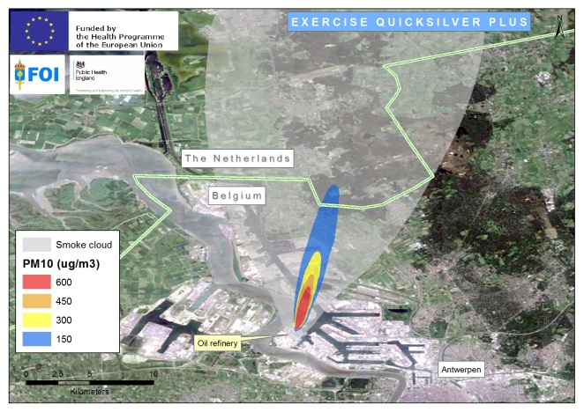
Major events (tentative places & dates)
Kick-off meeting (Utrecht, Netherlands; M1)
Technical WP2 & WP4 workshop (Oxford, England; M5)
Workshop for risk assessors and stakeholders (Vienna, Austria; M9)
Table-top exercise (M11)
Interim project meeting (Umeå, Sweden; M12)
Workshop for risk assessors and stakeholders Brussels, Belgium; M15)
Table-top exercise (M18)
Final meeting (Utrecht, Netherlands; M22)

Slide 8
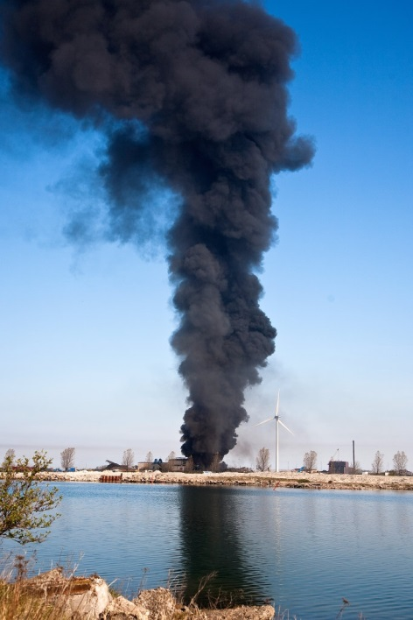
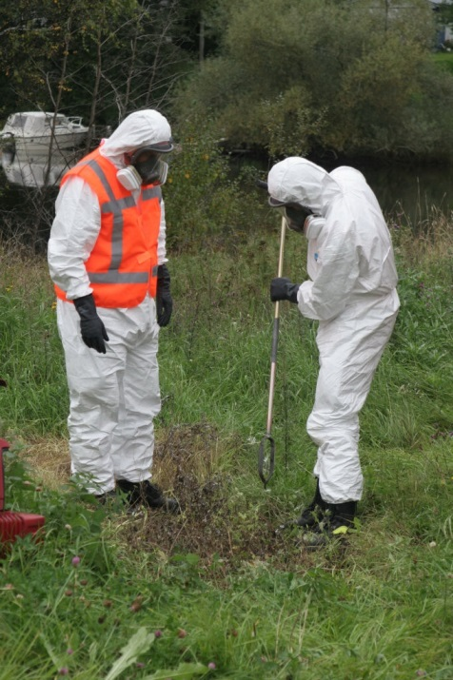
Expected results
Raised awareness and collaboration between experts, European and Member States’ Authorities with competencies in risk and impact assessment of emerging multiple environmental hazards
Extended pool of expert risk assessors for use by DGs to assess emerging threats
Harmonised methodology and support mechanism for EU Member States to assess emerging risks
More efficient, shared, risk and impact assessment procedures at the European level

Slide 9
Follow up
Project outputs will be made available to:
DG ECHO for use by ERCC to support the CPM
DG SANTE for use by Health Emergency Operations Facility and the European Scientific Committees for the ad hoc risk assessment of emerging public health threats
Directorates (DG ECHO and DG SANTE) to discuss formal or informal agreement of the interoperability of risk assessment of emerging threats with health impact
A Joint Action could support the uptake and further use of the methodology, guidance and approaches by EU Member states
Support from the EU Commission and EU Member states will be required for continuation of work to enhance EU prevention and preparedness to future disasters and protect EU citizens from harm

Slide 10
For more information: lisbeth.hall@rivm.nl www.EMETNET.eu (provisional address)

