Slide 1
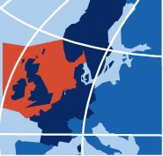
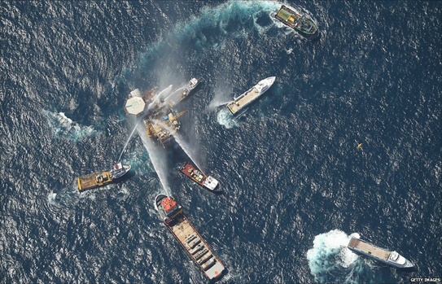
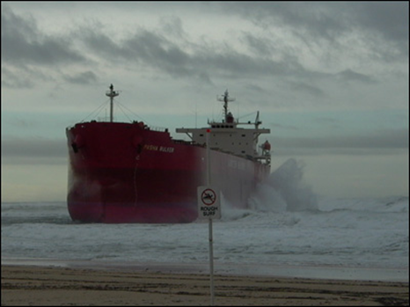
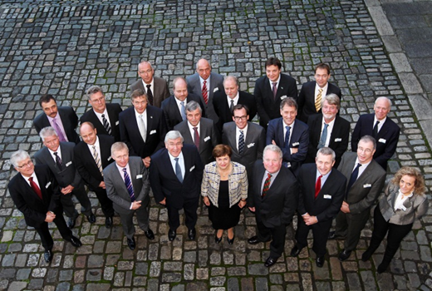
BE-AWARE Project
BONN AGREEMENT
Bonn Agreement: Area-wide Assessment of Risk Evaluations
John Mouat, Deputy Secretary

Slide 2
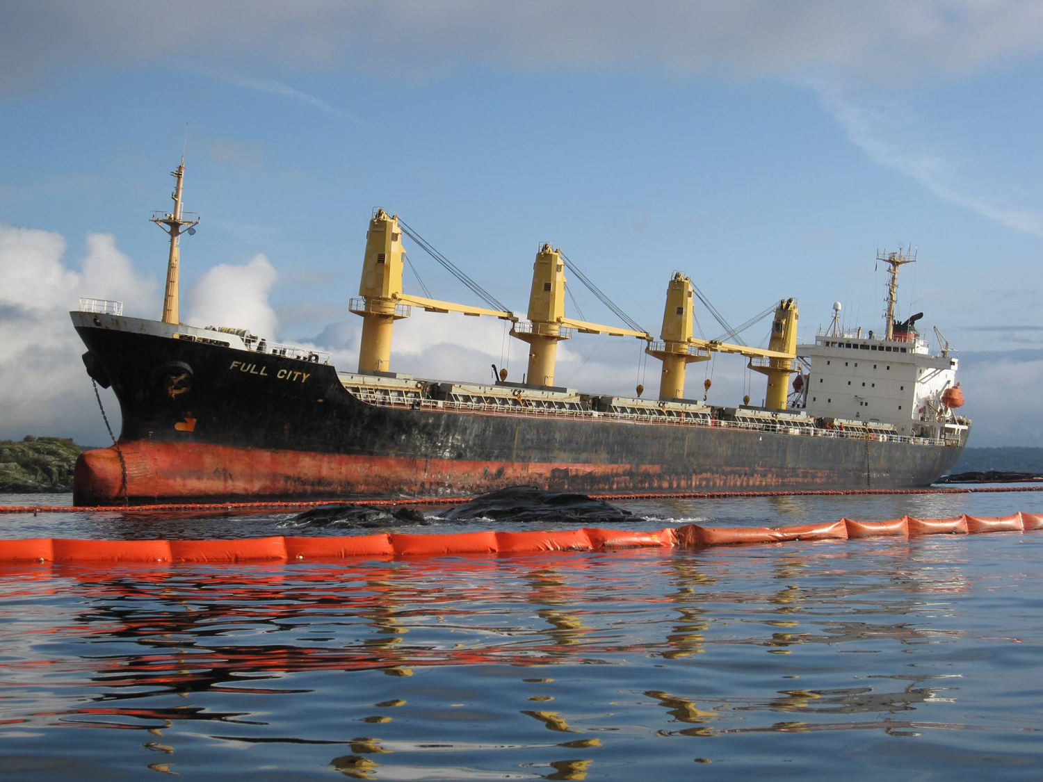
Bonn Agreement Agreement for cooperation in dealing with pollution of the North Sea by oil and other harmful substances
Surveillance for threats of marine pollution
Development of common operational methods
Support in response operations
Sharing research and development
Carrying out joint exercises
Risk assessment

Slide 3
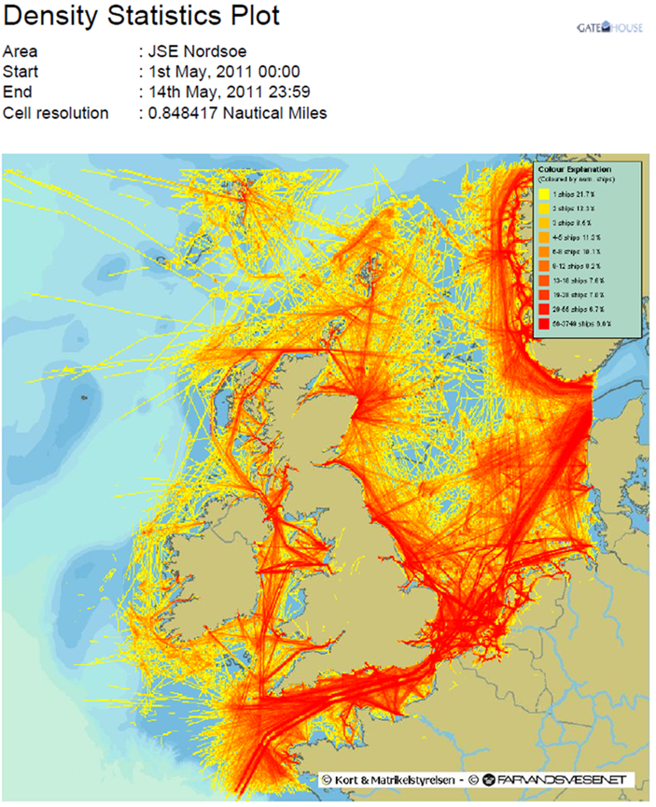
Why do we need a risk Assessment in the Greater North Sea?
Increasing traffic and vessel size
Increased transports of oil and HNS
New maritime uses and activity
Energy generation
Ocean aquaculture
Marine protected areas
Increased storminess

Slide 4
Project Background
Bonn Agreement Ministerial Meeting 2010
Dublin Declaration
Bonn Agreement Action Plan (BAAP)
Risk Analysis Workshop, May 2011
No existing overview
Need to further develop on National risk assessments
Notes:
Hazard identification
Risk modelling
Lessons learned
Awareness
Multinational participation

Slide 5
Regional risk of marine pollution
- evaluating resources (regional database)
- use levels (traffic and projected use)
- environmental sensitivity (most vulnerable)
Blue-print for disaster prevention (tested / validated)
- common tools
- collate information from existing studies
- regional overview
- sub-regional case study

Slide 6
Project Structure
A) Project Management
Administrative and financial management
Information exchange and dissemination
B) Kick off Meeting
10-11th January, Delft, Netherlands
Partnership agreement, Communication plan
C) Regional Database
Data collection
Analysis of national risk assessments
Overview presentation

Slide 7
Project Structure
D) Methodology
Development of a method note
Model modification
E) Area-wide traffic and use study
Present and projected traffic
F) Sensitivity Analysis
Environmental and socio-economic sensitivity
Maritime uses
Method seminar, Denmark, March 2012, tbc
Seminar to confirm common criteria, Belgium, Date tbc

Slide 8
G) Risk Assessment Workshop
Workshop in Conjunction with Bonn 2012 (24-28th Sept)
H) Risk
Assessment
Validation of the risk assessment through application to a high risk area
J) Project Conference
I) Case Study
Quantitative risk assessment for mineral oil
Qualitative risk assessment for HNS
Identification of risk reduction measures
Review of final project results
Perspective on balance of resources
Dec 2013, [World Maritime University, Malmo, Sweden, tbc]

Slide 9
Project partners
Coordinating Beneficiary:
Bonn Agreement
Associate Beneficiaries:
RBINS
MUMM
RWS
Noordzee
Admiral Danish Fleet HQ
Co-Financiers:
Norwegian Coastal Administration
Belgian Federal Public Service: Marine Environment Unit

Slide 10
Project Funding
Total value : €540,800
BA Secretariat (CO) €40,000 in kind
Belgium (AB1) €2,000
Denmark (AB2) €15,000 + €31,300 in kind
Netherlands (AB3) €25,000
Belgium (ENV) €15,000
Norway €10,000
Co-financing by EU €402 500

Slide 11
Timeline

Slide 12
Reporting Schedule
Progress report 1 – July 2012
Interim Technical and Financial report – January 2013
Progress report 2 – July 2013
Final Technical and Financial report – March 2014

Slide 13
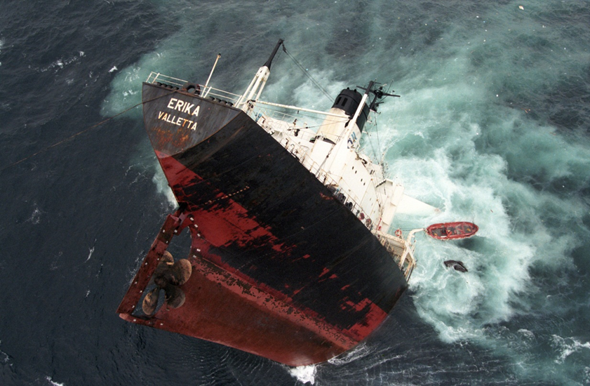
Continuation
Joint sensitivity mapping and detailed analysis of impact
Modelling of a range of scenarios comprising additional risk reducing measures and response capabilities
Comprehensive HNS analysis
Enhanced preparedness in high risk areas

Slide 14
Thank you www.bonnagreement.org 0044 (0)20 7439 5200

