Slide 1
Wildland - Urban Interface Forest Fire Risk Observatory and Interest Group in Europe
WUIWATCH
Grant Agreement Nº ECHO/SUB/2014/694556
www.wuiwatch.org

Slide 2
Beneficiary and partners
Beneficiary – MeteoGrid (Spain)
Partners
Associacao para o Desenvolvimento da Aerodinamica Industrial (ADAI) (Portugal)
Fundacio d'Ecologica del Foc i Gestio d'Incendis Pau Costa Alcubierre (PCF) (Spain)
Universita Degli Studi di Sassari (UNISS) (Italy)
Entente Pour la Foret Mediterraneenne (CEREN) (France)

Slide 3
The problem
Expansion of urban areas, abandonment of rural lands -> creation of wildland-urban interface areas (WUI)
Houses, infrastructures, services intermingle with wildland areas, exposed to associated risks such as forest fires
Forest fires in the WUI demand high level of operation coordination of many agents
Lack of common procedures on fire prevention and emergency management
Lack of capitalisation of experience

Slide 4
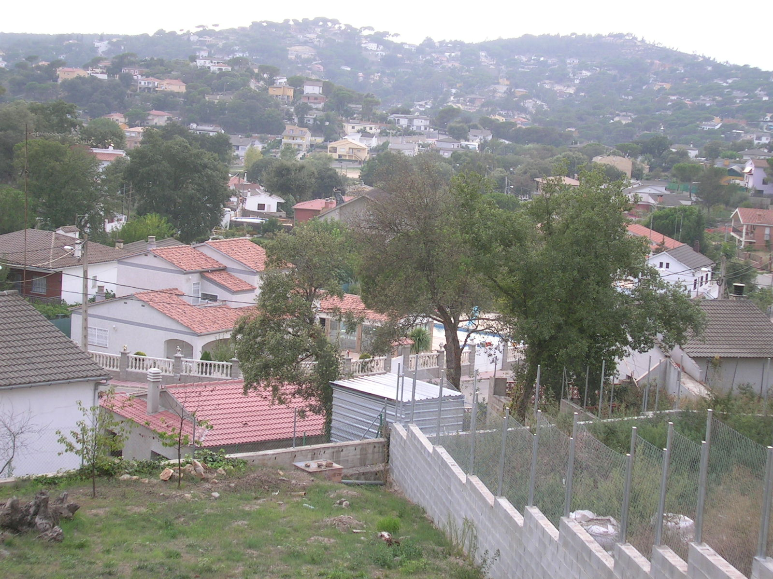
Foto D. Caballero

Slide 5
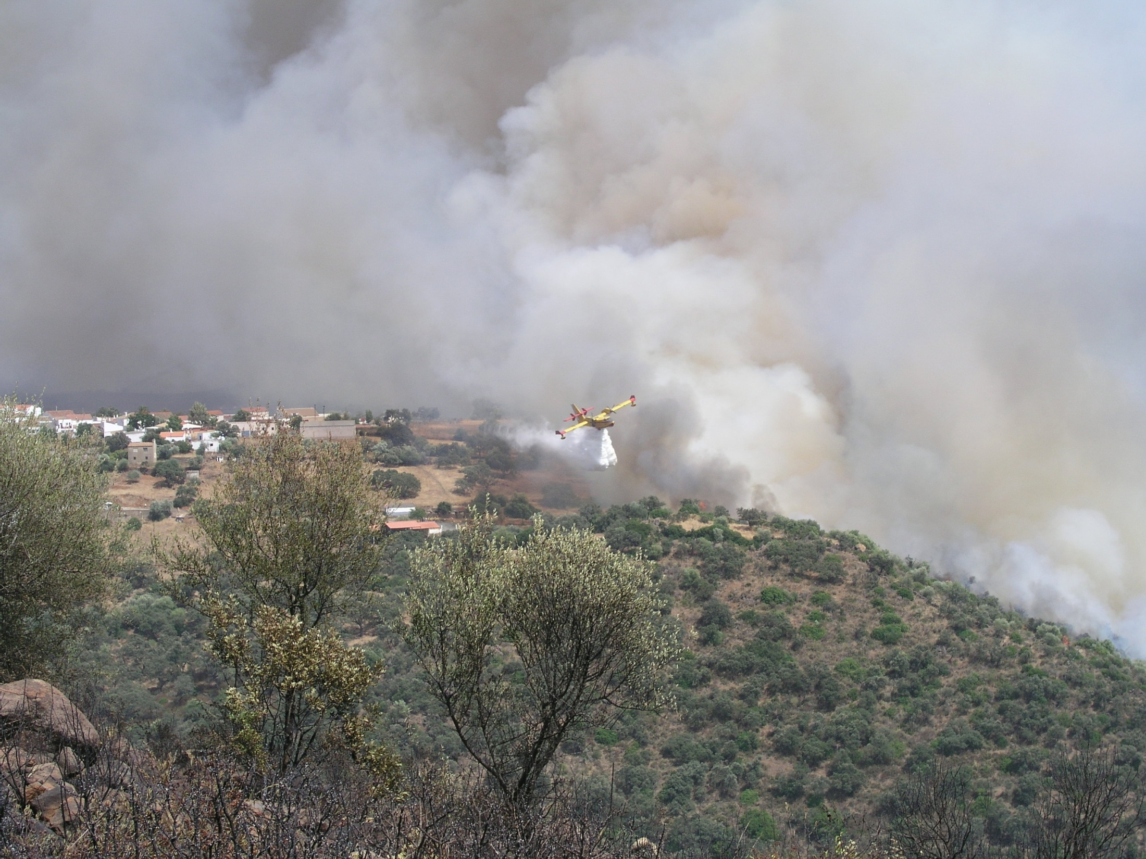
Foto: incendio Berrocal (Huelva), 2.004. Fuente: Junta de Andalucía

Slide 6
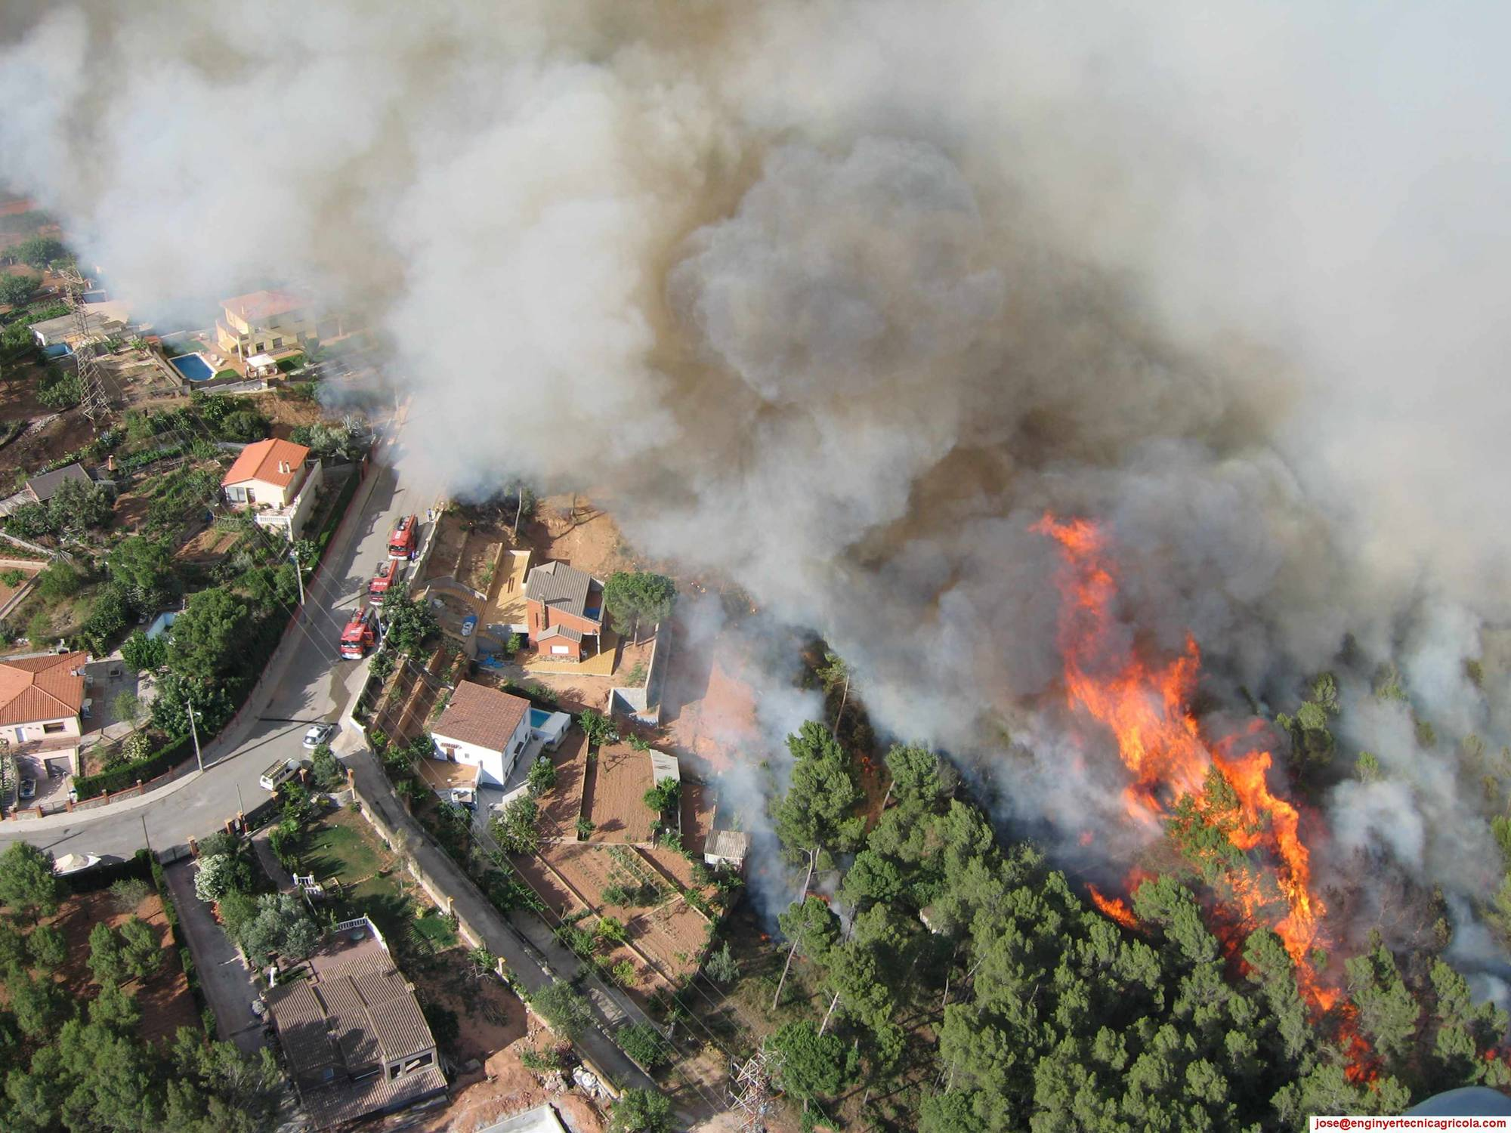
Foto UT GRAF

Slide 7
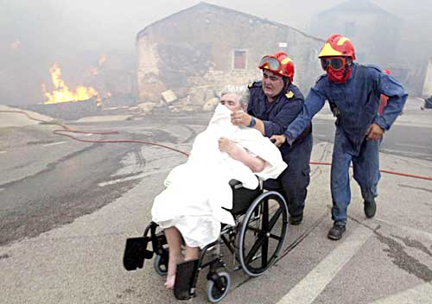
En incendios de comportamiento extremo confinar es preferible
Una buena acción de confinamiento implica educar en la autoprotección
(FORMACIÓN e INFORMACIÓN)
Foto: Montorig, 2.007. Fuente: Bombers Generalita de Catalunya.

Slide 8
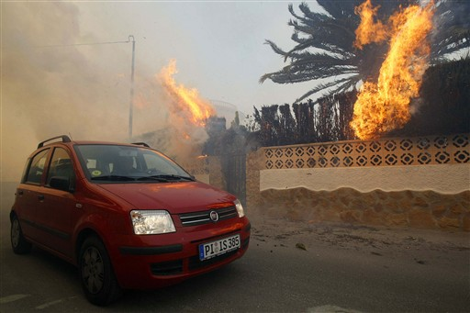
Foto : La Nucía, Alicante, 2.009. Fuente: Manuel Lorenzo, AFP.

Slide 9
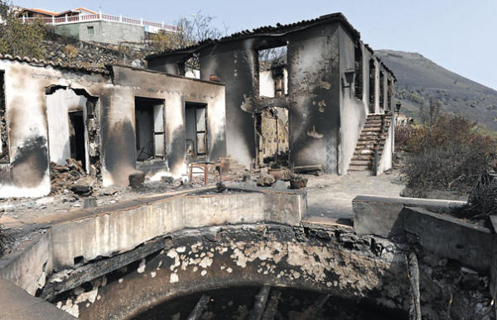
Foto F. Grillo
Notes:
Frequently destruction of houses occur because the house is left alone, without any preparation and open windows

Slide 10
Project outline
Main figures:
Duration: 24 months
Total cost: 657.584€, EC grant: (75%) 493.188€
Objectives:
Create and consolidate a European Observatory on prevention and defense against forest fires affecting urban areas and communities
Creation of a permanent forum and interest group, capitalisation of experience
Elaboration of consensuated protocols and procedures for risk mapping, prevention and operation

Slide 11
Expected results
Improve cooperation and exchange of good practices
Improve networking amongst actors and policies across Europe
Improve understanding of factors and processes involved in vulnerability
White book on WUI gathering common prevention and operational procedures
Database of fire events affecting WUI areas, capitalisation of experience

Slide 12
Timeline

Slide 13
Deliverables (1)
D1.1 Report on WUI fire prevention and emergency management in Europe (M7)
D2.1 WUIWATCH community members database (M7) (M24)
D3.1 Permanent Forum and interest group platform (M13)
D4.1 Online tool and database of experience capitalisation (M15)
D4.2 WUIWATCH Knowledge base (M21)
D5.1 Report on houses vulnerability, tests and experiments (M13)
D5.1 Report on fire safety in the WUI, tests and experiments (M19)
D6.X Workshops Proceedings and conclusions (M6)(M14)(M20)(M24)
D7.1 Guide of good practices for prevention and self-protection (M21)
D7.2 Report on defence operations and safety (M23)
D7.3 WUIWATCH White book on fire prevention and defence in WUI (M24)
D8.1-3 Brochures (M13)(M18)(M24)
D8.4-7 Videos (M13)(M24)
D8.8 Report on dissemination activities (M24)

Slide 14
Deliverables (2)
D9.1 Project Steering Committee (M1)
D9.2 Cooperation Agreement (M1)
D9.3 Project operations manual (M1)
D9.4 Annual Work Programme – Year 1 (M1)
D9.5 Project monitoring and evaluation systems (M1)
D9.6 Progress Report 1 (M8)
D9.7 Annual Work Programme – Year 2 (M12)
D9.8 Progress Report 2 (M16)
D9.9 Final Report (M24)
D9.10 Sustainability Plan (M24)
D9.11 External final evaluation (M26)

Slide 15
Major Events
Four international workshops:
May 2015 in Italy, on prevention and risk mapping
December 2015 in Portugal, on vulnerability
June 2016 in France, on defence operations
November 2016 in Spain, on human factors, closing event
Coupled with periodical project meetings
Experiments and lab testing carried out in Coimbra (P) ADAI Firelab (CEIF)
Operational essays on safety carried out in Valabre (F) CEREN installations

Slide 16
Web Site
Project’s Web site at www.wuiwatch.org
Several Web-based functionalities:
General information on the project
Project results and events
Dissemination material
WUIWATCH Forum
WUIWATCH Toolbox
WUIWATCH Library
WUIWATCH Database
Project’s internal administration (restricted)

Slide 17
Thanks!
More information:
David Caballero
david@meteogrid.com

