Slide 1
Project START Strengthening cross border and inter-sectorial operability
ECHO/SUB/2014/693897

Slide 2
PROJECT PARTNERS
Project coordinator: Asociaţia Multisalva (Multisalva Association) (RO)
Partner 1: Felső-Tiszavidéki Búvár és Mentő Közhasznú Egyesület (Upper Tisa Diving and Rescue Public Utility Association) (H)
Partner 2: Inspectoratul pentru Situaţii de Urgenţă “Someş” al judeţului Satu Mare (“Someş” Inspectorate for Emergency Situations Satu Mare) (RO)
Partner 3: Szabolcs-Szatmár-Bereg Megyei Katasztrófavédelmi Igazgatóság (Disaster Management Directorate of Szabolcs-Szatmár-Bereg County) (H)
Partner 4: Societatea Naţională de Cruce Roşie din România, Filiala Satu Mare (Romanian Red Cross National Society, Satu Mare Subsidiary) (RO)
Partner 5: Magyar Vöröskereszt Szabolcs-Szatmár-Bereg Megyei Szerevete (Hungarian Red Cross - Szabolcs-Szatmár-Bereg County Organization) (H)
Partner 6: Asociaţia Organizaţia Caritas a Diecezei Satu Mare (Association Caritas Organization of Satu Mare’s Diocese) (RO)

Slide 3
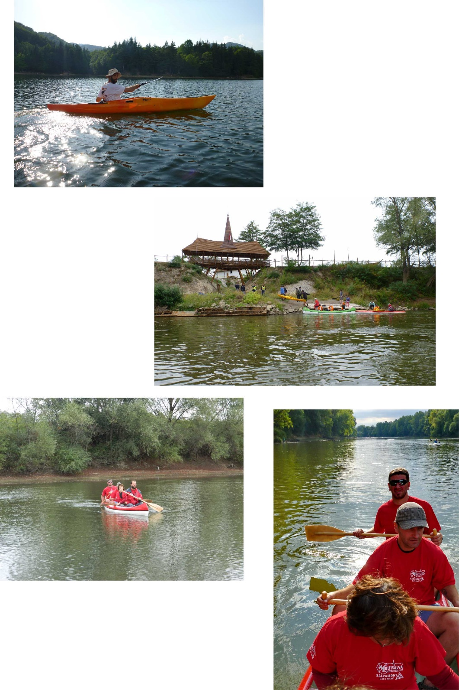
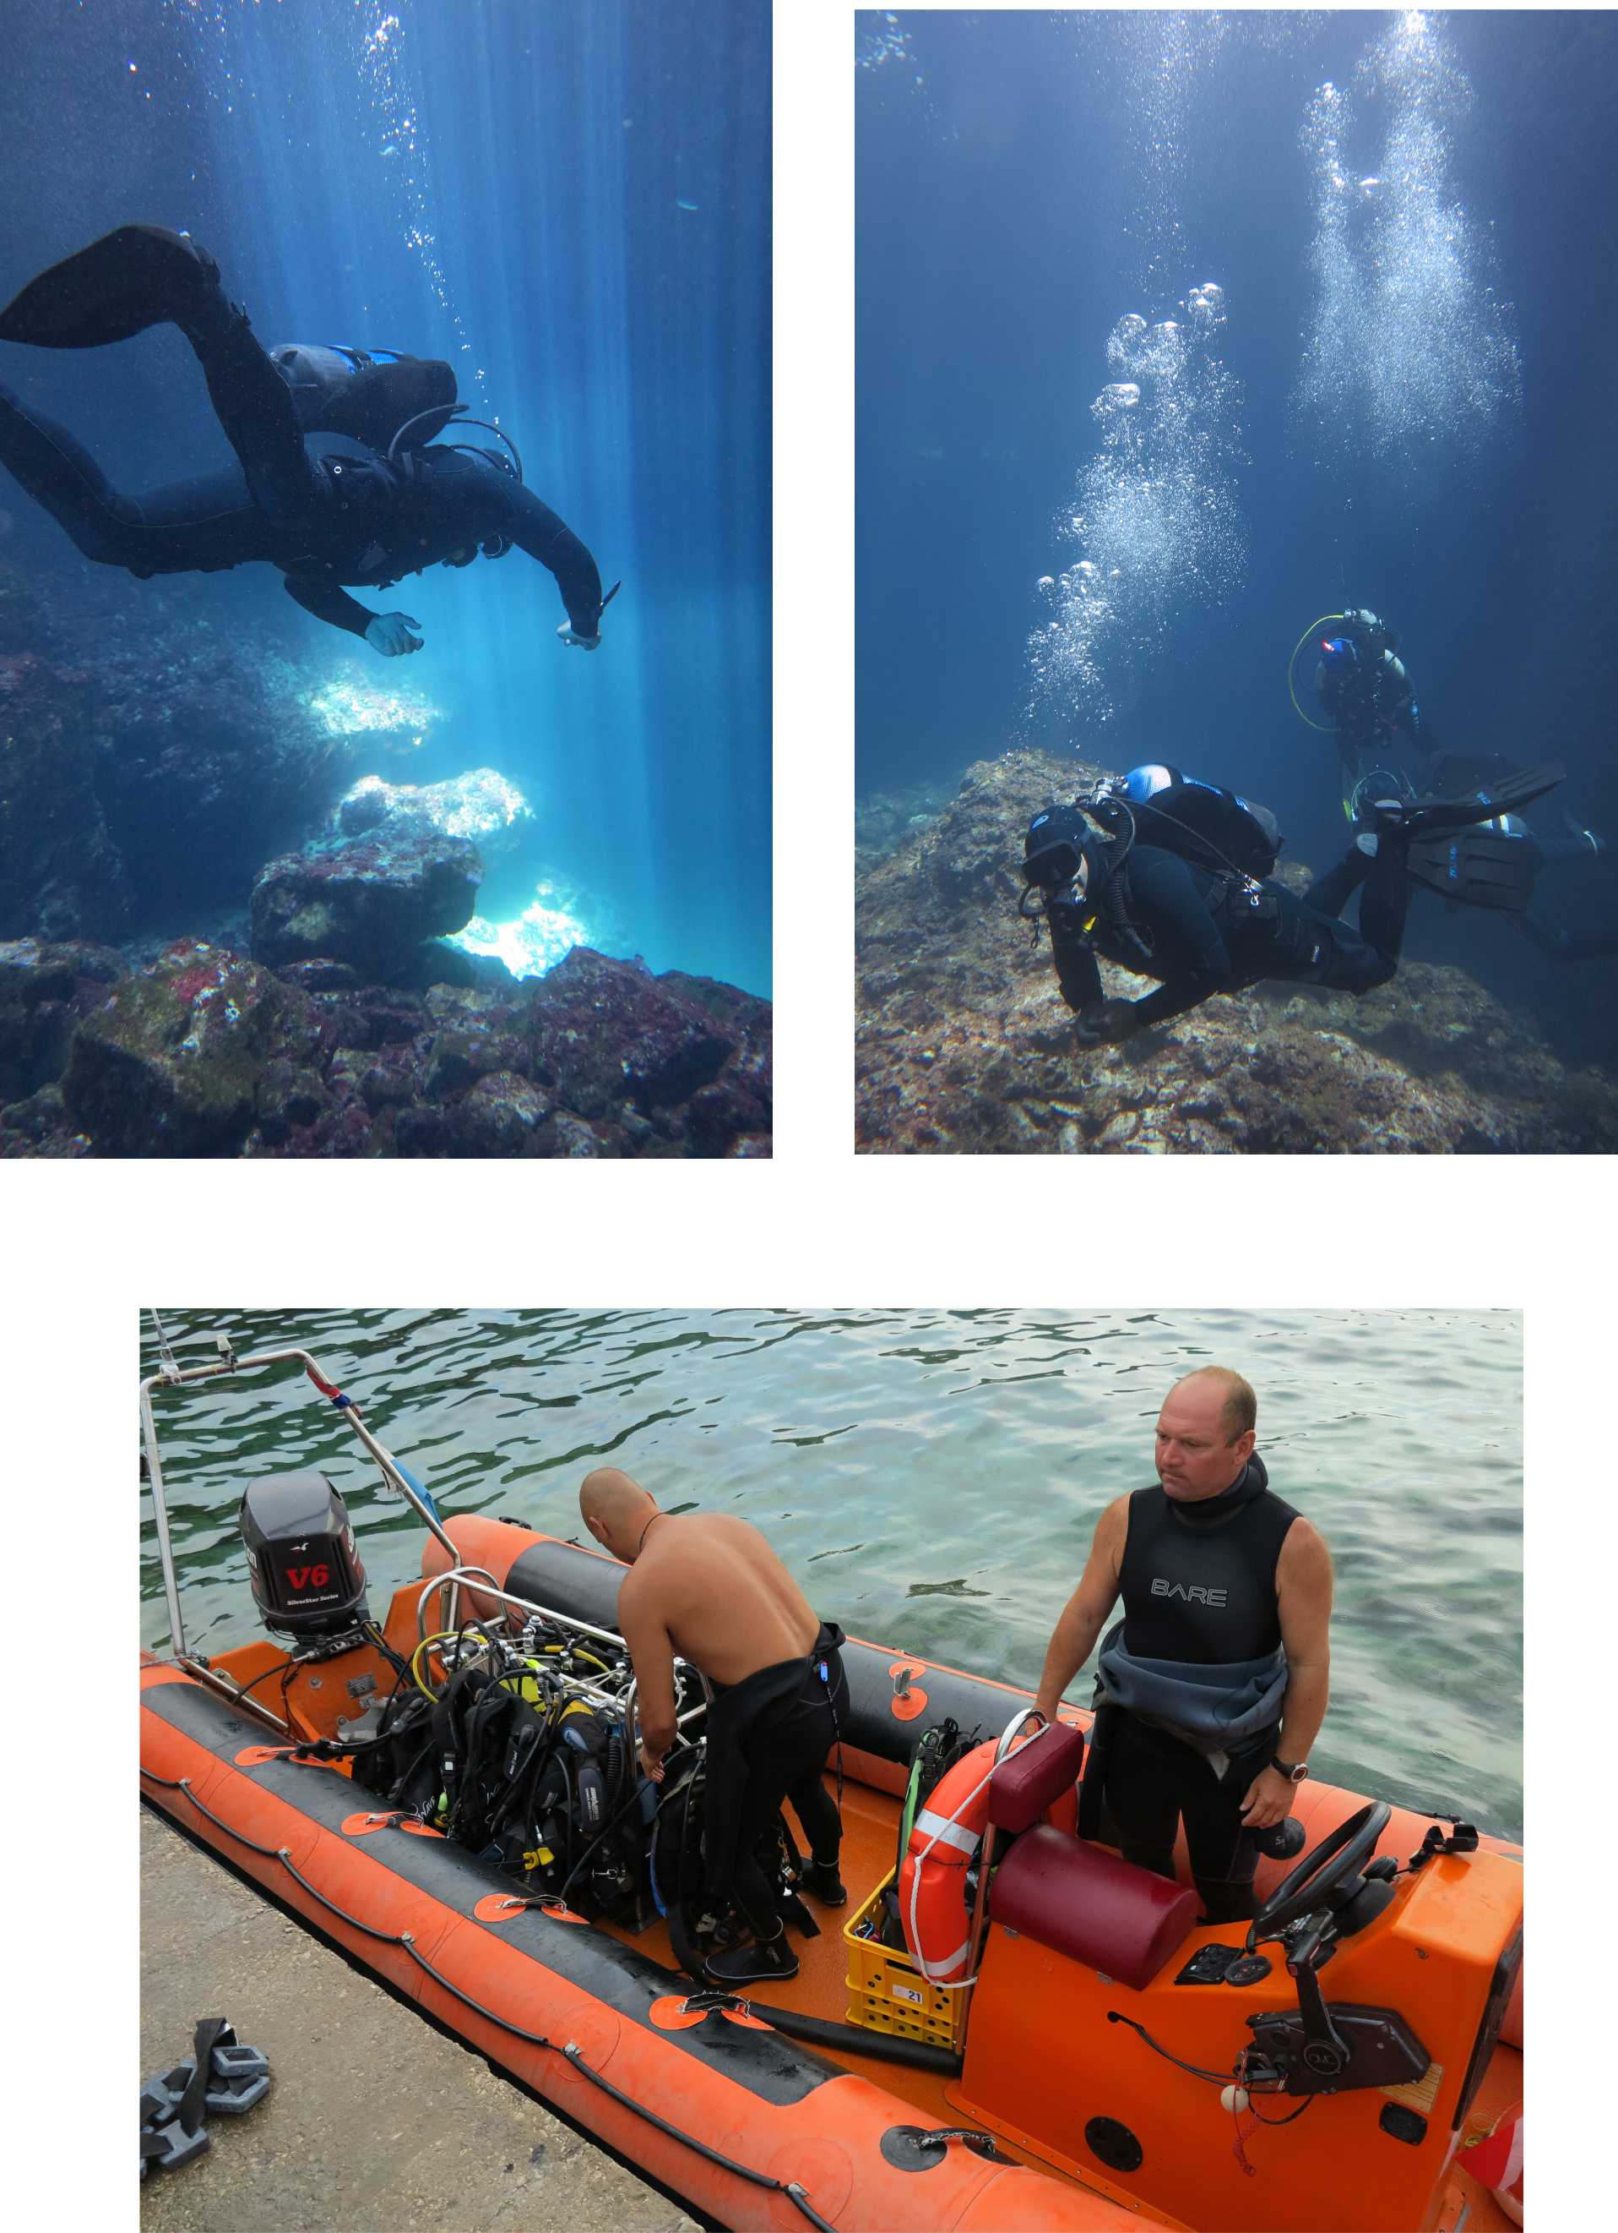
rescue exercises and trainings

Slide 4
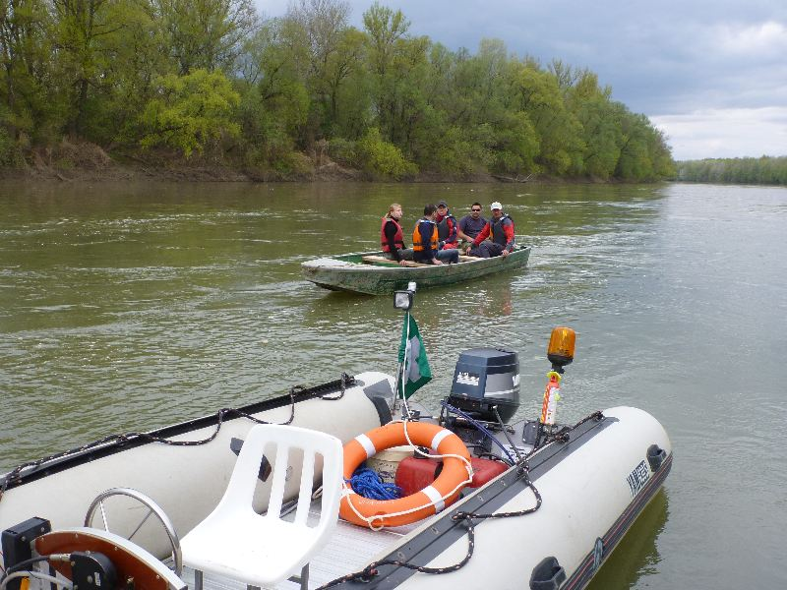
PROJECT BUDGET and DURATION
Total eligible cost: 257.976,00 EUR
EC co-financing: 192.966,00 EUR
Project duration: 15 months
Implementation period:
01/01/2015 – 31/03/2016

Slide 5
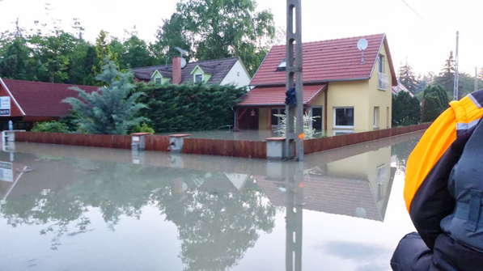
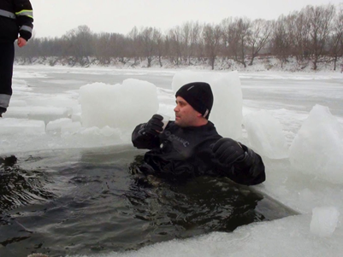
PROJECT OBJECTIVES
The project aims to improve the preparedness of civil protection professionals and volunteers acting at the Romanian–Hungarian border area through strengthened coordinated action and capacity building and through developing a cross-border informational system that enhances its coordinated reaction capacity.
O1. Developing cross-border civil protection cooperation and interoperability by creating a locally coordinated cross-border group of 7 institutions and organizations that will exchange information and develop common intervention procedures in the context of 2 workshops and 3 roundtables, during 11 months.
O2. Supporting capacity building in emergency preparedness for at least 15 institutions and organizations from Hungary and Romania, in the target area (including local volunteer groups) that will participate at 5 training sessions and 4 small scale exercises during 11 months of the project implementation.
O3. Developing a cross-border informational system by planning and creating a Local Resource Database and Communication System (LoRDaCS) for dynamic adjustment of response capacity in case of disasters.

Slide 6
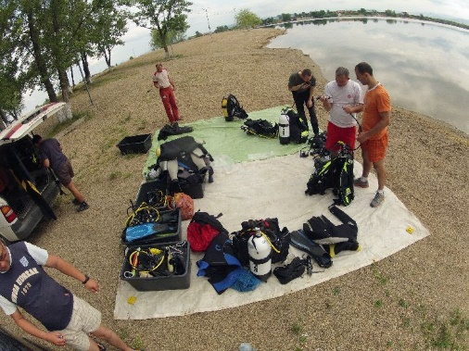
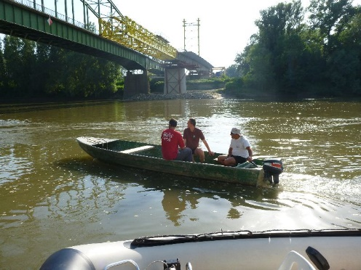
WHY IS THIS PROJECT NECESSARY?
Even if working in the same sector, there is a lack of interoperability and of specific methodology of collaboration between the national bodies empowered to coordinate emergency situations and the private (civil) special rescue teams, support NGOs, local volunteer action groups.
This lack of procedures and similar knowledge about rescue issues could lead to results like during the 1970 flood that affected this region too, when the intervention teams and even the army were overwhelmed by the situation, which lead to a high number of death.
The area of coverage of the problem is the Water Basin of Tisa River with its tributaries: Someș, Crasna and Tur, that flow along dams from N-W Romania into N-E Hungary, an area prone to flooding (floods occurred in 19 of the last 45 years, the last being in 2013, and usually affects both counties).
During common activities in emergency situations, frequently appeared misunderstandings between coordinators, specialists and volunteers, leading to delays or errors in the rescue process. Causes: lack of similar rescue procedures and techniques and differences in structure types and way of functioning (“military” versus “civil”).

Slide 7
MAIN DELIVERABLES
Tasks | Deliverables
Management and Reporting to the Commission | 1 Progress Report & 1 Final Report to the Commission
Publicity | 3000 leaflets (in RO, HU, EN languages). 3 roll-up banners (in RO, HU, EN languages). 200 visibility stickers. 1 video film (about the exercises and project results) – with subscription in RO, HU, EN (as required). 1 web page of the project
Elaboration of the Common Intervention Plan (CIP) and Establishment of the Cross-Border Crisis Team (CBCT) | 3 round table discussion reports 1 Common Intervention Plan (CIP) 1 Cross-Border Crisis Team (CBCT), formed by delegated members of the partners and other public authorities in charge in decision making (ex. County Councils)
Endowment of partners with specific consumables and equipment | IT equipment: laptop, projector, screen and dive computer A set of consumable goods acquired by each partner
Trainings and small scale exercises for the public and private rescue teams and support organizations | List of participants + pictures + event report of the small scale exercises
Elaboration of a cross-border local resource database for emergency situations | Local Resource Database with min 60 items that shows specific resources that can be used in case of emergencies (human and material resources) At least 15 Agreements signed for usage of resources in case of emergencies
Elaboration of a feasibility study for an autonomous communication system | Feasibility study regarding implementation of an autonomous communication system for the local stakeholders, that could operate independently from phone operators, satellites

Slide 8
deadlines
Tasks | Start date | End date
Management and Reporting to the Commission 1st Progress Report – 31.08.2015 Final Report – 30.05.2016 | 01.01.2015 | 31.03.2016
Publicity | 01.01.2015 | 31.03.2016
Elaboration of the Common Intervention Plan (CIP) and Establishment of the Cross-Border Crisis Team (CBCT) | 01.03.2015 | 31.12.2015
Endowment of partners with specific consumables and equipment | 01.03.2015 | 31.07.2015
Trainings and small scale exercises for the public and private rescue teams and support organizations | 01.04.2015 | 28.02.2016
Elaboration of a cross-border local resource database for emergency situations | 01.06.2015 | 28.02.2016
Elaboration of a feasibility study for an autonomous communication system | 01.06.2015 | 31.01.2016

Slide 9
dates and places for Major Events
April 2015 – “Dam failure and flooding” training
May 2015 – “Dam failure and flooding” small scale exercise
July 2015 – “Water rescue” training
August 2015 – “Water rescue” small scale exercises in Hungary
September 2015 – “Water rescue” small scale exercises in Romania
January 2016 – “Ice rescue” training
February 2016 – “Ice rescue” small scale exercises

Slide 10
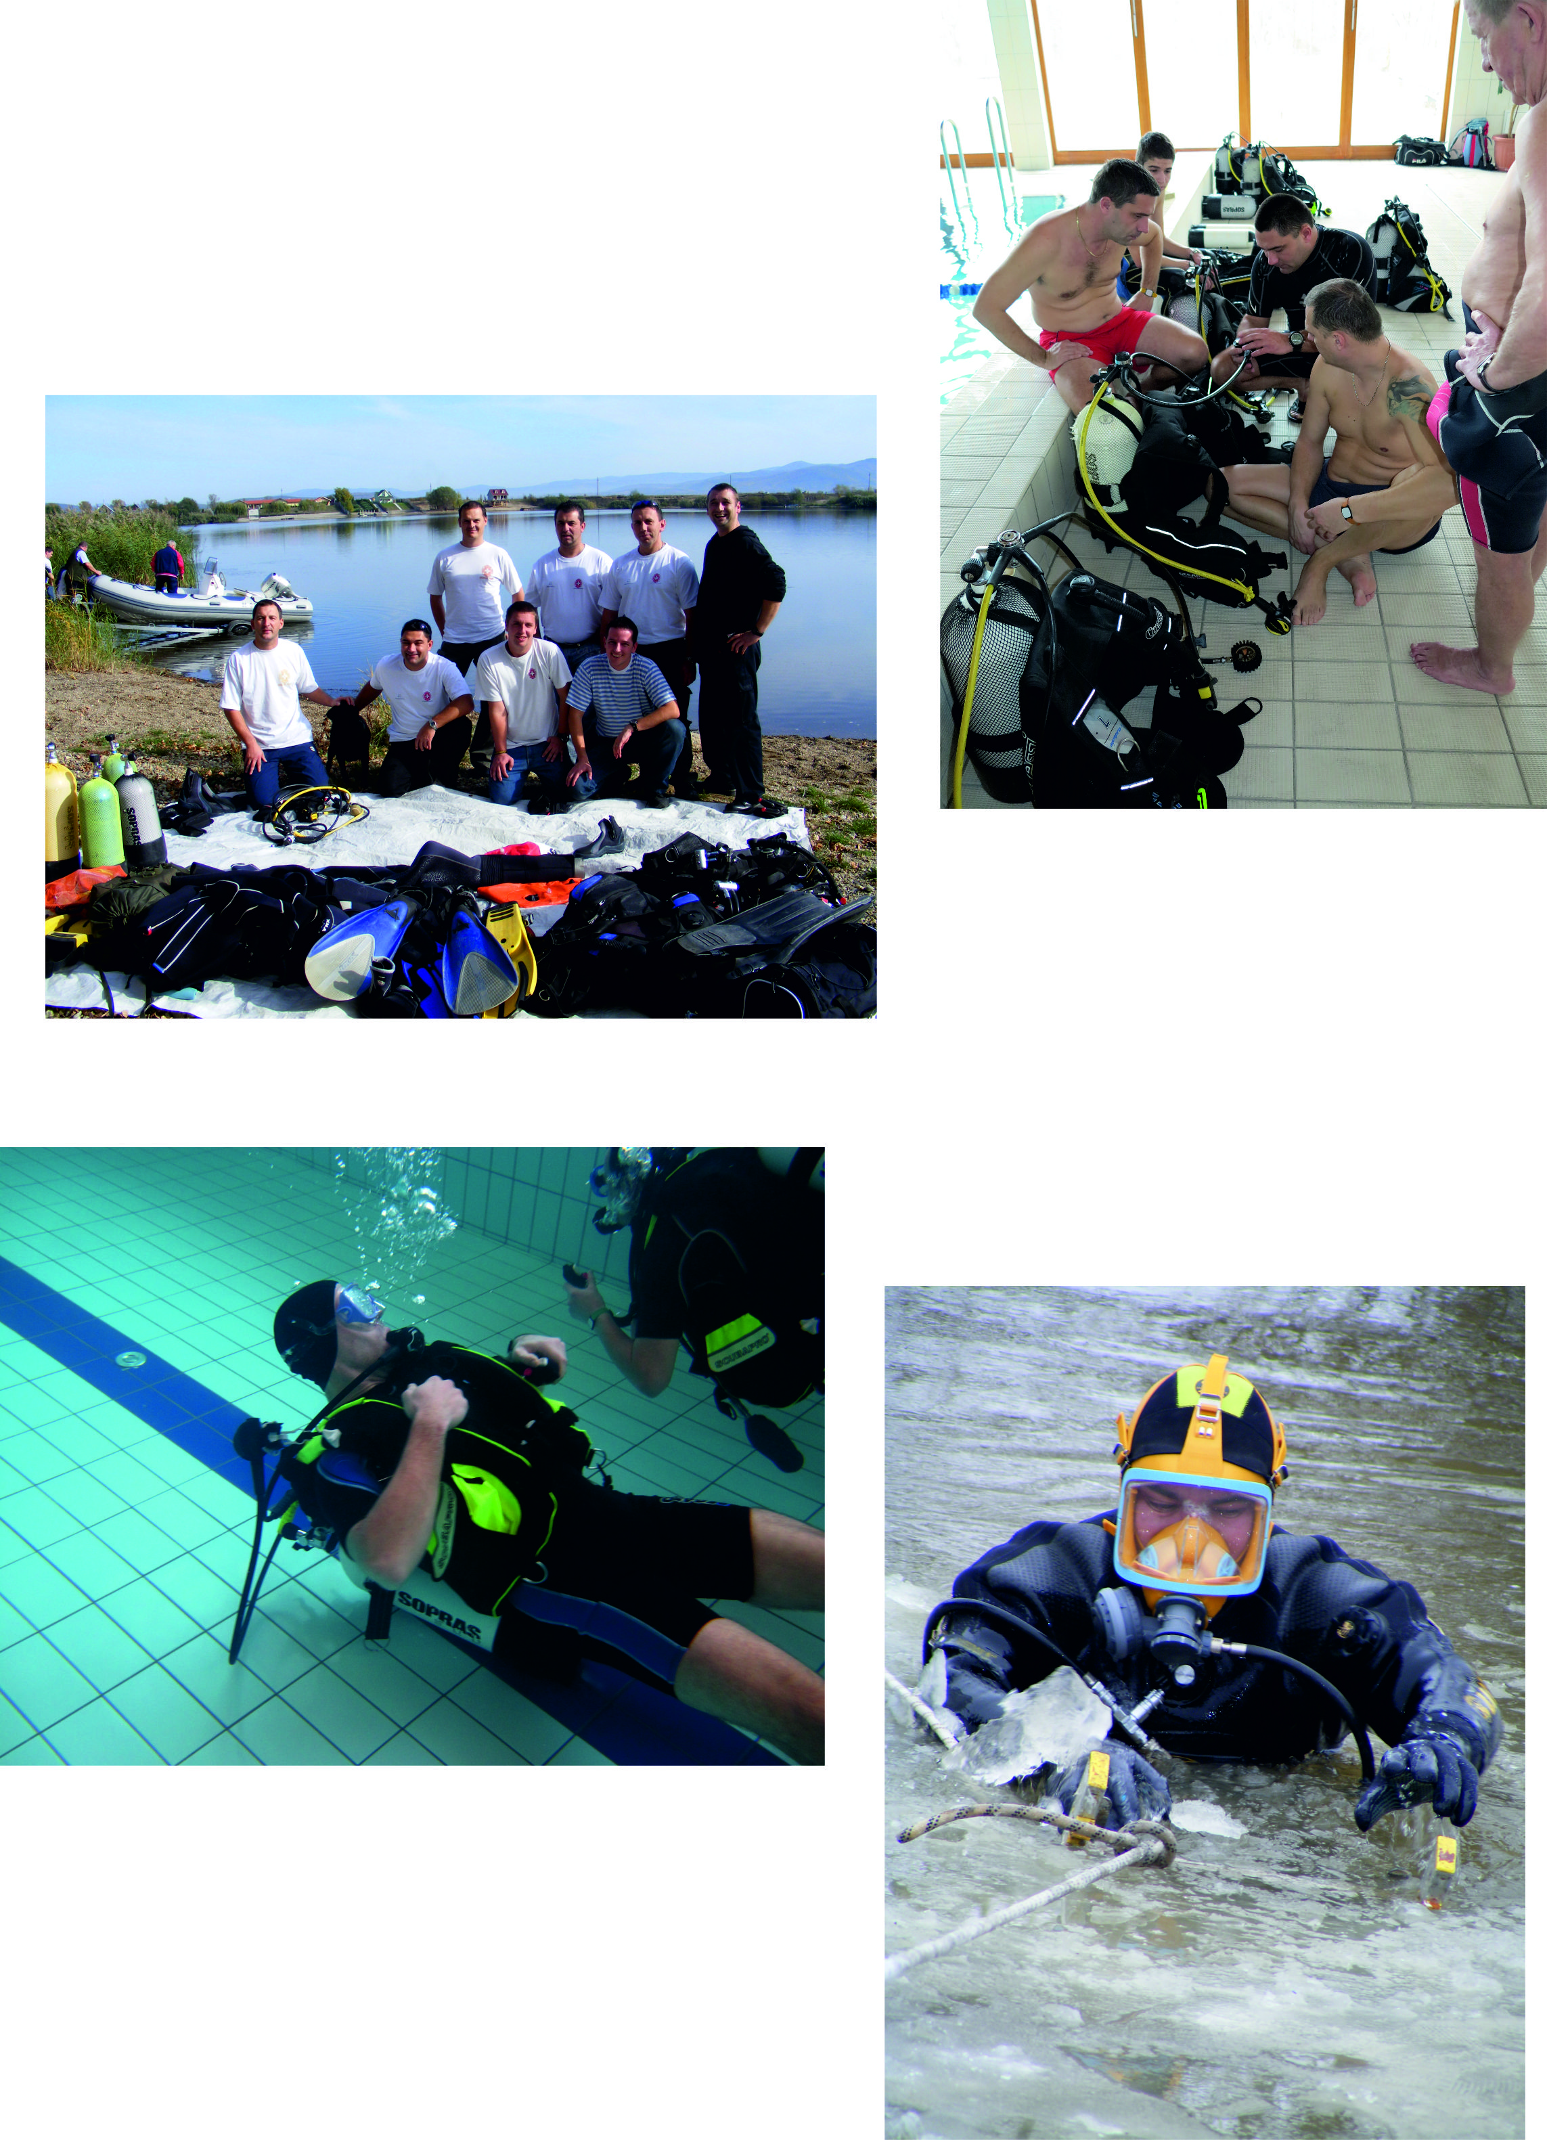
Follow up
Actions to be continued or maintained:
C. Elaboration of the Common Intervention Plan (CIP) and Establishment of the Cross-Border Crisis Team (CBCT): It should be constantly tested and improved.
E. Trainings and small scale exercises for the public and private rescue teams and support organizations: The common exercises should continue, in order to be able to constantly test the interoperability and cooperation issues.
F. Elaboration of a cross-border local resource database for emergency situations: It should be annually checked for the availability of the resources and updated.
G. Elaboration of a feasibility study for an autonomous communication system: If the study exists, it should be set up, tested and implemented for operation.

Slide 11
THANK YOU !
Brussels,
20th of January, 2015

