Slide 1
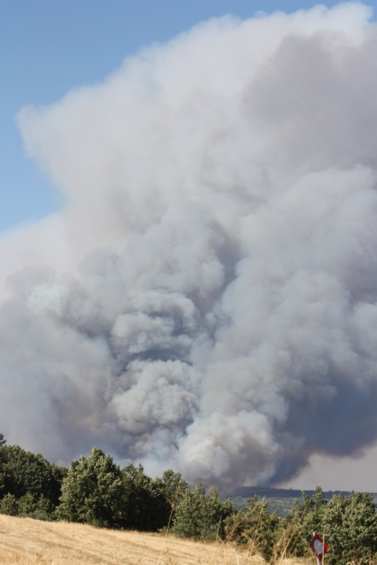
Spanish-Portuguese Meteorological Information System for Trans-Boundary Operations in Forest Fires
Agreement number ECHO/SUB/2014/693768

Slide 2
Spanish-Portuguese Meteorological Information System for Trans-Boundary Operations in Forest Fires
OBJECTIVES:
Improve information interchange on meteorology and fire risk in the area of the boundary between Portugal and Spain;
Harmonise products in the border area of both countries to increase efficiency of trans-boundary forest fires fighting;
Exchange and harmonize weather information, including the contents of fire risk indices.
FINANCING PLAN:
Total Costs: EUR 663,614
Requested EC contribution: EUR 497,711
Consortium own contribution: EUR 165,903
Kick-off meeting – Brussels January 20th, 2015

Slide 3
Spanish-Portuguese Meteorological Information System for Trans-Boundary Operations in Forest Fires
CONSORTIUM
Association for the Development of Industrial Aerodynamics (www.adai.pt)
Portuguese centre of studies with expertize on forest fires and related subjects
Portuguese Institute of the Ocean and Atmosphere (www.ipma.pt)
National institute for meteorological issues
National Civil Protection Authority (www.prociv.pt)
Portuguese Authority for civil protection activities including forest fires
National Meteorological Agency (www.aemet.es)
Spanish Agency for meteorological issues
Meteogrid – Meterological Sevices (www.aemet.es)
Spanish private firm dedicated to studies related to meteorology including forest fire risk indices
Kick-off meeting – Brussels January 20th, 2015

Slide 4
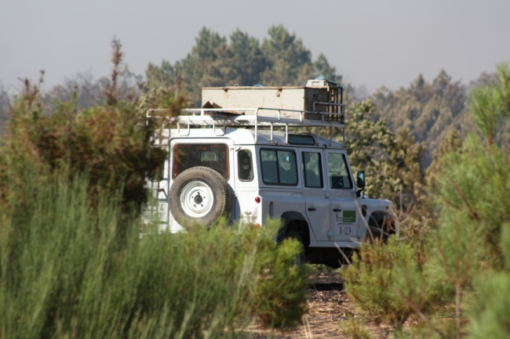
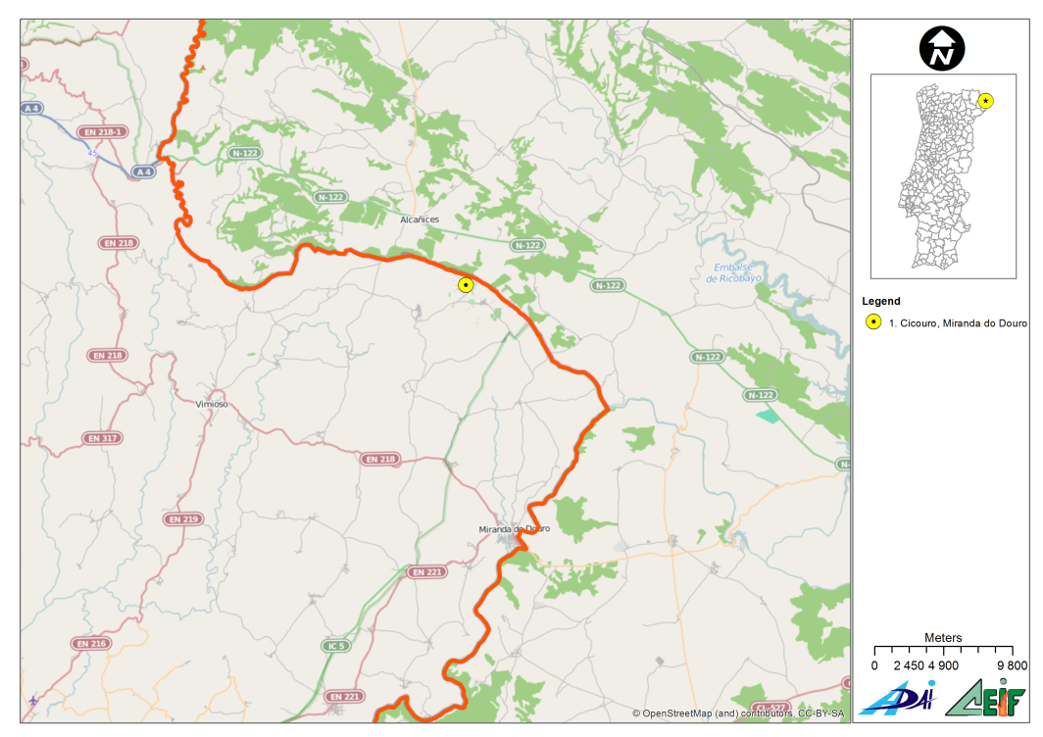
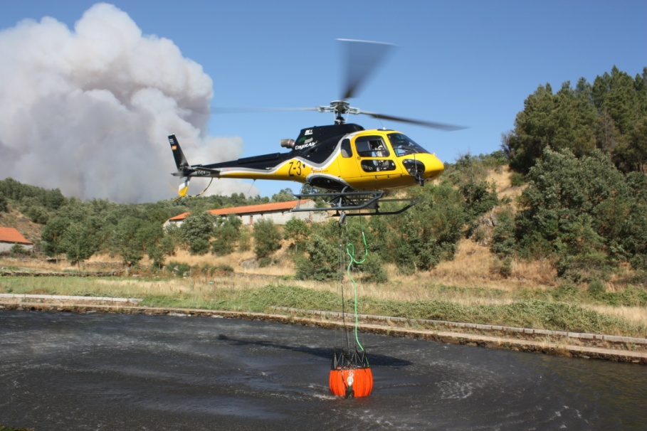
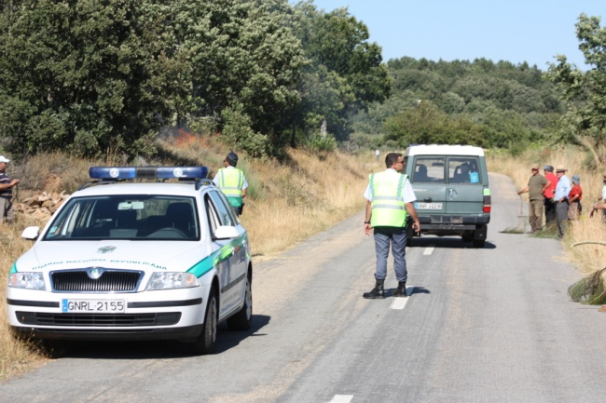
Spanish-Portuguese Meteorological Information System for Trans-Boundary Operations in Forest Fires
Fire of Cicouro, 1st August 2013
POTENTIAL END USERS
Portuguese Civil Protection Entities and Private Fire fighting Agencies: ANPC, GIPS, Afocelca, Fire fighter Corporations.
Spanish Civil Protection Entities and Private firefighting Companies: Magrama, UME, Regional Civil Protection.
Portuguese and Spanish Weather Forecast Agencies: IPMA, AEMET
Regional and Municipal Authorities.
Kick-off meeting – Brussels January 20th, 2015

Slide 5
Spanish-Portuguese Meteorological Information System for Trans-Boundary Operations in Forest Fires
WORKFLOW DIAGRAM
T01
Requirement analysis, survey and assessment on
existing services, system specifications
T02
Information collection and data repository
T08
Project Management and Reporting to the
Commission
T07
Publicity and communication
T03
Common Fire Weather Indexes
T04
Platform development and implementation
T05
Training and operational implementation
T06
International training and interchange workshops

Slide 6
Spanish-Portuguese Meteorological Information System for Trans-Boundary Operations in Forest Fires
GANTT DIAGRAM
 |  | 01 | 02 | 03 | 04 | 05 | 06 | 07 | 08 | 09 | 10 | 11 | 12 | 13 | 14 | 15 | 16 | 17 | 18 | 19 | 20 | 21 | 22 | 23 | 24
T01 | Requirement analysis, survey … system specifications |  |  |  | D | D |  |  | D
A.01.01 | Existing services and protocols
A.01.02 | Requirements for common fire risk indices.
A.01.03 | Common platform requirements.
A.01.04 | System specifications.
T02 | Information collection and data repository |  |  |  |  |  |  |  |  |  | D
A.02.01 | Survey of existing data sources
A.02.02 | Data Collection & harmonization
A.02.03 | Dynamic data generation
A.02.04 | Data fitting and integration – data repository
A.02.05 | Regulatory framework analysis
T03 | Common Fire Weather Indices |  |  |  |  |  |  |  |  |  |  |  |  |  |  |  |  |  |  |  |  |  |  | D
A.03.01 | Development of common weather based fire risk index
A.03.02 | Development of common fire risk potential indices
A.03.03 | Statistical testing of fire risk indices
T04 | Platform development and implementation |  |  |  |  |  |  |  |  |  |  |  |  |  | D |  |  |  |  |  |  |  | D | D
A.04.01 | System adaptation and new functionalities integration.
A.04.02 | Portuguese and Spanish meteorological data integration.
A.04.03 | Services development and integration in user platform(s).
A.04.04 | Operational validation in real fire campaigns.
T05 | Training and operational implementation |  |  |  |  |  |  |  |  |  |  |  |  |  |  |  | D |  |  |  |  | D |  |  | D
A.05.01 | Development of specific protocols and operational guidelines
A.05.02 | Operational cross-training activities.
A.05.03 | Operational implementation of protocols.
T06 | International training and interchange workshops |  |  |  |  |  |  |  |  |  |  |  |  | D |  |  |  |  |  |  |  |  |  |  | D
T07 | Dissemination activities | D | D |  |  |  |  |  |  |  |  |  |  |  |  |  |  |  |  |  |  |  |  |  | D
T08 | Project coordination | D |  |  |  |  |  |  | D |  |  |  | D |  |  |  | D |  |  |  |  |  |  |  | D

Slide 7
Spanish-Portuguese Meteorological Information System for Trans-Boundary Operations in Forest Fires
SUMMARY OF THE ACTION PLAN
Inception Phase
(2 months)
Implementation
(20 months)
Closure Phase
(2 months)
-Cooperation agreement signed with all partners;
-Resource mobilization;
-Kick-off meeting;
-Establishment of Steering Commitee and AWP No 1;
-Design and set-up of monitoring scheme.
On-going execution
-Provision of human, financial and material resources;
-Implementation of activities service delivery;
-Results achieved;
-Performance and progress monitoring;
-Revision of work plans;
- Progress reports.
Progressively:
-Assure Sustainability Plans and defined and in place;
Transfer of ownership (if applicable);
-Preparation of final external evaluation (ToR drafting and consultant contracted);
-Final Reports for the EC (technical and financial).
Kick-off meeting – Brussels January 20th, 2015

Slide 8
Spanish-Portuguese Meteorological Information System for Trans-Boundary Operations in Forest Fires
PROJECT STRUCTURE AND ORGANIZATION
Steering Committee
- Meets three times a year
- Approves AWP
- Provides strategic guidance
Composition
- Senior Member of ADAI (Applicant)
- 1 Senior representative from each partner
ECHO
Reports
Request for payments
Enquiries
Strategic guideline
Reports
Project Coordinator (ADAI)
- Coordinates the work of all actors
- Reports the Steering Committee
- Prepares AWP in cooperation with the Technical Team
- Quarterly progress reports
- Progress Reports for ECHO
MONITORING & EVALUATION Committee
- Meets three times a year
- Contributes to quarterly progress reports and reports to ECHO
- Implements and supervises M&E Scheme
Composition:
- 1 Representative from each Partner
Assistance
Reports
Technical Team
- Implementation of activities
- Leadership of tasks and actions
External experts
Monitoring Technical Assistance
Consultant Final Evaluation
Kick-off meeting – Brussels January 20th, 2015

Slide 9
Spanish-Portuguese Meteorological Information System for Trans-Boundary Operations in Forest Fires
EXPECTED RESULTS:
Analysis of the existing information and data sources, formats, and mechanisms (weather station networks, spatial resolution, temporal resolution, fire risk indices, etc.).
Based on the SIMIF Spanish system, an extension of this service will be designed, developed, calibrated, validated and implemented in the trans-boundary area of influence of both countries, including data, thematic maps and risk indices obtained from both countries.
Organization of training sessions and workshops to disseminate the results among the operational community (PT- SP and for other trans boundary areas).
1st workshop – Preliminary results and arrangements (M11-M13)
Operational cross-training activities (M20-M23)
Operational implementation of protocols (M21-M24)
2nd workshop – Exhibition of final results (M22-M24)
Kick-off meeting – Brussels January 20th, 2015

Slide 10
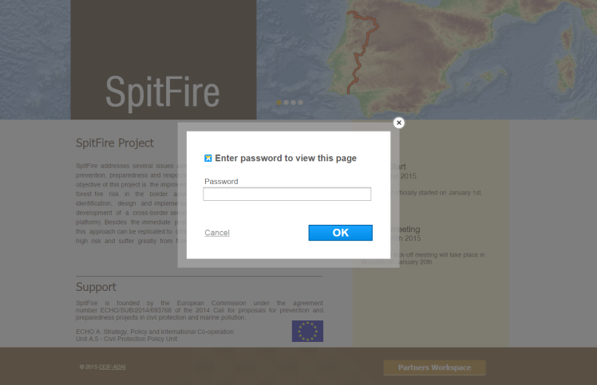
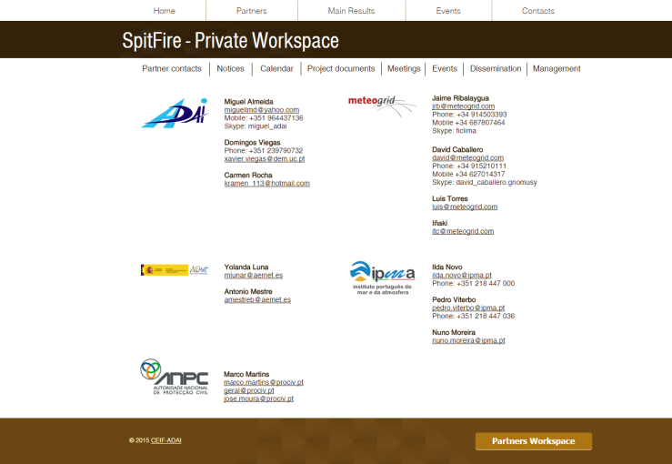
Spanish-Portuguese Meteorological Information System for Trans-Boundary Operations in Forest Fires
SPITFIRE WEBSITE
http://adai.pt/spitfire
Kick-off meeting – Brussels January 20th, 2015

