Slide 1
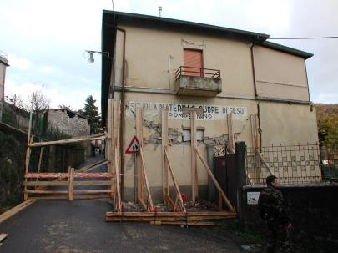
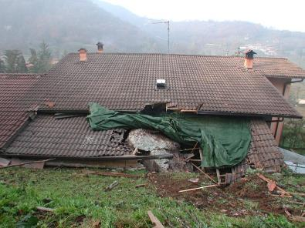
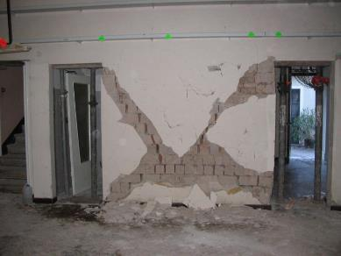
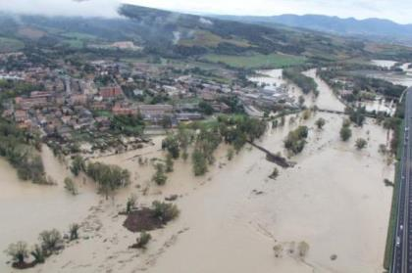
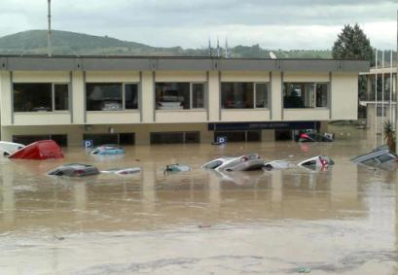
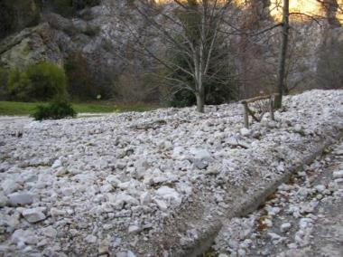
IDEA
Improving Damage assessments to Enhance cost-benefit Analyses
Call Identifier: Prevention 1. Actions on the economics of investing in disaster risk prevention, including costs and benefits of risk prevention measures, and the “risk-proofing" of public and/or private investments and strategies.
Scira Menoni and Francesco Ballio – Politecnico di Milano on behalf of the IDEA Consortium

Slide 2
Project partners in the Consortium:
4 partners + the coordinator from 3 Member States; 3 Research Institutions and 2 Regional Civil P
rotection Authorities

Slide 3
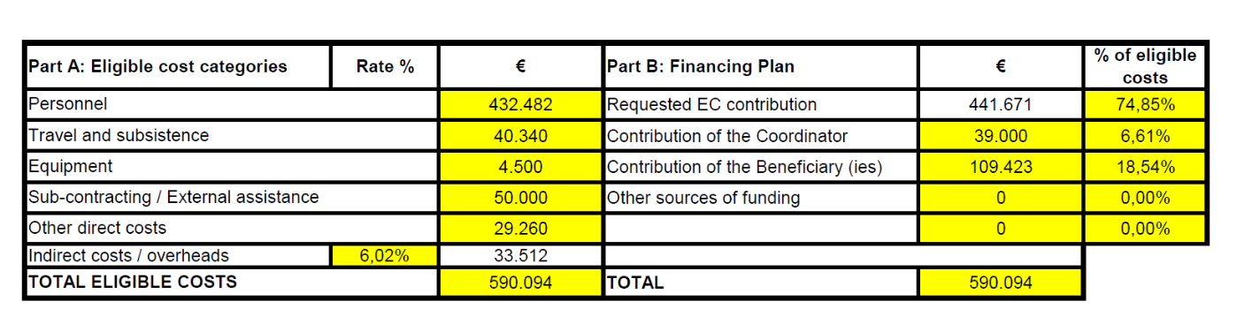
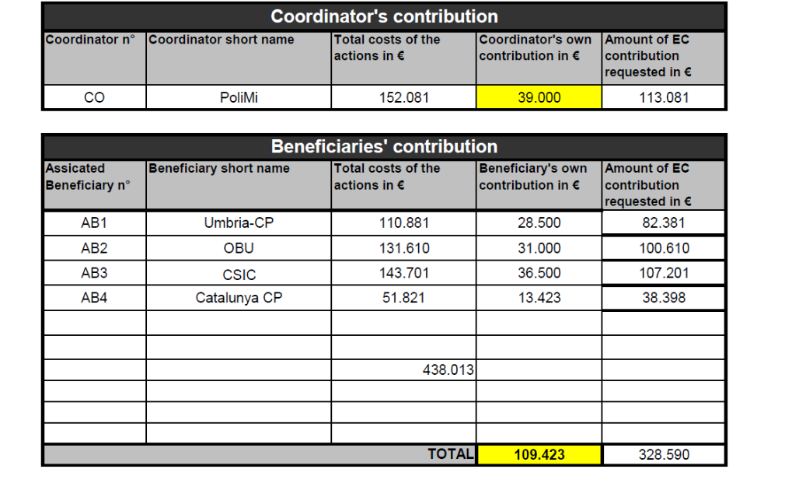
Budget of the action

Slide 4
Rationale and motivation of the IDEA project
The proposal is aimed at improving current practices in data collection, storing, and use to support enhanced and more reliable cost benefit analyses in the field of natural hazards mitigation. The project aims at having an impact on the international initiatives currently ongoing on the issue, for example the IRDR with the Peril classification and particularly the JRC technical group working on the improvement of losses databases at the European level.
Objectives of the IDEA project
Support more effective mitigation measures in the aftermath of a disaster, by analysing damage data according to a forensic perspective.
Show how better data may better inform pre-event risk modelling, so as to develop more reliable cost benefit analysis of measures that are taken today to prevent a future disaster.
Focus on damage to critical infrastructures and economic activities as key to identify the impact of a disaster on the economy of the affected region.
Develop tools that will enable public administrations to manage damage and losses data for multiple purposes: compensation, forensic investigation to guide recovery, better risk assessments for future events, to feed more reliable cost benefit analyses of mitigation measures.

Slide 5
Rationale and motivation of the IDEA project
The framework below is based on the one developed by the JRC technical working group (De Groeve, K. Pljansek, D. Erlich, Recording disaster losses, JRC, 2013)

Slide 6
Rationale and motivation of the IDEA project
Conceptual link between pre- and post- event damage assessment and cost benefit analysis of both pre- and post- disaster mitigation measures (prevention and recovery)

Slide 7
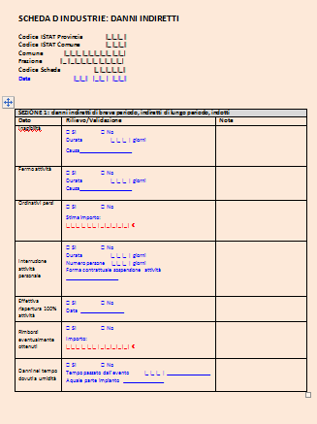
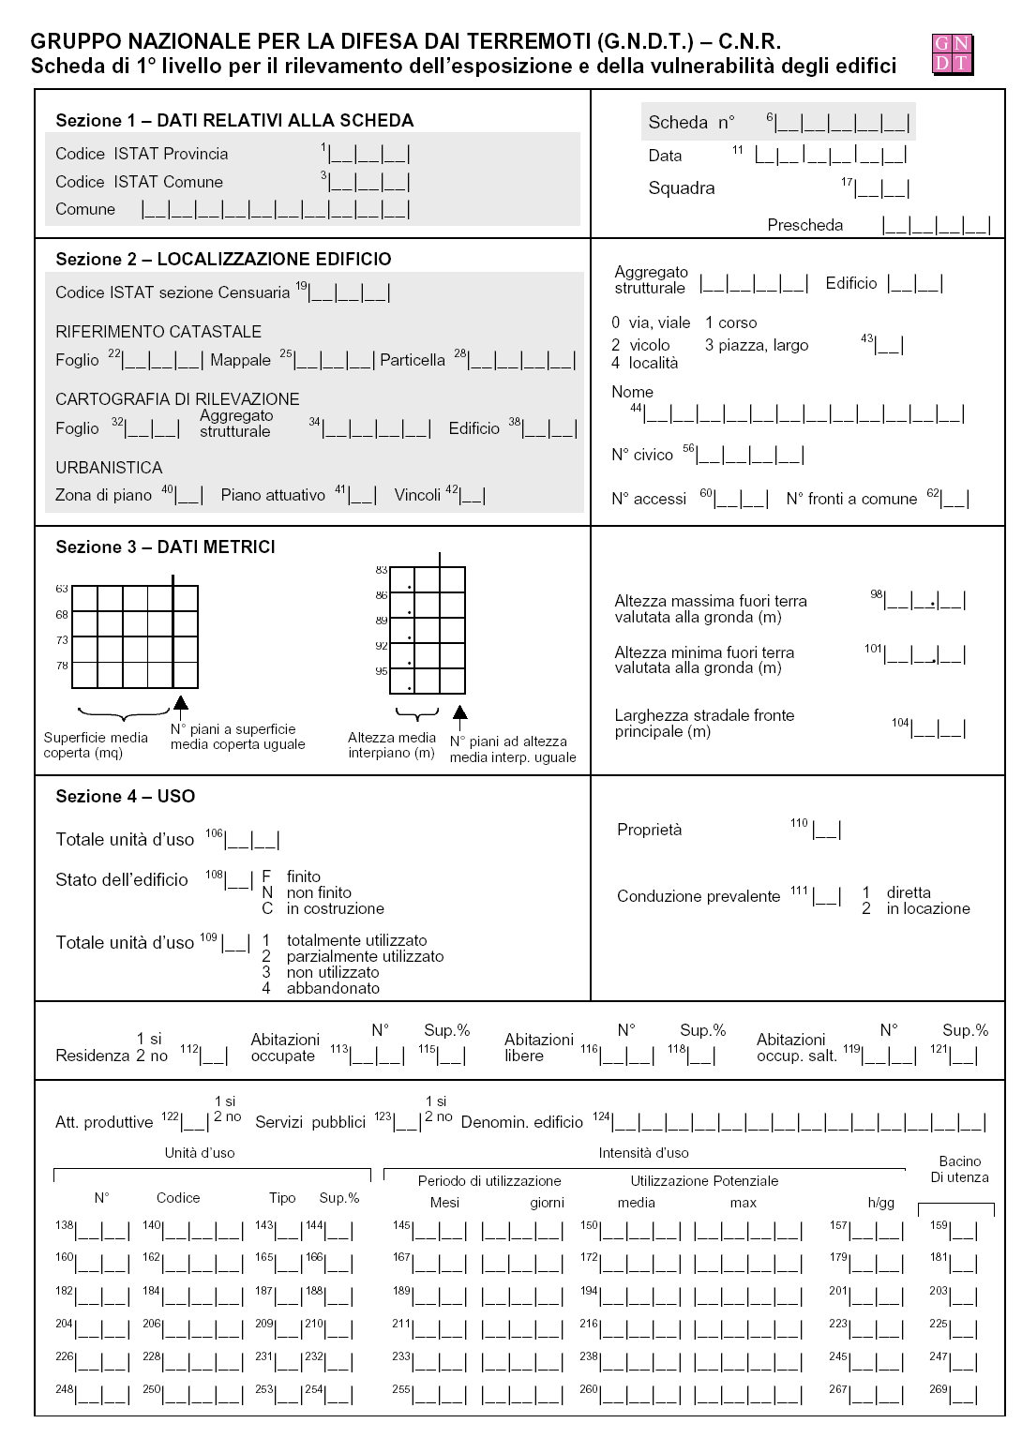
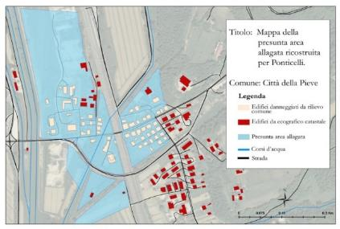
Rationale and motivation of the IDEA project: having an impact
The project aims at having an impact on the international initiatives currently ongoing on the issue, for example the IRDR with the Peril classification and particularly the JRC technical group working on the improvement of losses databases at the European level.
The project will apply methodologies and IT systems partially developed in previous work with public administrations and partially to be developed in the next two years to case study areas (Lorca, Catalunya, Umbria Region, Severn Catchment), with the aim of having an impact in the areas and the countries of the latter (UK, Spain, Italy).
The project ambition is to share with many more stakeholders of both involved countries and other Member States the developed methodologies and IT systems to support enhanced damage and losses data collection and analysis practices.

Slide 8
Project structure: tasks in the green boxes relate to activities sustaining the entire project.
Task A Preliminary task
Identification of key stakeholders; selection of types of damages and losses to consider in the project; critical assessment of currently used procedures for damge data collection; collection of data for the case study areas.
Task B Linking collected data to forensics
a. Forensic investigation of the events for which data is available in the case study areas.
b. Cost benefit analyses of some proposed recovery investments
Task C. Linking collected data to the financial forms of compensation
a. Description of the use of damage and losses data for compensation under different financial arrangements.
b. Workshop with stakeholders to assess if and how data can satisfy both compensation requirements and forensic investigation
Task D. How to link post-damage estimation to pre-event risk assessment
a. Comparing post-event damage data with pre-event risk scenarios.
b. Cost/benefit analyses of a selection of mitigation measures that could have been implemented before the impact.
Task F Publicity
Workshops that will be organised with stakeholders relevant in the damage and losses data colelction and management at differnt stages of the project; project website.
Task G Managmeent
Managemetn of he project; production of reports and meetings minutes
Task E. Design of the architecture of the information system to collect, store, manage, and query damage and losses data
Designing the conceptual architecture of an information system structuring the logic flow of data to be collected, stored, memorised, queried and analysed by different stakeholeders to support the generation of full event reports, damage compensation, forensic investigation, and risk modelling. Key recommendations to the EU Commission on the feasibility of proposed changes in damage data collection procedures and tools.

Slide 9
Project structure: deliverables in the last column, this and the following slide

Slide 11
Expected meetings and workshops of the project.
Basically two international workshops one in April 2016 and the second in September 2016 and a number of meetings with relevant stakeholders

