Slide 1
Improving Preparedness to Face HNS Pollution of the Marine System
2014 CALL FOR PROPOSAL PREVENTION AND PREPAREDNESS
Agreement Number – ECHO/SUB/2014/693705
Brussels, January 20th 2015
Sebastien Legrand, Ph.D.
Head of Belgian Marine Forecast Centre
Royal Belgian Institute of Natural Sciences
Operational Directorate Natural Environment
Notes:
Portada

Slide 2
HNS = Harmful and Noxious Substances
2000+ HNS transported by sea
bulk or packaged form
Transported volumes always increasing
Number of reported spills exponentially increasing
Large variety of chemical and physical behaviours
(Source: EMSA, 2013)
HNS spills, a major threat for marine environment,
maritime safety and civil protection.

Slide 3
HNS-MS objective & expected results Developing an operational decision-support tool for HNS spills in the Bonn Agreement area and Bay of Biscay
A HNS data base with physicochemical parameters suitable for computing fate of HNS spilt at sea
GIS layers for environmental and socioeconomic HNS-sensitive resources
A 3-dimensional HNS spill drift and fate model
A user-friendly web-based tool accessible 24/7 by Coastguard stations
Notes:
MARCIS (~200), GESAMP (1404), MIDSIS-TROCS from REMPEC (672)

Slide 4
HNS-MS Partnership
A 2 year project from 01/01/2015 till 31/12/2016
Total budget : 645.283,00€ / Total EC contribution : 483.963,00 € (75%)
1. Royal Belgian Institute of Natural Sciences (ex. MUMM)
Operational marine forecast, including oil spill / Marine Chemistry /
Web & App / EIA & monitoring in case of pollution of the marine system
2. Centre de documentation, de recherche et d’expérimentation sur les pollutions acciedentelles des eaux
Large knowledge on HNS (SEBC – MAR-ICE) /
Marine Chemistry facilities for HNS / Response / Socio-economic impact
3. Ecoles des mines d’Alès
Expertise in risk management / CLARA, a first HNS drift and fate model /
Lab facilities / MAIA HNS data base
4. Alyotech
Consulting in technology, including oceanographic modelling /
Modelling experience in blow-out & gas dilution in marine environment
5. Belgian DG-Environment
Belgian Maritime Authority / Outreach towards stakeholders including
Bonn Agreement / End users of the HNS-MS decision-support tool.

Slide 5
Project resume
HNS-MS work flow

Slide 6
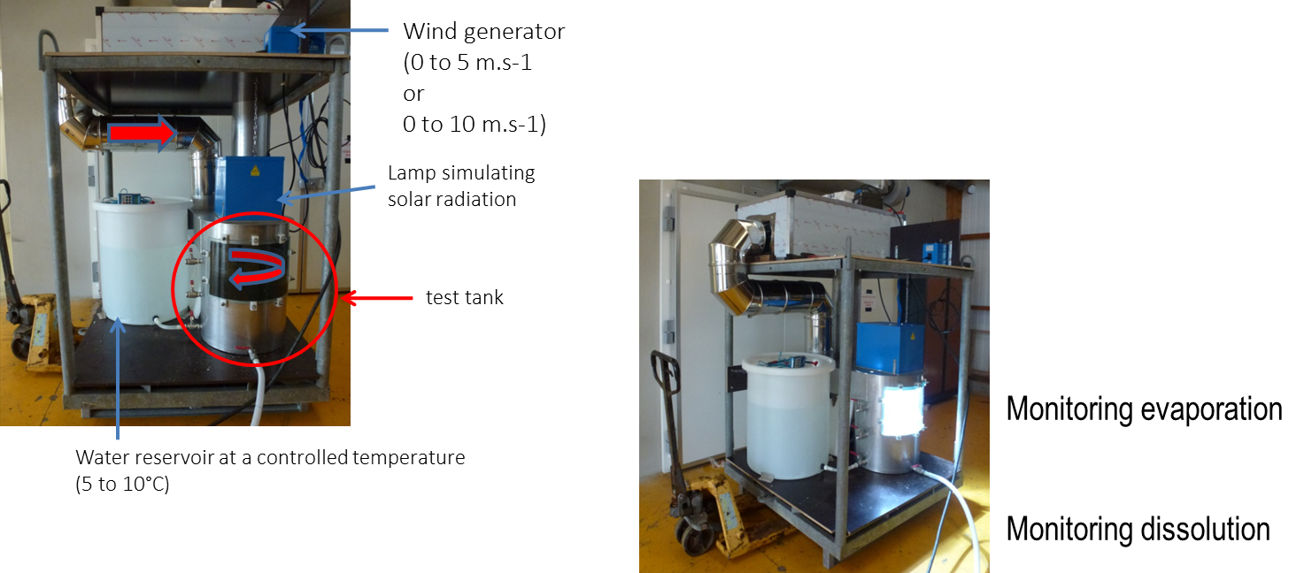
Task C – HNS at the sea surface
Elaborate a list of the top 100 HNS for BA area and Bay of Biscay taking into account traffic data, accidental data, hazard level and HNS characteristics as reported in previous work (BE-AWARE, MARCIS, GESAMP, MIDSIS-TROCS/REMPEC,…)
To experimentally characterise the fate of 20 floaters and evaporators

Slide 7
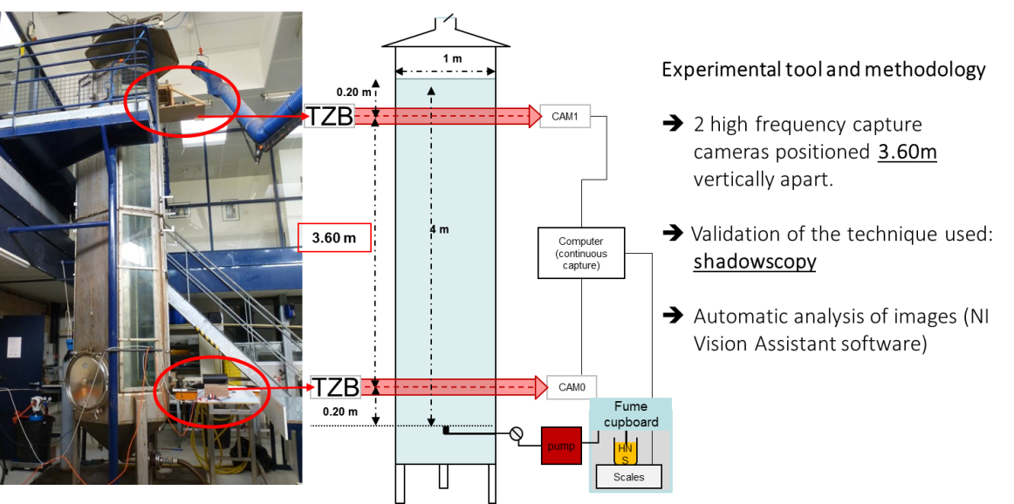
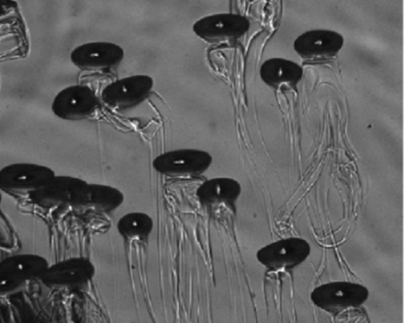
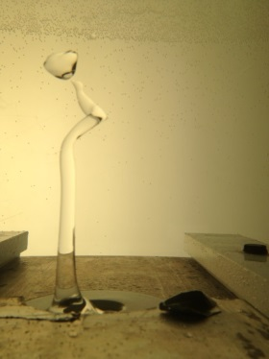
Task D - Behaviour of a chemical compound in the sea water column
To improve the understanding of HNS behaviour in the water column including dissolution processes
To collect relevant observations to model HNS release from wrecks, including the characterization of HNS droplets distribution

Slide 8
TASK E – Field Experiment
To conduct 2 field experiments in order to produce a data set of HNS behaviour at sea suitable for validation purpose.
This data set will then be used
to check the consistency of the observed HNS behaviour in Lab and in the field
to validate the model simulation against realistic data.

Slide 9
TASK F – Modelling HNS drift and fate at sea
To develop an advanced three-dimensional HNS spill drift and fate model at the sea surface and the water column
General parameterisations of HNS behaviour (ARMINES)
Modelling HNS dissolution (Alyotech)
Modelling sinkers behaviour (RBINS)
All these developments will be integrated into the OSERIT model (RBINS)

Slide 10
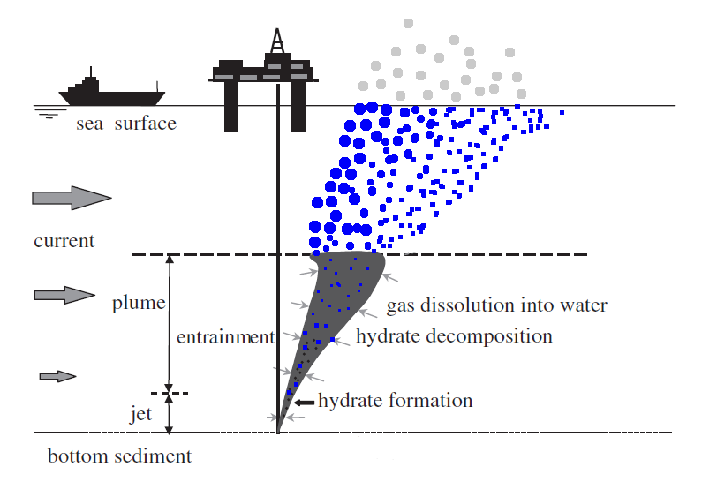
Task G - Simulating the most likely HNS release scenarios in the marine system
Release from the sea surface and shoreline:
collision between two vessels,
illegal discharges from a moving tanker,
Release from a container or a drum adrift,
Release from an industry onshore…
Release in the water column and from seabed
wells, sunken vessels and pipelines

Slide 11
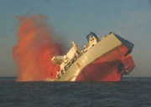
Task H - Atmospheric dispersion model
In case of marine HNS pollution, toxic gas clouds are likely the greatest threat for responders and coastal cities citizens.
This task aims at developing an atmospheric dispersion Gaussian model that is able to predict areas at risk, downwind from the HNS release location.

Slide 12
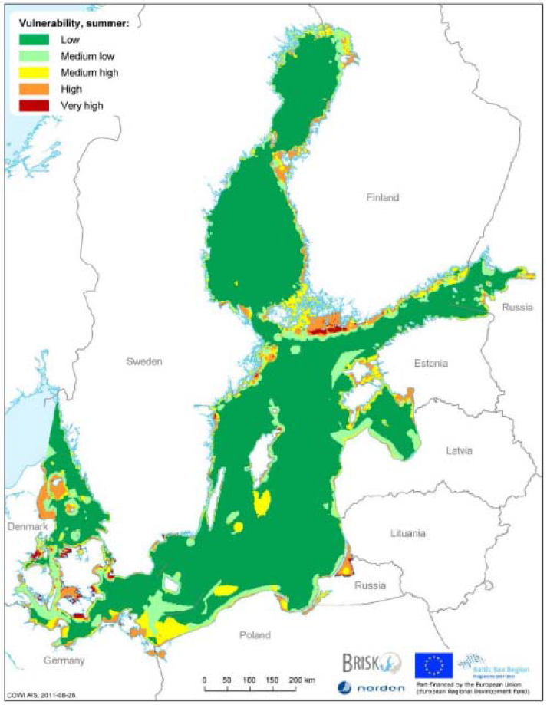
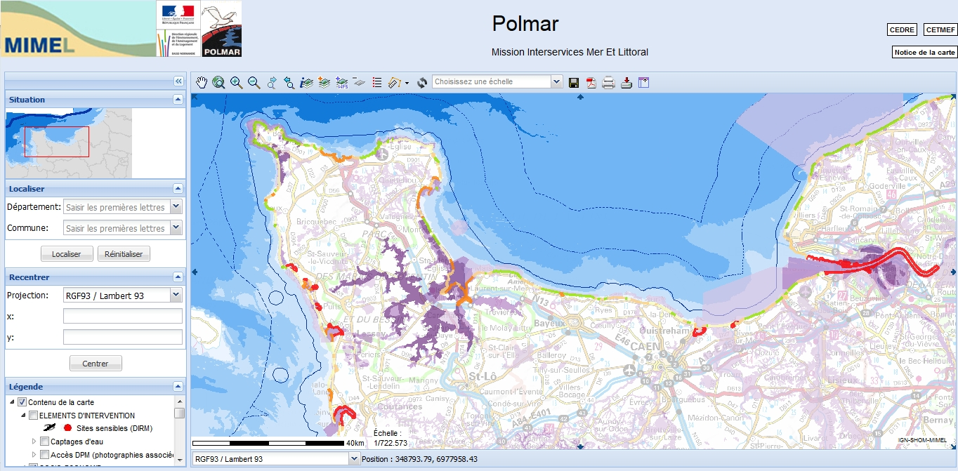
Task I Environmental and socio-economic vulnerabilities
To adapt existing BA (Bonn Agreement) region-wide sensitivity maps to HNS spill scenarios
To determine and prioritise the relevant information to be featured on maps, taking into account what is already available, through the BA region-wide risk assessment project BE-AWARE and also what is implemented in France in the framework of ORSEC-POLMAR plans.

Slide 13
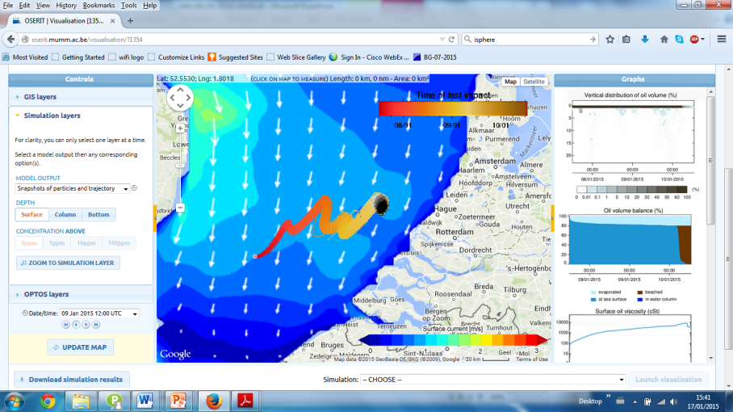
Task J - Decision-support tool
The results and tools obtained in tasks C to I will be integrated into a user-friendly web-based decision-support tool.
This tool will be implemented as a one stop-shop service where coastguard stations and environmental experts will find all the relevant information to evaluate the consequences of a marine HNS pollution.

Slide 14
Deliverables and dates
Major project events
First Tuesday of each month | Teleconference with all members of the HNS-MS steering committee
20/01/2015 | Program kick-off, DG-ECHO, Brussels, Belgium
24-25/02/2015 | Kick-off meeting of the project, Cedre, Brest, France
May 2015 | OTSOPA meeting 2015
January 2016 | Mid-term meeting, Alyotech, Rennes, France
January 2016 | Bonn Agreement’s head of delegation
May 2016 | Report to OTSOPA meeting 2016
December 2016 | Stakeholders meeting, Belgian DG-environment, Brussels, Belgium
December 2016 | Final meeting, Belgian DG-Environment, Brussels, Belgium

Slide 15
Deliverables and dates
Deliverables in 2015
---- : deliverables to EC
April 2015 | Webpage of the project (Task B) first list of HNS substances (Task C)
June 2015 | Specification of the decision-support tool (Task J)
August 2015 | 1st intermediary report on lab experiments (tasks C and D)
31/08/2015 | 1st progress report (Task A)
December 2015 | Report of the first field experiment (tasks E)

Slide 16
Deliverables and dates
Deliverables in 2016
---- : deliverables to EC
March 2016 | 2nd intermediary report on lab experiments (tasks C and D)
April 2016 | Beta version of the modelling codes (tasks F to H)
30/04/2016 | 2nd progress report (Task A)
July 2016 | Final version of GIS layers for environmental and socio-economic vulnerabilities (Task I)
September 2016 | Alpha version of the modelling codes (tasks F to H) Report on the second field experiment (Task E)
October 2016 | Final report on lab experiments (tasks C and D)
November 2016 | Final version of the decision-support tool (Task J)
15/11/2016 | Layman´s report (Task B)
December 2016 | Final version of the modelling codes (task F to H) Decision-support tool implementation report and user-guide (Task J)
28/02/2017 | Final report (Task A)

Slide 17
Follow up
Follow up & continuation after the project ends
RBINS, Cedre and the Belgian DG-environment will use the HNS-MS decision support tool in their operation
ARMINES will use the HNS-MS decision-support tool to train French engineers in risk management
As a whole, the consortium wishes to continue developing the tool
Update of the HNS data base
Tackling the issue of HNS reactivity
As a whole, the consortium wishes to set cooperation with other national agencies and regional agreements in order to
Apply the HNS-MS decision-support tool to other areas
Perform region-wide HNS risk analysis

Slide 18
Thank you for your attention
You may follow our progress at http://www.hns-ms.eu/
Sebastien.legrand@naturalsciences.be

