Slide 1
Portada
URready4OS
Autonomous Underwater Vehicles Ready for Preparedness of Oil Spill
(URready4OS)
2013 CALL FOR PROPOSAL PREVENTION AND PREPAREDNESS
Agreement Number – ECHO/SUB/2013/661056
Brussels, January 22nd 2014
Javier Gilabert Ph.D.
Universidad Politécnica de Cartagena - UPCT
Notes:
Portada

Slide 2
Project resume
● 24 months duration (01/01/2014 – 01/01/2016)
● Total cost: 579.569 € [EC financial contribution: 434.228 € (75 %)]
● 4 Mediterranean Countries Participating
Technical University of Cartagena (Spain)
Prof. Javier Gilabert Ph.D. - Coordinator
University of Porto (Portugal)
Prof. Joao Sousa Ph.D.
University of Zagreb (Croatia)
Prof. Zoran Vukic Ph.D.
Oceanographic Center
University of Cyprus (Cyprus)
Prof. Georgios Georgiu Ph.D.
URready4OS

Slide 3
Objective
Objectives
● To make available to European Civil Protection a fleet of autonomous underwater vehicles (AUVs), unmanned aerial vehicles (UAVs) and unmanned surface vehicles (USVs) with operational capability to intervene against oil spills in European Seas using new cooperative multivehicle robotic technologies.
● Set up a cheap, flexible, expandable, precise and rapid decision support system tool for Civil Protection decision makers that allow the increase of the response since the spill take place until the oil reach the coast.
URready4OS

Slide 4
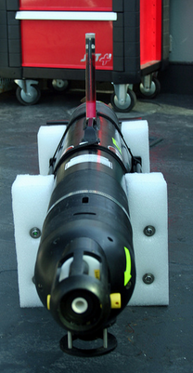
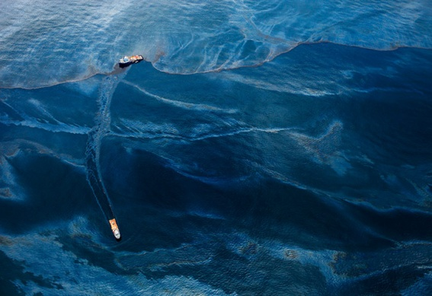
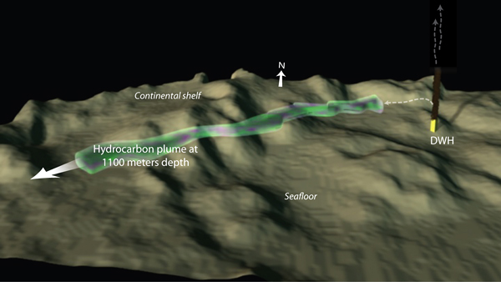
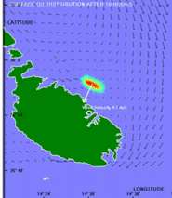
Motivation
Motivation
● Underwater oil plumes form sub-surface patches reaching the surface far away from the spill point.
● A fleet of autonomous vehicle will provide earlier detection and tracking of these plumes to feed numerical models and increase the preparedness to reduce the consequences of the oil spill in the coast.
Picture: Daniel Beltrá
Figure: WHOI
URready4OS

Slide 5
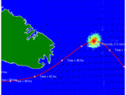
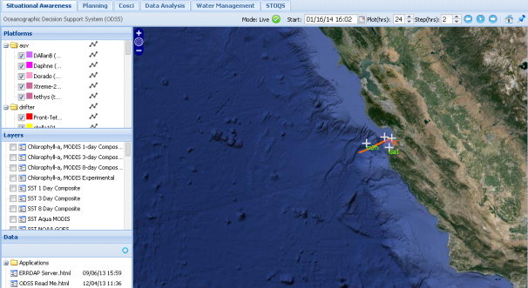
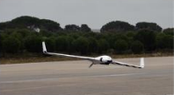
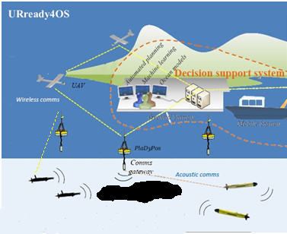
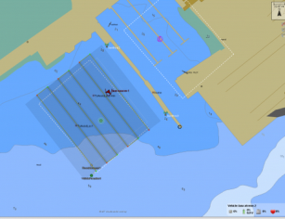
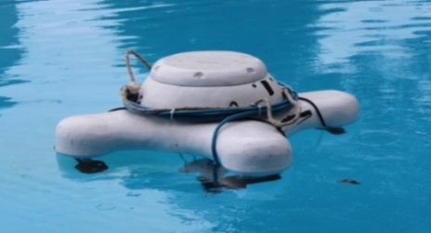
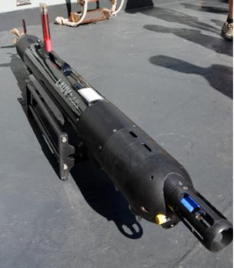
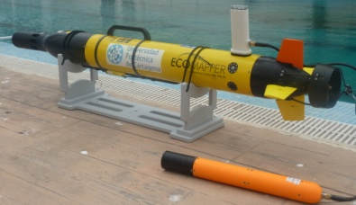
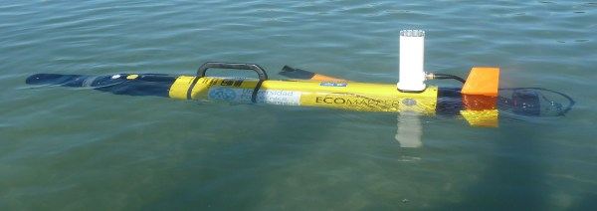
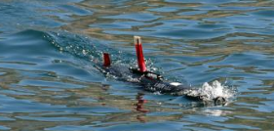
Mean involved
Means Involved
Numerical Models
Decision support system
UAVs
USVs
AUVs
URready4OS

Slide 6
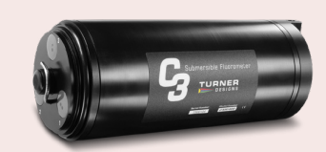
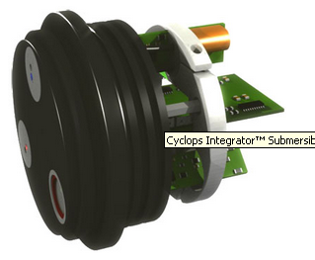
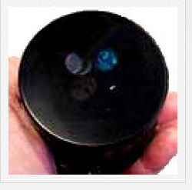
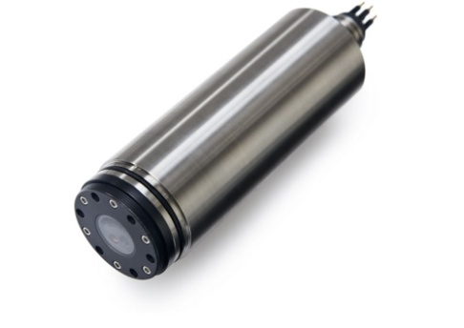
Action1. Probes
Action 1
● Check the performance of existing commercial and
prototypes of oil-in water probes to be integrated into the
AUVs
Turner Cyclops
Integrator
Turner C7
Turner C3
ECO Puck
WET labs
HydroC Contros
URready4OS

Slide 7
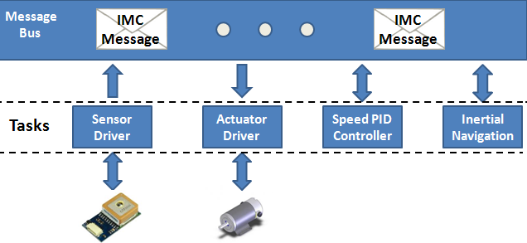
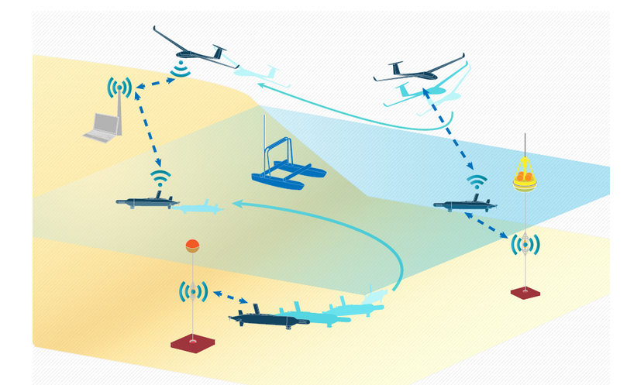
Action2-3. White papers,protocols
Actions 2 and 3
● Design detailed protocols to define and elaborate the “Concept of Operations” (ConOps) for AUV missions against oil spills
● Write a “White Paper” with detailed experience and protocols for rapid intervention of AUVs in collaborative missions
URready4OS

Slide 8
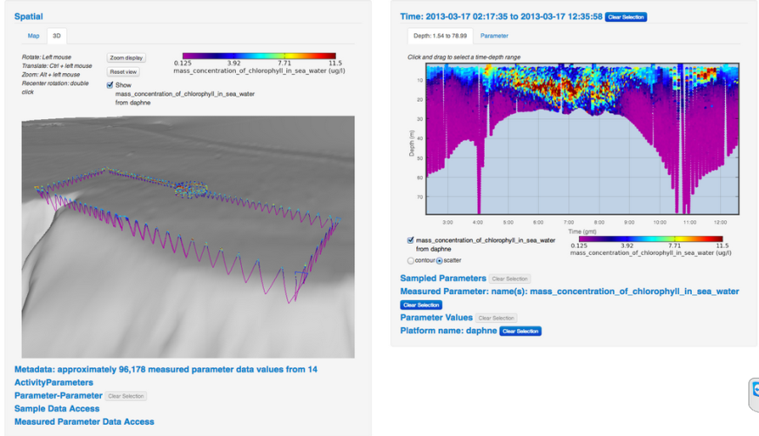
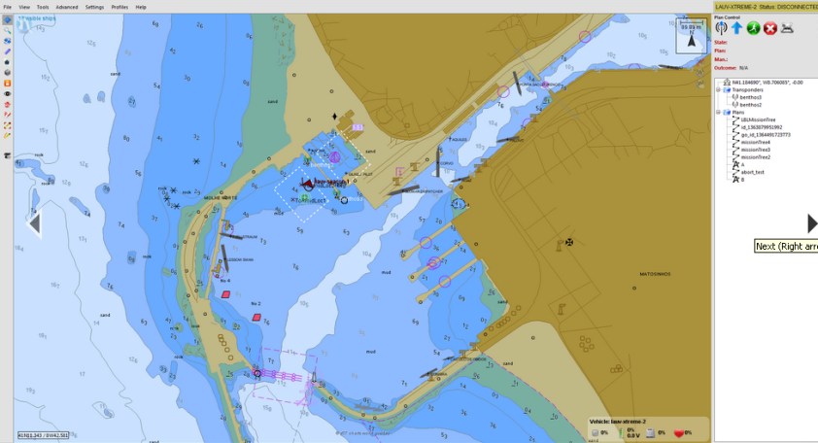
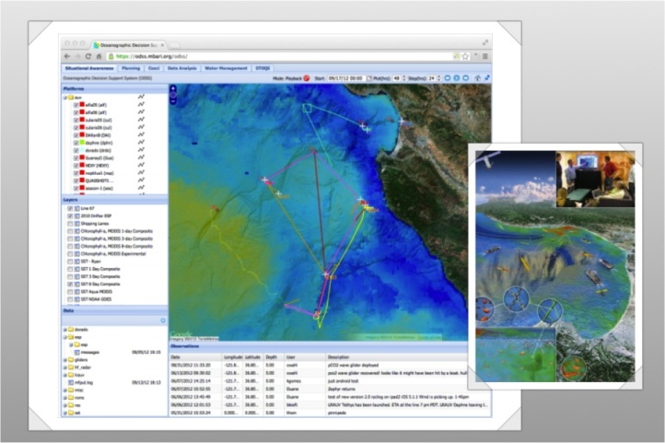
Action2-3. White papers,protocols
Action 4
● Adapt, improve, rewrite and developed novel advanced
algorithms to coordinate multivehicle cooperative missions
● Develop interfaces integrating recorded environmental data
by robots with those obtained by external platforms such as
satellites or buoys
URready4OS

Slide 9
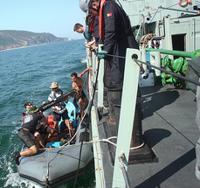
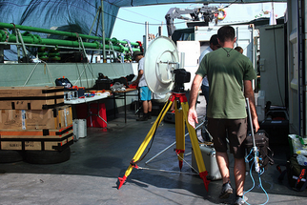
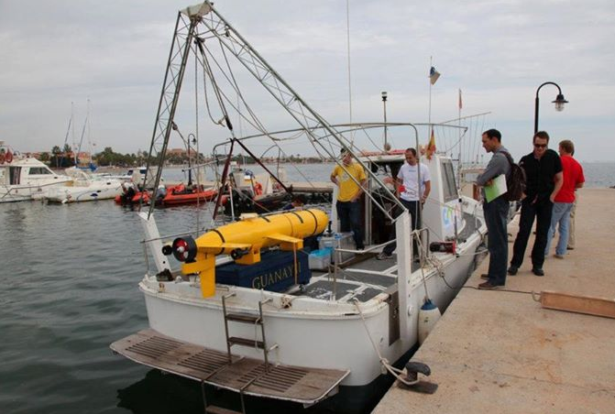
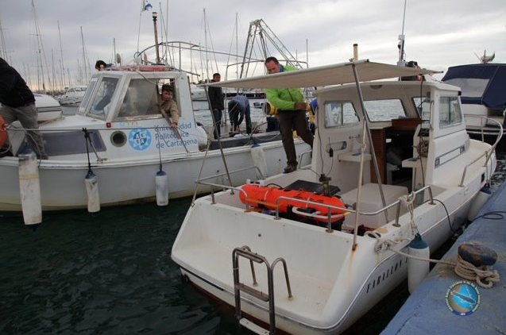
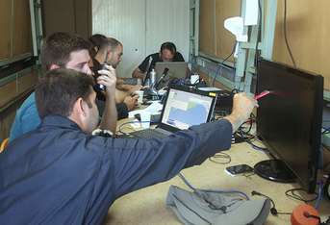
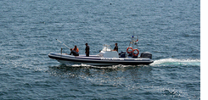
Action4. Preliminary experiment
Action 5
Preliminary experiment
Croatia, 15/27 Sept 2014
Train a fleet of 3 AUVs, 2 UAVs and 3 USVs.
Check and identify weak points in protocols and software
Establish guidelines to define the ConOps for deployment
of robotics assets to oil spill preparedness
URready4OS

Slide 10
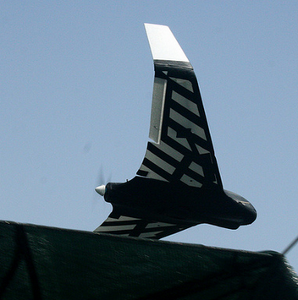
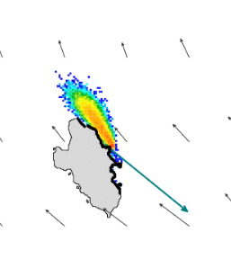
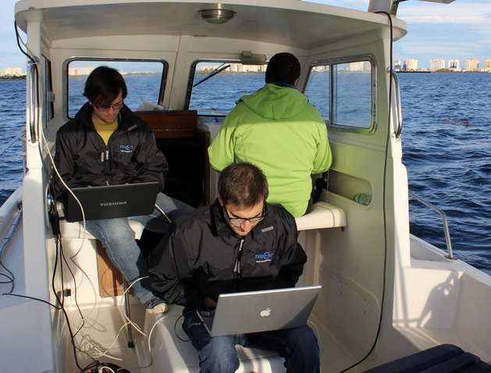
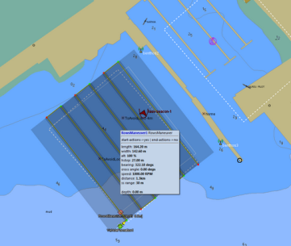
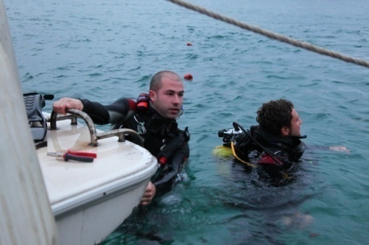
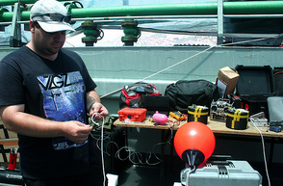
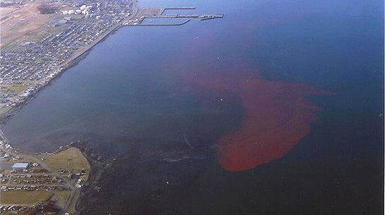
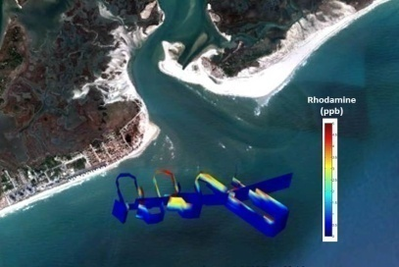
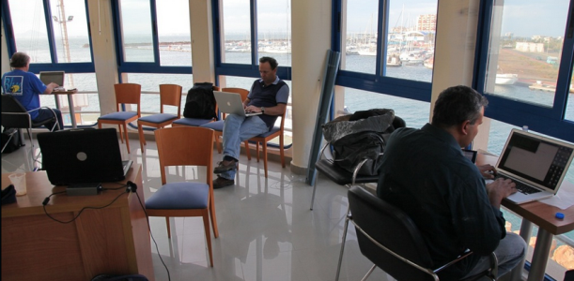
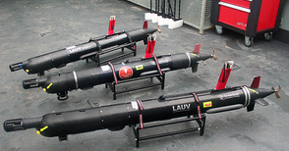
Action4.Demostrative experiment
Action 6
Demonstrative experiment
Spain, May-2015
Check the validity of protocols, ConOps and software developed
Demonstrate the capabilities acquired to European National Civil
Protection authorities and other decision makers.
Picture: Hydrosoft
Figure: UCSD
URready4OS

Slide 11
Deliverables and dates
Deliverables and dates
02/01/14 | Webpage of the project
03/10/14 | AUVs enable to detect oil-in water
07/01/14 | 1st progress report
10/30/14 | Preliminary experiment report Multimedia records of operations and Web and social media coverage
06/20/15 | Demonstrative experiment report Multimedia records of operations and Web and social media coverage
07/01/15 | 2nd progress report
12/01/15 | Protocols for collaborative operations (ConOps) between agents (AUVs, UAVs and USVs) Software for collaborative navigation and communications Software for integration of AUVs trajectories, field data and external sources White paper for oil-in water tracking with agents
12/31/15 | Layman´s report and Project Multimedia
URready4OS

Slide 12
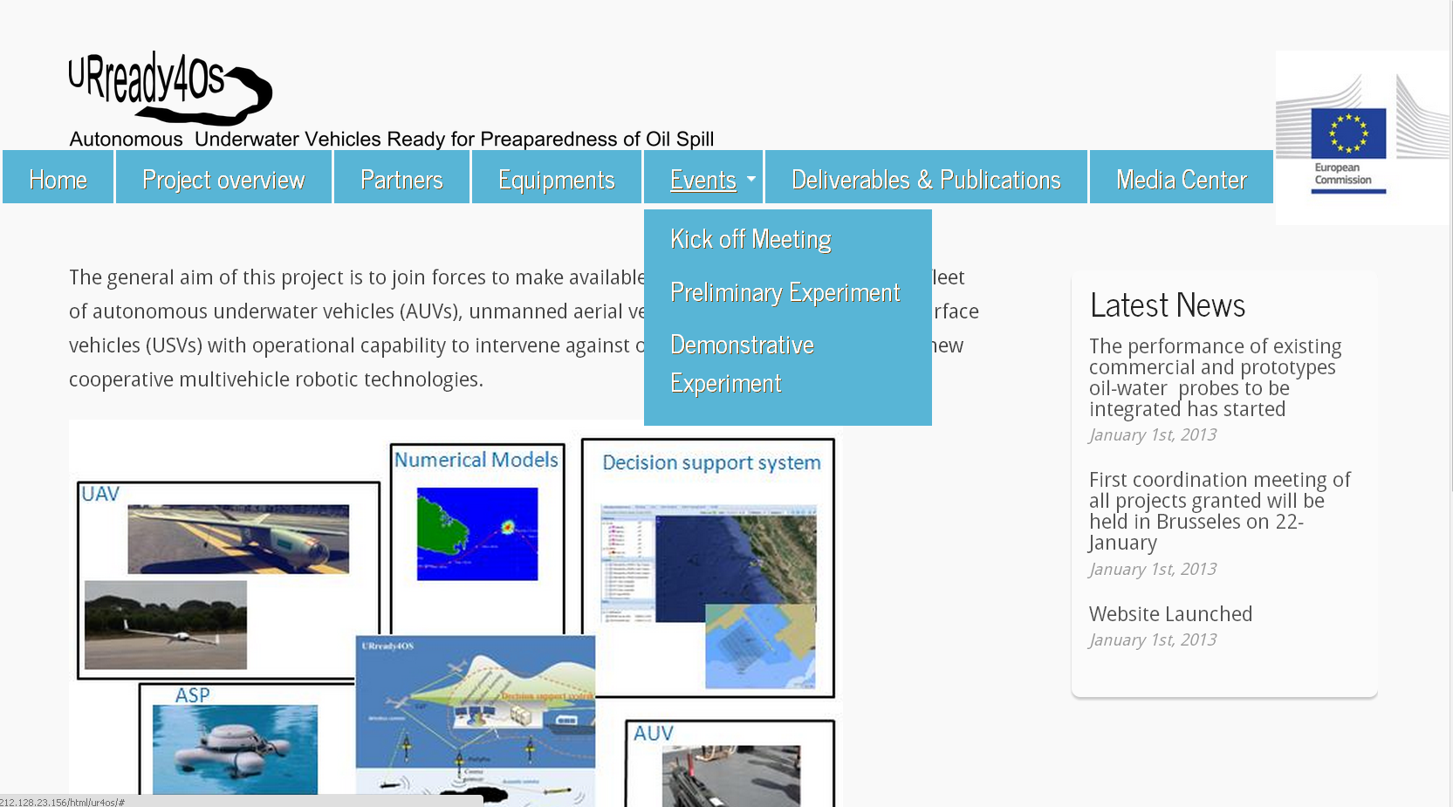
www.upct.es/~ur4os
URready4OS

Slide 13
Expected results
Expected results
● Write a “White Paper” containing detailed guidance and protocols for rapid deployments and operation of a multivehicle collaborative fleet of AUVs to track oil-in water
● Increase preparedness against oil spill by decreasing the response time using underwater robotics technology together with a rapid, flexible, expandable and integrative decision support system
● Make available to European Civil Protection Authorities a trained fleet of AUVs, UAVs, and USVs with operational capability ready to rapid intervention
URready4OS

Slide 14
Follow up
Follow up
● Keep a fleet of assets trained and ready to rapid intervention
● Increase the fleet of agents to other EU countries and seas
● Increase capabilities to reach deep waters
● Create an open consortium of institutions with some legal
coverage in order to facilitate the contact with the Civil
Protection Authorities requesting our immediate service.
URready4OS

Slide 15
Thank you for your attention
URready4OS

