Slide 1
SAMETS Social Affairs Management in the Emergency Temporary Shelter ECHO / SUB / 2013 / 671416
Kick Off meeting for the selected projects under the 2013 Call for proposal for prevention and preparedness
BRUSSELS - 22 January 2014

Slide 2
BENEFICIARY
National Association of Public Assistance
ANPAS Italy
ANPAS, founded in 1904 in Spoleto, is present in 19 of the 20 nation’s regions, and currently representing 869 associations. Involved daily in services ranging from emergency medical care and transportation to social programs, healthcare programs, disaster prevention and relief and civil protection. ANPAS with their 90.000 volunteers ( 64.000 of them active in Civil Protection) and 400.000 members, is one of the largest volunteer association in Italy.

Slide 3
PARTNERS
Arbeiter-Samariter-Bund
ASB - Germany
The ASB-Germany was founded in 1888 and is an aid and welfare organization. Its tasks extend from civil protection, emergency medical service as well as first-aid training and humanitarian aid, to a comprehensive range of social services. The basis of the organization are formed by 224 regional branches Around 29.000 full-time employees as well as more than 12.000 volunteers support the ASB. Most are active in the field of civil protection, disaster relief and rescue services.

Slide 4
PARTNERS
Arbeiter-Samariter Bund
ASBO – Austria
As an indipendent Austrian humanitarian NGO, the Samaritain Austria - ASBO is one of the major providers of health, rescue and ambulance services, of disaster relief service, care for elderly and persons with disabilities in Austria. With 1541 professional and around 5.300 volunteers ( medical doctors, paramedics, and techical experts) ASBO has been active in international Humanitarian Aid since many years.

Slide 5
PARTNERS
Asociácia samaritánov Slovenskej republiky
ASSR - Slovakia
ASSR is registered since 2005 as the civic association of volunteers based on the idea of helping people in need, educate volunteers in proper areas especially relating to disaster relief and civil protection.
Since last three years ASSR successfully participated at some international projects resulted in creation of special teams and modules acting in disaster relief operations, or educational project aimed on best practices exchange.

Slide 6
PARTNERS
Landesrettungsverein Weisses Kreuz onlus White Cross – Italy South Tyrol
The regional NPO "Landesrettungsverein Weisses Kreuz-onlus" (called White Cross) was founded on August, 10th 1965 The White Cross performs the following services: Rescue service, patient transport services, disaster relief and civil protection activities. With 378 professionals and around 2.700 volunteers the organization is well prepared for the tasks to be fulfilled within a civil protection environment

Slide 7
COSTS & DURATION
Eligible Cost: 480.000 €
EC Contribution: 360.000 €
Duration: 2 Years
01/01/2014
31/12/2015

Slide 8
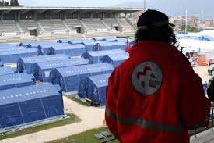
WHY
Background
The recent experience involving ANPAS in the management of emergency camps after the earthquakes in Emilia Romagna region of 2012, and the 2009 in L’Aquila, has shown the need for a preparation of volunteers and professionals, not only for, emergency response but also to the management of social affairs originate and matured within the field
.

Slide 9
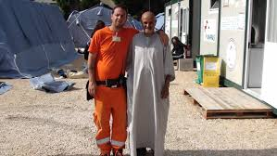
WHY
Background
i.e. the presence of families and guests from third country, impose a different APPROACH in the management of everyday life, within the emergency camp

Slide 10
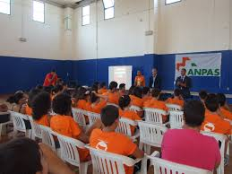
WHY
Main Objective
The SAMETS project, intend to develop a Management Module of training for volunteers and professional to facing at “social affairs” testing them at local level and to identify a Guidelines useful to all volunteers or professional involved in the Civil Protection mechanism Response.

Slide 11
WHY
Specific Objectives
Implement the skills and the curricula for experts volunteers in the Camp Management system with a special focus on social affair with multi-ethnic aspects;
Increasing the volunteer capability to work in a Multicultural Emergency environment;
Improving the competencies of volunteers and professionals in an emergency context.

Slide 12
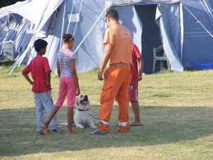
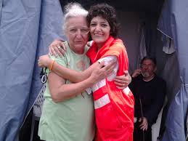
WHAT
Three transnational Peer review Workshop (PREW) focused on three specific social issues:
CHILDREN ( M 5 )
Germany
ELDERLY AND DISABLED( M 10)
Slovakia
MULTICULTURAL ( M 13 )
Austria

Slide 13
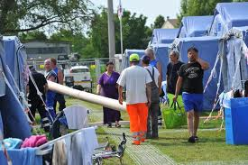
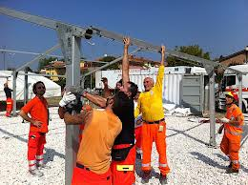
WHAT
One transnational seminar to set up Guidelines sorted out from PREW’s
that will be used by Trainers
( M 15 ) SOUTH TYROL - ITALY
One Training and Evaluation meeting to train and test the trained volunteers
( M 19 ) ROME - ITALY

Slide 14
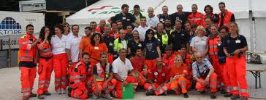
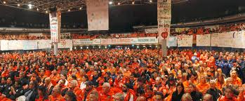
RESULTS
Printed Guidelines on three identified topics used by Volunteers Trainers
N°15 Volunteers Trainers , trained, for training others volunteers with a multiplier effects

Slide 15
Deliverables
First progress report submitted to ECHO 31 August 2014
Second progress report submitted to ECHO 30 March 2015
- N° 4 National Events – Ottobre 2015
Closure meeting with DG ECHO November 2015
Project Final Evaluation Report

Slide 16
Deliverables
➢ Executive project and Partners’ Agreement
➢ Minutes of the Kick-off partners meeting
➢ Minutes of Partners Coordination Meeting
➢ Blog ( Dropbox) to share documents
➢ Survey results data
➢ List of needs
➢ Database
➢ N° 9 Best Practice in action presented
➢ N°3 Reports From the Workshops
➢ Final guidelines translated in four languages
➢ Standard training program for volunteers in action
➢ Educated trainers for multiplier effects
➢ SAMETS Link Page in all Partners WEB Sites
➢ List of trainers

Slide 17
FOLLOW UP
All the SAMETS Partners are members of SAMARITAIN INTERNATIONAL a Network with 16 member associations in 15 countries Three million members, 130,000 volunteers and 30,000 full-time employees
share Guidelines in all SAM.i members -
Training activities for identified volunteers
Link with other SAM.i projects – ( FLOOD )

Slide 18
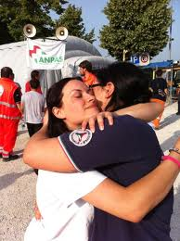
THANK YOU!
Aurelio Dugoni
a.dugoni@anpas.org

