Slide 1
PROFORCE
Bridging of Probabilistic Forecasts and Civil Protection
Yong Wang, Clemens Wastl, Franziska Strauss (ZAMG)

Slide 2
Project Information
Project Name: PROFORCE
Bridging of Probabilistic Forecasts and Civil Protection
Project Logo:
Project duration: 24 months
December 1st 2013 – November 30th 2015
Project budget: 557,405.00 €
Provided by the EC: 418,054.00 € (75%)
Co-financing: 139,351.00 € (25%)
Project coordinator: Dr. Yong Wang, ZAMG
Website: www.proforce.eu (under construction!)

Slide 3
Lead and Beneficiaries
AUSTRIA
HUNGARY
ZAMG
Central Institute for Meteorology and Geodynamics
Lead partner
OMSZ
Hungarian Meteorological Service
NOEL
Provincial Government of Lower Austria, Section for Fire Brigade and Civil Protection
DMDSC
Disaster Management Directorate of Somogy County

Slide 4
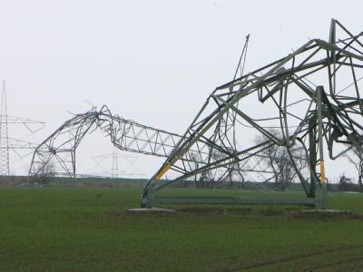
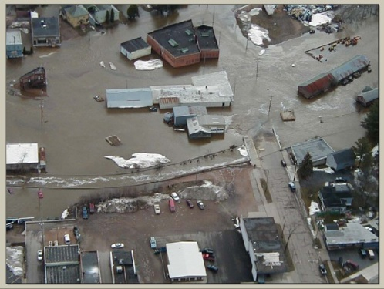
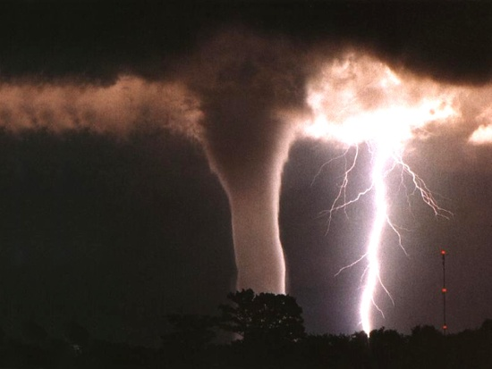
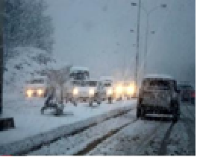
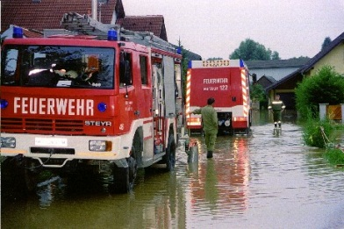
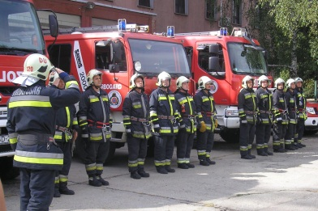
Why PROFORCE ?
Weather is chaotic
Forecast uncertain
How to deal with?
Weather warning
Civil Protection
Prevention and
Preparedness

Slide 5
Project idea: seamless + probablistic
Global ensemble
~ 30km resolution
7 days
Pre-warnings
Possible severe
weather event
Civil Protection
Precise warning
Preparedness actions
Regional ensemble
~ 10km resolution
3 days
More accurate forecast
Civil Protection
Local ensemble
~ 2.5km resolution
1.5 days
Final
actions
Forecast + uncertainty
Exact forecast
Nowcasting ensemble
~ 1km resolution
0-6h

Slide 6
Project method
feedback
implemen-tation
evaluation and training
requirements
development
What does CP need?
user tailored ensemble prediction system
seamless, probabilistic forecasting system for decision making (as weather forecasts become more detailed better decisions can
be made)
tell CP end users how to cope with probabilistic forecasts
Appliaction oriented products
foster communication between forecasters and end users at transnational scale

Slide 7
Task Overview
PROFORCE
Task A: Management and reporting to the EC
Task B: Publicity
Task C: Requirements
Task D: Integration of seamless forecasting
Task E: Pilot Implementations
Task F: Evaluation and Feedback
Task G: Training and transnational cooperation
A1: Monitoring and evaluation of project implementation
A2: Organization of meetings and workshops
A3: Communication and coordination with the EC
B1: Development and maintenance of a project website
B2: Publication of project results in papers and at conferences
B3: Dissemination of project information to public
C1: Identification of requirements for use of forecasts in CP
C2: Potentials for integration of probabilistic system in
Austria and Hungary
D1: Integration of probabilistic nowcasting system
D2: Integration of probabilistic short range forecasts
D3: Development of a seamless probabilistic system
E1: Pilot implementation of seamless probabilistic forecasting system
E2: Pilot implementation of process chain: Webportal
E3: Case studies of severe weather events
F1: Verification of the pilot implemented system
F2: Assessment of added value of probabilistic system in CP
F3: Feedback from CP and feedback to Task D
G1: Training session on probabilistic weather forecasting
G2: Training session on new products

Slide 8
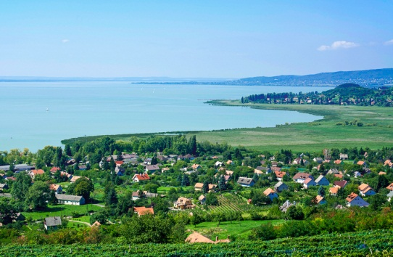
Deliverables and Deadlines
Deadlines |  | Duties
RP 1 (Dec. 2013 – Jul. 2014) | 31.12.2013 | LP delivers project handbook to the PPs
 |  | PPs provide budget plan to LP
 | 20.01.2014 | Kick off meeting in Vienna at ZAMG
 | 22.01.2014 | LP participation at EU meeting in Brussels
 | XX.05.2014 | Technical workshop in Hungary
 | 31.06.2014 | PPs submit technical contribution for PR to the LP
 | 15.07.2014 | PPs provide electronic version of financial report to LP
 | 31.07.2014 | LP submits PR 1 to the EC
RP 2 (Aug. 2014 – Mar. 2015) | XX.01.2015 | Mid-term meeting in Budapest at OMSZ
 | 28.02.2015 | PP submit technical contribution for PR to the LP
 | 15.03.2015 | PP provide electronic version of financial report to LP
 | 31.03.2015 | LP submits PR 2 to the EC
RP 3 (Apr. 2015 – Nov. 2015) | XX.05.2015 | Technical workshop in Austria
 | 31.10.2015 | PP submit technical contribution for PR to the LP
 | XX.10.2015 | Final Meeting in Austria
 | XX.10.2015 | LP participation at EU meeting in Brussels
 | 15.11.2015 | PP provide electronic version of financial report to LP
 | 30.11.2015 | LP submits Final report to the EC
 | 30.11.2015 | LP submits Layman’s report to the EC

Slide 9
Summary and Follow up
In the frame of PROFORCE, 4 weather and civil protection partners from Austria and Hungary will work together on:
an innovative seamless probabilistic forecasting system in time
(week to hour) and space (30km to 1km) tailored to civil protection
improvements in the accuracy and timeliness of severe weather
warnings
improved preparedness and decision making procedures in civil
protection agencies
cooperation between weather and civil protection authorities
transnational cooperation between Austria and Hungary
Adaptation of the developed system for further use in other European countries and in other application area

