Slide 1





Ecological COastal Strategies and Tools for Resilient European SocietieS
ECOSTRESS
2013 PROJECT FOR CIVIL PROTECTION FINANCIAL INSTRUMENT
PREPAREDNESS AND PREVENTION SCHEME
KICK OFF MEETING BRUXELLES 22-01-2014
Andrea Taramelli andrea.taramelli@eucentre.it

Slide 2




Consortium
EUCENTRE
Promote and support research and education in the field of seismology, geology, geotechnical engineering, hazard and risk assessment, flooding vulnerability assessment, ecological approach and emergency management, Re-insurance market
ISIG
The main fields of research and study are natural hazards, social mechanisms of adaptation/mitigation, social dynamics of sustainable development, natural resource management and environmental monitoring.
AFPCN
French Association for Disaster Risk Reduction with expertise in natural risks reduction starting from scientific knowledge and prevention to civil protection-led crisis management, rescue and reconstruction
DELTARES
Develop and apply expertise in Flood Risk, Ecosystems and Environmental Quality, Water and Subsoil Resources, Delta Infrastructures, Sustainable Delta Planning and Numerical Modelling

Slide 3
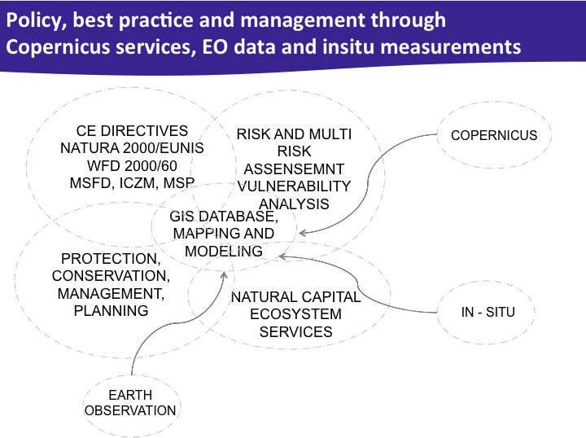
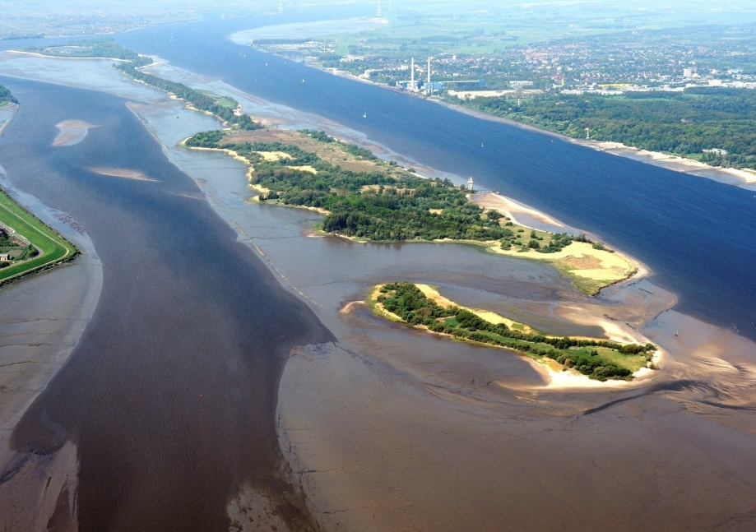
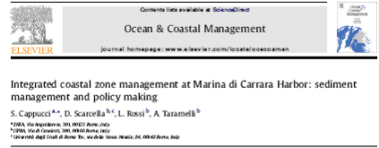
Challenges for science & management under coastal extreme event:
There is only one big idea in coastal management: how to maintain and protect ecological structure and functioning while at the same time allowing the system to produce ecosystem services from which we derive societal benefits also in extreme event.
Recovery/coping with historical legacy
Endangered coastal and marine ecosystem functions
Legal & adminstrative framework
Economic prosperity and delivery of societal benefits
Coping with climate change & moving baselines
Notes:
3
Increased dredging necessities and costs
Pressures led to endangered ecosystem functions
Implementation of EU directives: WFD, Birds & Habitats Dir.
Global developments in trade & ship constructions, competition between harbours
Predicted climate change, sea level rise, change in freshwater discharge

Slide 4
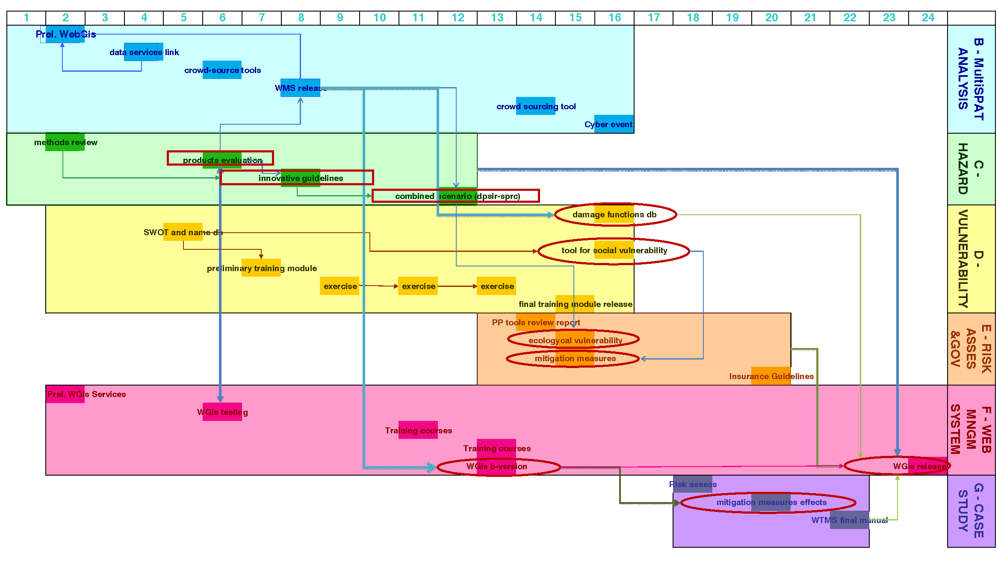
Overview of the Project
FRAMEWORK OF OPERATIVE TASKS
Risk analysis and evaluation
(task B-C-D-E-G)
Web Based Territorial Management System
(WBTMS) (task F)
Management, Dissemination and Results
Exploitation Plan (tasks A-H)
Hazard Identification
Hazard Analysis
Overview of Sub-Tasks
Structural Vulnerability
Societal Vulnerability
Ecological Vulnerability
Mitigation Opportunities Analysis
Technical review panel and public outreach

Slide 5
Methodology
Source
Pathway
Receptor
Risk
Present
R
V
H
E
=
Mitigation
Options
Morphology
Physics
probability
Ecology
Hydraulic
% damage
Future
Social Sc
depth
depth
H
R
V
E
=

Slide 6

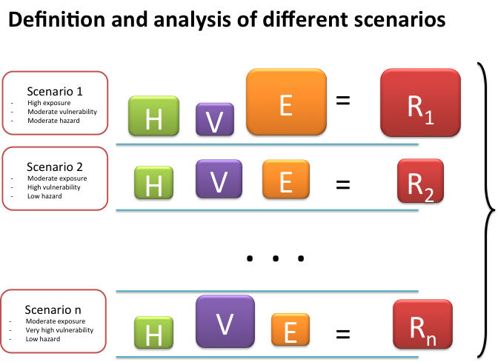
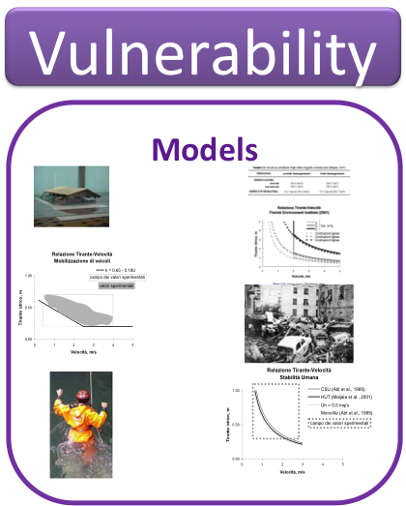

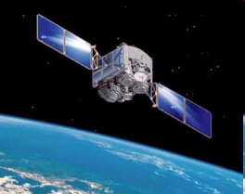



COASTS: The interface between
Land/Sea Scape
Copernicus Downstreaming and Support to Decision Process
Integration layer
COPERNICUS Services
Non COPERNICUS
Services
Assessment and mitigation options
ESA remote Segment +
Data in situ acquisition
Preprocessing modules
(archive search&new acquisition)
Publication layer
Data Processing layer
Data Access
layer
From Space Systems to non EO expert End Users

Slide 7

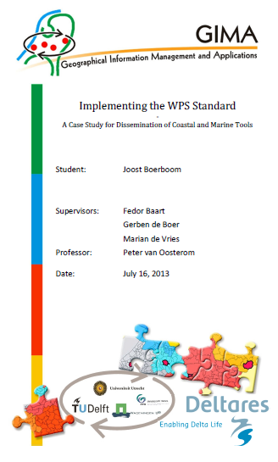
WPS: web processing Service
OGC WPS standard: web coupling between
Your thin client device: web browser (tablet)
Remote OGC data sources
Remote processing library
MSc thesis on WPS
in national
GIS MSc program
(4 universities)
Dynamic multi-hazard map
Web based territorial
management system
=
F.1) WebGIS Viewer + GUI
F.2) Python framework for
Web processing services
(models, tools)
for multi-scale analysis,
and risk assessment
(hazard + vulnerability)
+
Multi-spatial analysis
+
B.1) Link existing GMES +
non-GMES WebGIS
Services (data cloud)
B.2) Volunteer
Gathered
Information
(VGI) tools
inventory +pilot
B.1) Download GMES +
non-GMES data into
and provide as
WebGIS services
(local cache database)
+
+

Slide 8








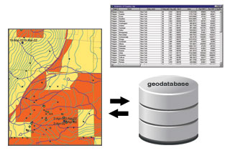

Crowdsourcing
Analysis of possible sources!
An additional source of input to the above repositories will come from the World Wide Web and photo sharing websites (e.g. Panoramio, Flickr,etc..).
The use of these resources has strongly increased in the last few years in the “transition to Web 3.0”
Web-published photos and descriptions are scrutinized for additional risk/damage-related information not available elsewhere.
Filtering / inform. extraction
Information fusion
discovery of sensitive assets
updated land cover
water level
spot-wise flood info
…

Slide 9



Costal Vulnerability Mitigation
WPS: web processing Service
Risk Mitigation
DB of
Esposore
DB of
Vulnerability
DRIVERS
STATE CHANGES
PRESSURE
DB of
Hazard
Update DB of
Damage Senario
Update DB of
Vulnerability /Exposure
ENGINE
ENGINE
RESPONCE
Sending Request
Sending Request
IMPACT

Slide 10
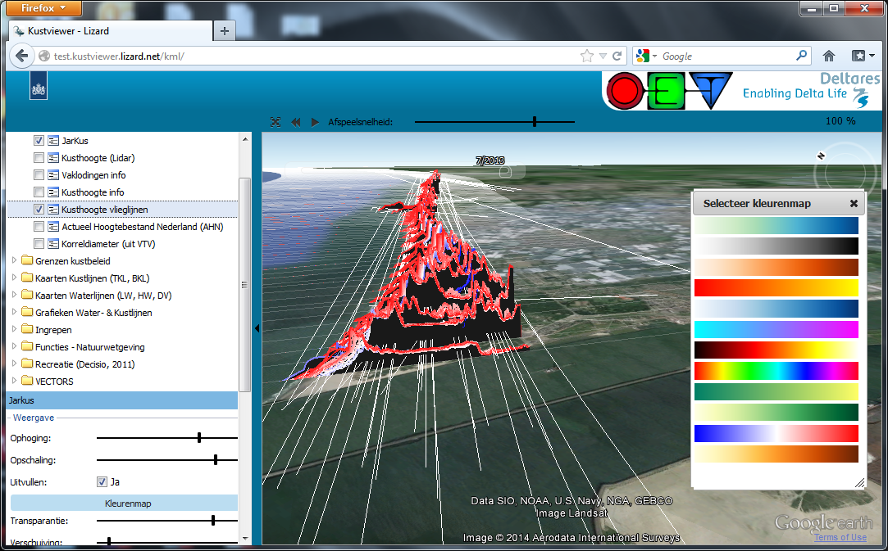
Example: Coastal sediment management for Rijkswaterstaat.
Morphological Copernicus data assimilation
http://test.kustviewer.lizard.net/
Action B and C
Linked remote data sources
Input toggles
for WPS:
e.g. dynamic
colorbars,
scales,
selections,
calcualtions

Slide 11
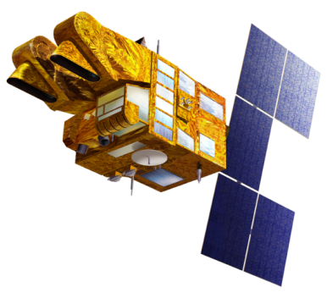
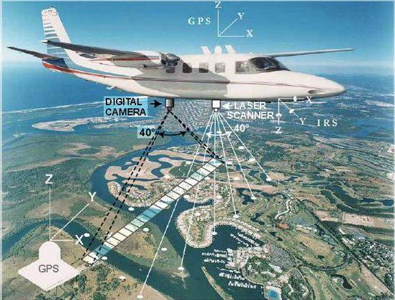
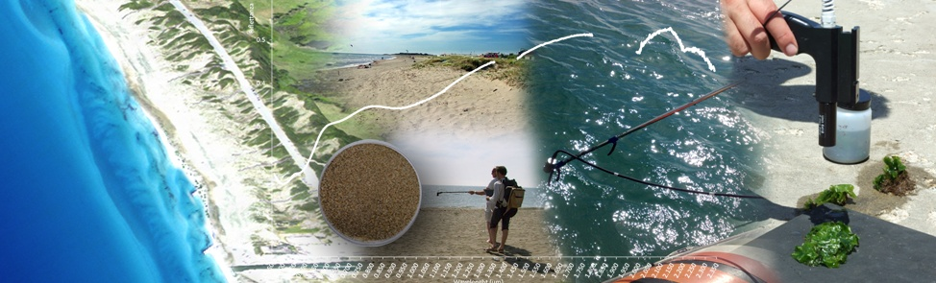
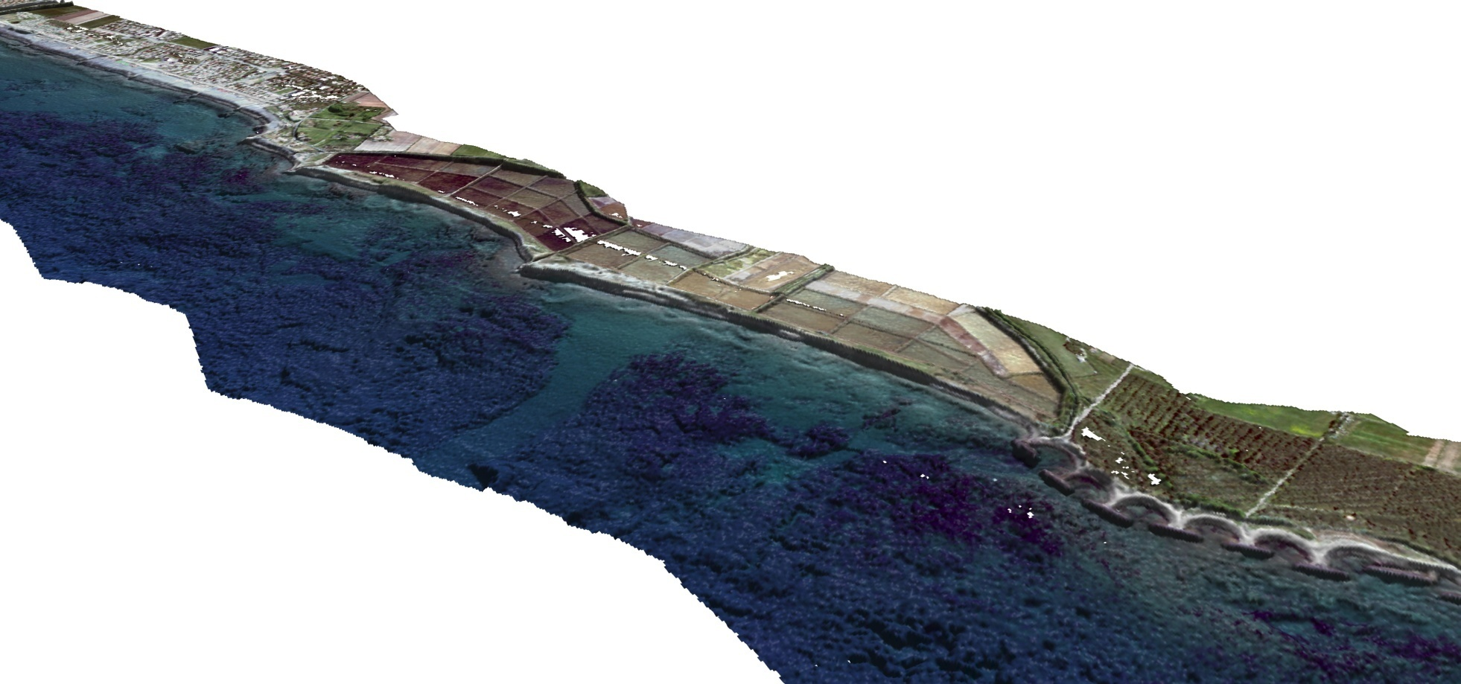
Ecological Copernicus data assimilation
Action B and C
The strategy of combining high and very high resolution spectral measurements in a multisensory and multi resolution analysis. This includes different ways of data fusion to assimilate spectral and spatial variability in complex coastal mapping and modeling.
Notes:
In situ coordination (i.e airborne) requires funding for standardization and publication of data and analysis. In this way ground truth and validation of Copernicus and EO data/products can be applied in the monitoring activities of environmental regional agencies. Institutes as ISPRA can provide guidelines and alerts about the monitoring and good environmental status implementation through the European strategies context. On the other side small and medium enterprises can benefit from an enhanced use of EO products.

Slide 12
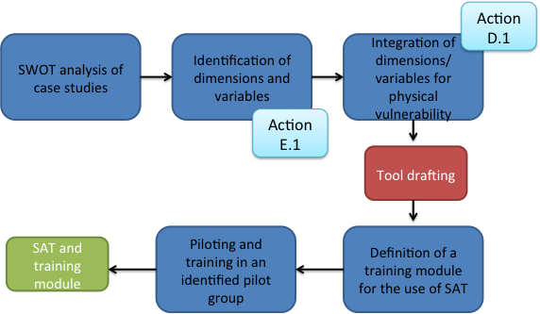
Self assessment tool (SAT) as means of capacity building
vulnerability not only measurable through physical factors, but also determined by a social component;
internal elements of strength and weakness and external elements of opportunity and threat for a community are context specific;
the identification of such elements is key for the development of strategies for diminishing community’s vulnerability;
SWOT analysis is used for systematization of data and the identification of development strategies
as means of community social capacity building this action develops a tool (based on SWOT methodology) that can be used for self assessment and development of adequate strategies;
the added value of this tool, from a social perspectives, is its capacity to offer an operative support for structured discussion and problem solving among different actors
DIMENSIONS/ CAPACITIES | VARIABLES | CONCRETE EXAMPLES | INTERNAL /EXTERNAL | POSITIVE/ NEGATIVE
Knowledge | of hazards/risk;
 | Of other actors involved in risk management
 | laws and legal frameworks
 | social norms and beliefs
Motivation | To anticipate effects of natural hazard
 | sense of responsibility towards individual actions,
 | sense of responsibility towards community actions,
Networks | Existence and value of social network formed (family, friends, neighbours, colleagues, etc)
 | Capacity to establish /stabilise trustful relationships among/between different organizational, local and individual actors
Financial capacities | existence of financial resources to anticipate, deal with and recover from effects of natural hazard
Action D and E – self assessment tool

Slide 13
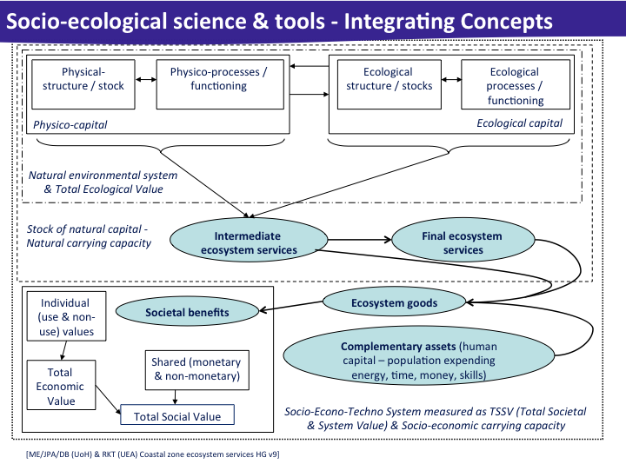
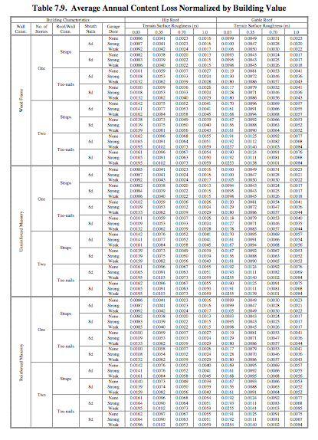
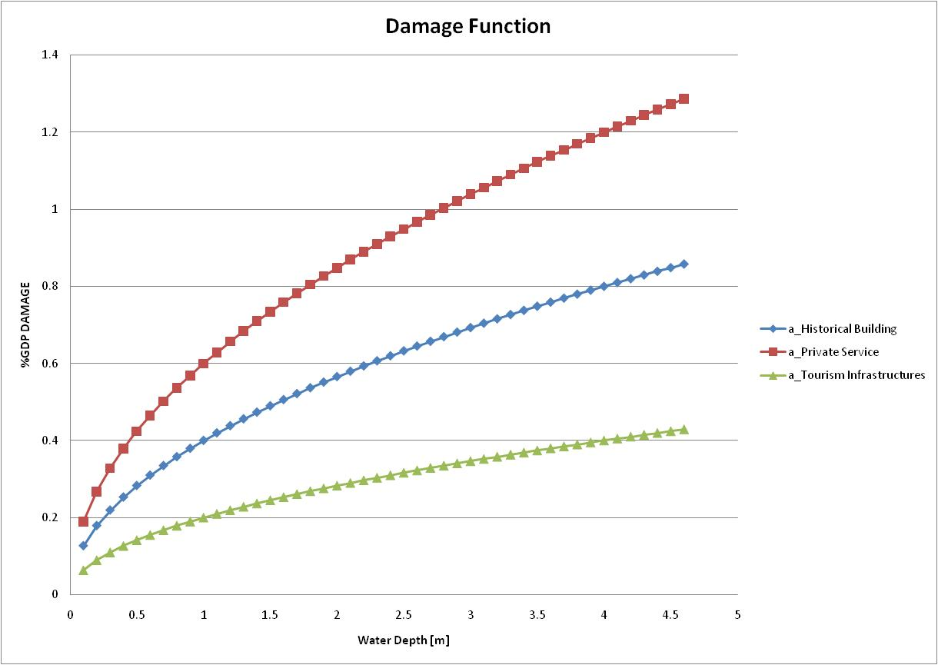
The damage function will be built using:
  • Flood maps to delineate the inundated area
  • Habitat maps to define different habitats/species within the area
  Based on the monetary value of the site applied, the area flooded and the environmental vulnerability of the site (a parameter to be chosen) has an overall value cost of a particular event can be calculated with a specific parameter for a Land Use Class.
Action F and G

