Slide 1


RISK
2012 CALL FOR PROPOSALS
CIVIL PROTECTION FINANCIAL INSTRUMENT
PREVENTION AND PREPAREDNESS
Risk management
via an Innovative System based on Knowledge

Slide 2

RISK - Risk management via an Innovative System based on Knowledge
Starting date: 1/1/2013
Ending date: 31/12/2014
Duration in months: 24
Project eligible cost: 665.000 €
EC financial contribution: 498.750 €
Coordinating Beneficiary:
University of Sannio
Italy
Associated Beneficiaries:
Amministrazione Provinciale di Avellino
Italy
University of Ljubljana
Slovenia
Municipality of Ajdovščina
Slovenia
Risques & Développement
France
University of Dortmund
Germany
University of Crete
Greece

Slide 3
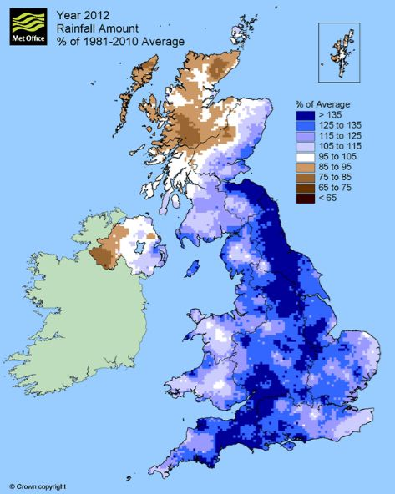
RISK - Risk management via an Innovative System based on Knowledge
RISK focuses on the challenges of adapting to climate change
and preparing for natural disasters facing areas of the EU
data from British Geological Survey, 2012

Slide 4
RISK - Risk management via an Innovative System based on Knowledge
Why RISK?
The entire territory of the EU is foreseen to be heavily impacted by climate change.
Natural hazards are increasing also due to various reasons (e.g. urban development, land use, etc…).
The institutional approaches to risk management can be very different. As a consequence, priorities related to climate change adaptation and natural hazards awareness are different.
Therefore it is crucial to promote collaboration at the regional level to avoid strong differences in mitigation strategies, but also to avoid conflicts for resources.
In order to enable such coordinated approach, a common framework for assessing hazards and risks is required.

Slide 5
RISK - Risk management via an Innovative System based on Knowledge
It is crucial
assessing the hazard and related risks also evaluating the the impacts of climate change;
preparing experimental action plans
engaging stakeholders in related decision-making.
RISK is addressed toward two different target groups
            Local, regional and national decision-makers at different levels (local civil protection, political, etc…);
            Technical and professional units (single person or agencies and companies with particular attention toward entities operating in the sphere of civil protection).

Slide 6
RISK - Risk management via an Innovative System based on Knowledge
Our principal goal is to propose an integrated approach that can guide decision-makers to manage natural risks developing a methodology that
harmonise the presentation of risk information,
provide comparative parameters to monitor changes in risk, as a measure of the evaluation of the effects of policies and investments in hazard management
improve the capacity of decision-makers on local, regional and national level to measure key elements of the risk

Slide 7
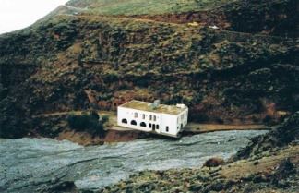
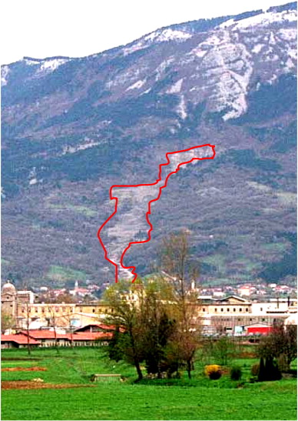
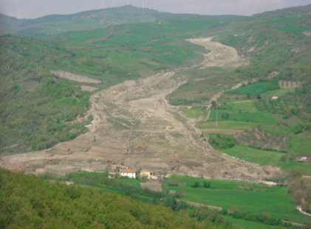
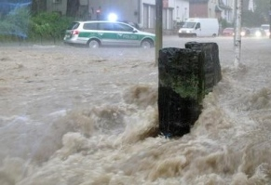
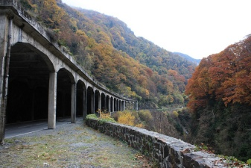
RISK - Risk management via an Innovative System based on Knowledge
Primary Areas: Sannio-Irpinia, Italy Ajdovščina, Slovenia Secondary Areas: Crete, Greece
River Wupper area, Germany
Luz Saint-Sauveur and Pierrefite Gorges (Hautes-Pyrénées), France
Crete: flood
Wuppertal:
storm water flooding
Montaguto: railway line landslides
Slano Blato: landslide
Pierrefite Gorges :
road protection

Slide 8
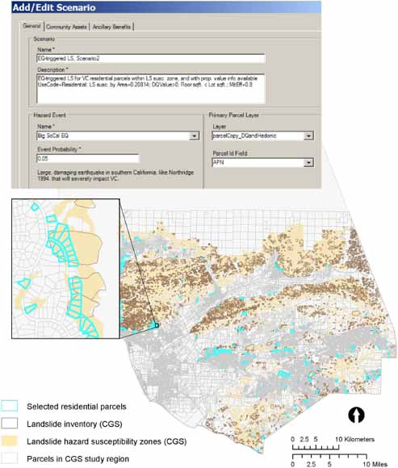
RISK - Risk management via an Innovative System based on Knowledge
Name: RISK tool - geospatial scenario-based risk-analysis software.
Why this tool is necessary? As people increasingly move to locations that are vulnerable to natural hazards, financial and human losses from natural hazard events will continue to rise. Community decision-makers and leaders face the challenge of how to plan for and allocate scarce resources to invest in protecting their communities.
Adopted strategy: integration of knowledge and techniques from many fields such as geology, hydrology, geography, mathematics, statistics, and economics.
Background: map-based online systems provide a framework and technology in which these disciplines can be combined to solve these types of complex, inherently spatial problems.
What the RISK tool do: modelling, mapping and communicating risk. It is designed to help public agencies and communities understand and reduce their vulnerability to, and risk of, natural hazards.
Basic model: It is adapted from financial-portfolio theory, a method for evaluating alternative, regional-scale investment possibilities on the basis of their estimated distributions of risk and return. Financial-portfolio theory can be linked with natural-hazard, land use, mitigation and emergency preparedness information to estimate risk to a community from natural disasters at the regional scale and to identify cost-effective pre-disaster risk-reduction policies.
How the RISK tool works:
the user inputs data that include the probability of the hazard event, the planning time horizon, the assets at risk (e.g. tax parcels), the spatial probabilities of damage, the monetary value and/or vulnerability of each asset, and the cost and effectiveness of the risk-reduction measures being considered.
the user selects a portfolio of locations and/or measures in which to invest a limited budget for hazard mitigation.
then, for that portfolio, the RISK tool calculates estimates for the total cost, number of locations mitigated, return on investment, expected loss, and community wealth retained.
the user can display maps showing the results of each mitigation policy, and compare and rank the policies according to their own priorities.
Activity Area N. 1 | Start date | End date | Objectives
Creation of a Risk Management Tool | 1/1/2013 | 31/8/2013 | Creation of a geospatial scenario-based risk-analysis software tool The utilised model is inspired by the financial-portfolio theory, a method for evaluating alternative, local and regional-scale investment possibilities on the basis of the distributions of risks (USGS). The model can be applied to any hazard. The tool integrates natural-hazards and economic information in an online Map Based System to estimate expected damages and loss and consequent costs. For a natural-hazard event, a user can run the tool to evaluate the risks and returns of investing in different portfolios of locations and loss-mitigation strategies, and then compare and rank them according to the user’s risk preferences. The tool is designed for decision-making at a local and regional level, but data at any scale can be entered into the model.

Slide 9
RISK - Risk management via an Innovative System based on Knowledge
Activity Area N. 2 | Start date | End date | Objectives
Risk Assessment | 1/1/2013 | 29/2/2014 | Risk assessments of the five selected areas
Activity Area N. 3 | Start date | End date | Objectives
Action Plans | 1/3/2014 | 31/12/2014 | On the basis of the risk assessments, specific action plans will be performed. These plans have the purpose of providing national and, mainly, local stakeholders with strategies to address the priority areas and the related investments in the public investments.
Activity Area N. 4 | Start date | End date | Objectives
Dissemination | 1/1/2013 | 31/12/2014 | The dissemination of the activities and the results of the project (tools) will be done in the the involved nations and among other interested parties at a European level (additional regions, user groups, etc.).

Slide 10
RISK - Risk management via an Innovative System based on Knowledge
Main Deliverables and Deadlines
1st Interim Report – 31/12/2013 / 2nd Interim Report – 30/6//2014 / Final Report – 28/2/2015 Risk Management Software Tool – 31/8/2013 Risks maps of the two primary areas – 31/1/2014 Risks maps of the three secondary areas – 31/1/2014 Action Plan section concerning the institutional preparedness and emergency plans for the two primary areas – 31/10/2014 Action Plan section concerning the institutional preparedness and emergency plans for the three secondary areas – 31/10/2014 Action Plan section containing detailed economic evaluation of the recommended remedial adaptation actions against the costs of the impacts of climate change and natural disasters for the two primary areas – 30/11/2014 Action Plan section containing detailed economic evaluation of the recommended remedial adaptation actions against the costs of the impacts of climate change and natural disasters for the three secondary areas – 30/11/2014 Newsletter (4nd, 12th, 15th, 18th, 24th month) Web Portal – 1/3/2013 / Brochure – 15/5/2013

Slide 11
RISK - Risk management via an Innovative System based on Knowledge
Main Events
Workshops: France (2nd month), Slovenia (6th month), Italy (12th month), Germany (15th month), Greece (18th month) Final Conference: Italy or Belgium (24th month)
Follow Up
Amongst the target groups: by means of a feedback questionnaire during the workshops and the final conference; Project partners: they will monitor improvements in the five project areas related to the project themes.

