Slide 1
PrismA Promoting and implementing strategies for risk management and assessment
www.prismaproject.eu
Kick-off meeting ECHO
Brussels, January 17th 2013
Nico van Os / Tim te Pas

Slide 2
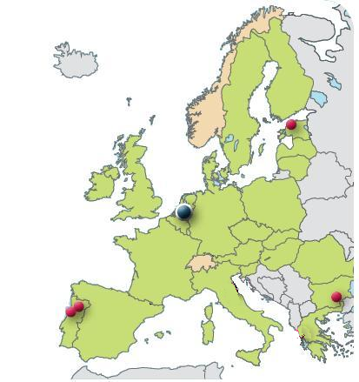
The project partners
www.prismaproject.eu

Slide 3
The project objectives
www.prismaproject.eu
Testing MiSRaR’s cross-sectoral implementation of the risk management strategies
Promoting risk management and knowledge exchange on risk assessment and risk management

Slide 4
Actions
www.prismaproject.eu
Partners will:
Build a risk management network
Perform a risk assessment
Perform a capability assessment
Develop an implementation strategy
Organize 3 international congresses
Organize the project management and reporting

Slide 5
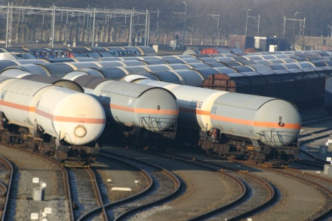
5 risks to mitigate
www.prismaproject.eu
Dangerous substances in
SEVESO II industries - Aveiro
Urban fires in historic city
centre -Mirandela
Forest fires - Stara Zagora
Urban fires in area with protected wooden houses - Tallinn
Rail transport dangerous goods - ZHZ

Slide 6
Duration & budget
www.prismaproject.eu
Duration: 18 months
from 01/01/2013 to 30/06/2014
Estimated eligible costs : €652.298,-
Max. contribution EU : €489.224,-

Slide 7
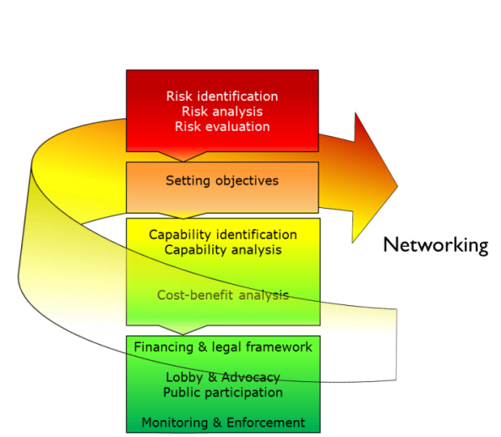
Deliverables & deadlines
Each partner will make a:
Stakeholder assessment (1-3-2013)
Declaration of principles (1-4-2013)
Risk assessment report (1-9-2013)
Policy memorandum on risk management strategy (1-1-2014)
Risk management plan (1-3-2014)

Slide 8
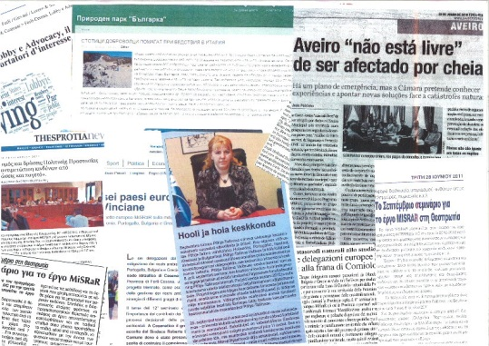
Deliverables & deadlines
www.prismaproject.eu
Dissemination:
Project factsheet (2013-1)
Newsletters (2013-1 / 2013-6 / 2014-1 / 2014-6)
Press releases (2013-1 / 2013-6 / 2014-1 / 2014-6)
Layman’s report (2014-6)
National dissemination (> 10 presentations)
Conferences (2014-3 / 2014-4 / 2014-5)
Website

Slide 9
Deliverables & deadlines
www.prismaproject.eu
Project management:
Partner contract (January 2013)
Technical and financial progress reports (July 2013 and January 2014)
Project evaluation (June 2014)
Final technical and financial report (September 2014)
Task 1
Task 2
Task 3

Slide 10
Deliverables & deadlines
www.prismaproject.eu
Meetings:
Kick-off meeting (29 & 30 January 2013)
4 Partner advice and counseling meetings (2013-1 / 2013-5 /2013-9 / 2014-1)
Meetings with local partners (5 x 6)
Steering committee (2013-1 / 2013-9)
Project evaluation meeting (2014/6)

Slide 11
Thank You
www.prismaproject.eu

