Slide 1
Improvements of Shorelines Defences Against Marine Pollution
ISDAMP+
project 2012/PREP/17
Frédéric MUTTIN (EIGSI La Rochelle)
Kick-off meeting selected projects 2013 Call for proposals for prevention and preparedness DG-ECHO Brussels 17 January 2013

Slide 2
Partners
Beneficiary name | Total number of days | Total costs of the actions in € | Beneficiary's own contribution in € | Amount of EC contribution requested in €
EIGSI (coord.) FR | 644 | 204 730 | 54 753 | 149 977
IST University of LISBOA PT | 668 | 129 080 | 66 988 | 62 092
AM Action Modulers PT | 614 | 143 660 | 37 615 | 106 045
FHC Falmouth Harbour Commissioners UK | 228 | 104 477 | 26 362 | 78 115
TOTAL | 2 154 | 581 947 | 185 718 | 396 229
Duration 24 months (starting date 1/1/2013)
In-kind costs: 565 751 € not included in the budget

Slide 3
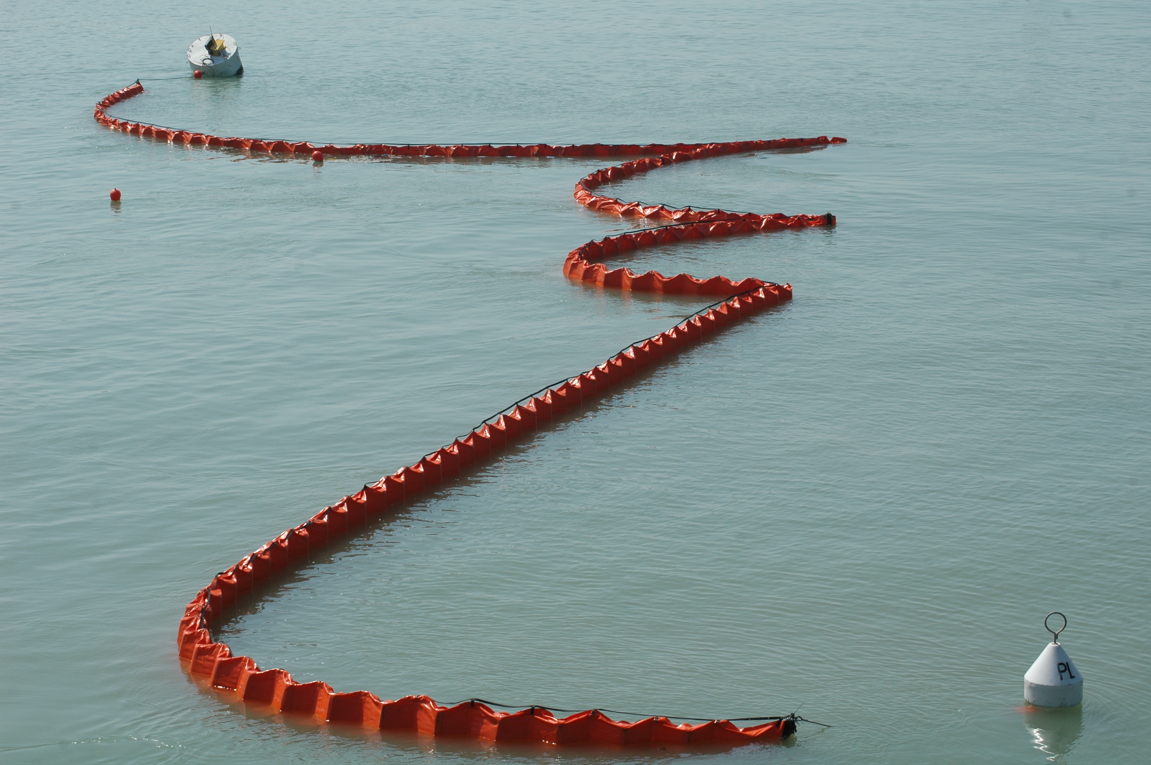
Project description
Objective
To improve the protection of the coast by floating barrier when a marine pollution occurs
Main result
Software decision aid tool and methodology to help local coast protection decision makers to implement barriers

Slide 4
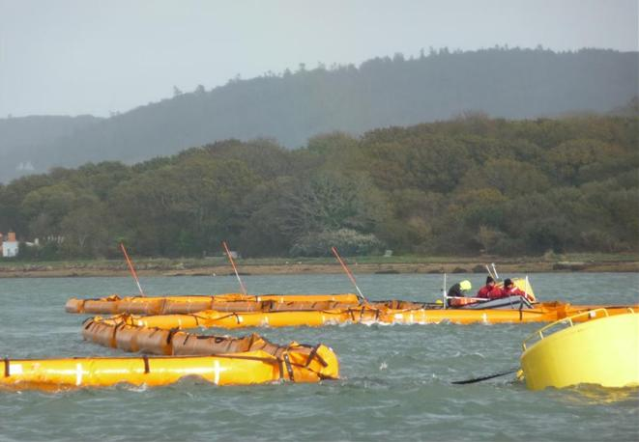
Project description
Actual situation:
Lack of efficient tools to anticipate and react on pollution hazards
Increase of responsibility of Local authorities on coastal protection
Scientific algorithms but not integrated approaches
Difficulties to optimise the utilisation of available resources

Slide 5
Work packages
A Task Management and Reporting to the Commission
Leader EIGSI
B Modelling
Leader IST
C Software
Leader AM
D Experimentations
Leader FHC
E Task Publicity
Leader EIGSI

Slide 6
Deliverables
(essential/task)
Progress Report n°1 (technical and financial implementation) M10
Progress Report n°2 (technical and financial implementation) M18
8 Reports on Modelling (barrier 2D and 3D, Hydrodynamic and waves Models, stochastic processes…) M5-M22
Beta Software Version with all features implemented (coupled MOHID and barrier model with OpenMI interface ) M16
Final Software Version M22
List of the sites retained for experimentations (simulated and real-life) M8
Simulation reports (8-10 Simulated exercises) M18
3 Experimentations reports M20
2 workshops M8 M20
Training sessions (2 per country) M12-22

Slide 7
Milestones and main events
Specifications for soft developments
Availability of decision aid tool for experimentation design
3 experimentations in real-life situations
Lisbon Harbour ( M10… M20)
Falmouth Cornwall ( M12… M22)
Charente-Maritime ( M12… M22)

Slide 8
Follow up
Steering committee meetings every 6 months (+ DG ECHO reporting)
Technical committee meetings …..
Consolidation of technical achievements
Software development
Methodological guide
Experimentations
Local working groups with stake holders
Detailed plans
Synthesis

Slide 9
Thank you for your attention
www.eigsi.fr
frederic.muttin@eigsi.fr

