Slide 1
Implementation of the EU Host Nation Support Guidelines
Kick-off meeting of projects selected under the Civil Protection Financial Instrument
‘Prevention and Preparedness Projects’
Brussels, 17 January 2013
Jón B. Birgisson – Icelandic Red Cross

Slide 2
One day on a rock far up in the north

Slide 3
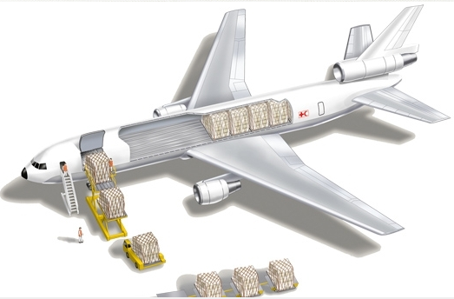
Let´s bring in some assets

Slide 4
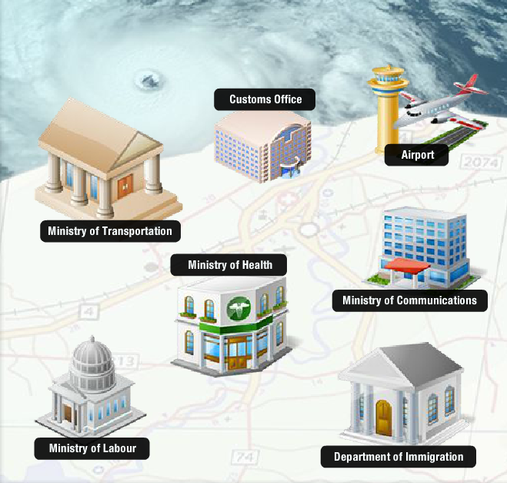
Sorry guys! Clearance needed. Please refer to the following:

Slide 5
HNSG Implementation
Host Nation Support Guidelines:
The Host Nation Support Guidelines (approved in Jan 2012 by the EU Civil Protection Committee) are intended to support and assist affected states in receiving international assistance, whether in the preparedness or disaster response phases. They highlight key actions to be taken in relation to emergency planning, emergency management and coordination, logistics, transport and legal and financial issues.

Slide 6
HNSG Implementation – Project information
Preparedness Project under Civil Protection Financial Instrument
Partners:
Coordinating beneficiary: Icelandic Red Cross
Associated beneficiaries: Latvian Red Cross, Irish Red Cross, Polish Red Cross, Finnish Red Cross and International Federation of Red Cross and Red Crescent Societies.
Funding
Co-financed by European Commission / DG ECHO / Civil Protection Financial Instrument
Total budget: 276.652€; 74.22% (205.317 €) co-financed by EC
Timeframe:
22 months
February 2013 – November 2014

Slide 7
HNSG Implementation – Objectives and expected results
General objective
Improve effectiveness of host nation support in participating states.
Aim
To strengthen domestic contingencies by improving facilitation of foreign emergency assets.
Tasks
Examination of law and regulations in participating states in order to see how they promote or hinder the speedy and effective flow of cross-border assistance in disaster situations.
Table-top exercises in order to test how law and regulations help or hinder cross-border assistance.
Expected results/outcomes
Heightened attention to gaps in regulatory framworks and recommendations to policy makers.
Reduction of red tape which obstructs the flow and quality of civil protection assistance within the EU/EEA.

Slide 8
HNSG Implementation – Main events
Country level studies 1 Apr to 30 Sep 2013
Mid-term meeting (country level studies reviewed) Oct 2013
Country-level workshops on domestic and EU disaster law in each country Jan 2014
Printing and dissemination of country level studies.
Table-top exercises in Finland and Iceland in May and June 2014.
Regional-level workshop: “What could European Governents and EU do to strengthen the facilitation and regulation of cross-border disaster assistance?” Sep 2014

Slide 9
HNSG Implementation – Deliverables and deadlines
First progress report submitted to ECHO 30 Jun 2013
Second progress report submitted to ECHO 30 Nov 2013
Third progress report submitted to ECHO 30 Apr 2014
Draft synthesis report 30 Jun 2014
Fourth progress report submitted to ECHO 30 Sep 2014
Modified draft synthesis report 10 Oct 2014
Launch of the synthesis report in Brussels Nov 2014
Closure meeting with DG ECHO Nov 2014

Slide 10
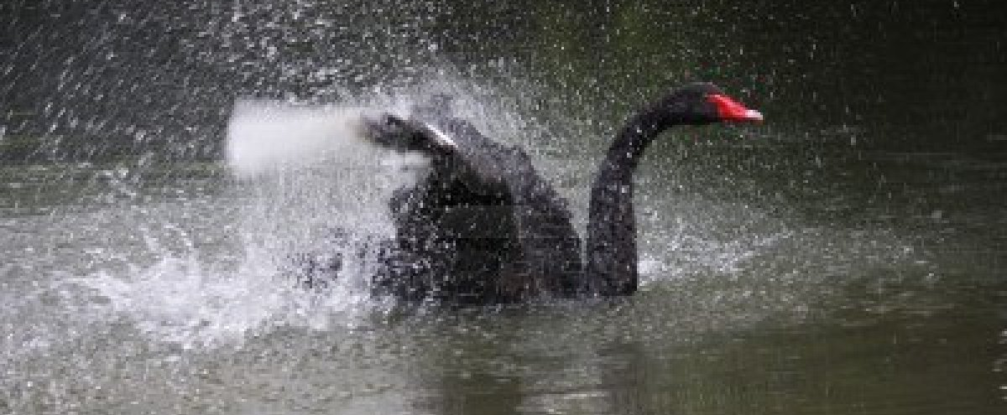
HNSG Implementation – The Black Swan
A black swan is an unpredictable, rare, but nevertheless high impact event.
We have no idea where, when or how the next Black Swan will occur.
We can however prepare ourselves so that whoever faces a black swan in the near future can expect to be assisted by fellow states without delays and life threatening complications.

