Slide 1
Aware and Resilient
Project overview – Austrian Red Cross

Slide 2
Administrative Overview
Grant Agreement No. ECHO/SUB/2012/640926
Total eligible costs: EUR 460.571
EC co-financing: EUR 345.428 (75%)
Project duration: 24 months - 1.4.2013 – 31.3.2015
Headquaters
2

Slide 3
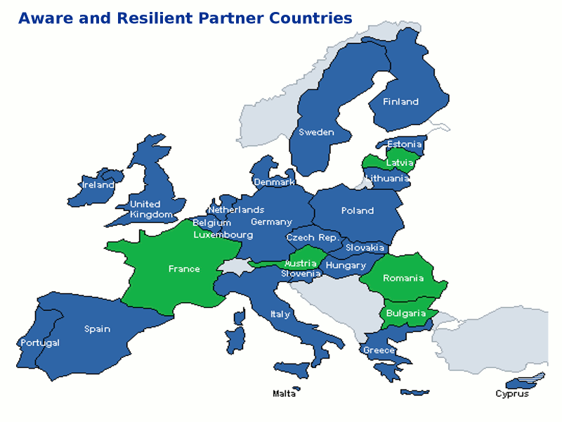
Regional Scope Project countries
Partner Name | Role
Austrian Red Cross | CO
Bulgarian Red Cross | AB1
French Red Cross | AB2
Latvian Red Cross | AB3
Romanian Red Cross | AB4
French Ministry of Ecology, Sustainable Development, Transport and Habitation | AB5
Headquaters

Slide 4
Background (in target countries)
Young citizens (14-35) not aware of their role in disaster prevention
Presently no well developed communication measures in place on how to reach these groups
No community exercises in for young people in place
Need for raising awareness of what difference a trained individual can make

Slide 5
Project aims:
Awareness rising of target group (younger citizens aged 14-35 years) of the value and benefits of disaster prevention by:
innovative e-learning applications
community based learning triggered by a train the trainers curriculum
community-based exercises on a risk relevant to the respective communities.
To improve the link between relevant stakeholders

Slide 6
Actions and deliverables

Slide 7
A - Managing and Reporting to the EC
Project management team (coordinator, assistant, all country managers), national projects teams, a Quality Management Board (project-control comprised by all task leaders and some external experts)
Main Deliverables:
Partner Meetings (Paris, Vienna, Riga, Bucharest and Brussels)
2 Progress reports to EC (30.11.2013 / 31.7.2014)
Final Report (30.6.2015) – 3 months after project completion
Headquaters
7

Slide 8
B – Publicity
Development of a project dissemination strategy. Communication to relevant stakeholders. Exchange of experience and knowledge.
Main deliverables
Project websites
Project presentation at events and conferences
Dissemination materials

Slide 9
C – Train the Trainer
Develop curriculum 1) general preparedness, 2) country specific response for citizens and 3) trainers the trainers (ToT) module. One ToT in the partner countries (15 trainers/country). Develop ToT e-learning application.
Main Deliverables:
Curricula agreed (31.1.2014)
Training material in 5 languages (30.6.2014)
Delivering trainings 31.10.2014 and beyond the project scope.

Slide 10
D – Social Learning Platform
Project Website - publicity and social learning platform: E-Learning application in 5 languages, with functions for sharing training material, enabling bi-directional communication (trainers – citizens), providing feedback possibilities and generate user statistics
Deliverables
Recommendation report (30.6.2013)
Master scripts for 3 scenarios (30.10.2013)
Online learning tool (30.6.2014)

Slide 11
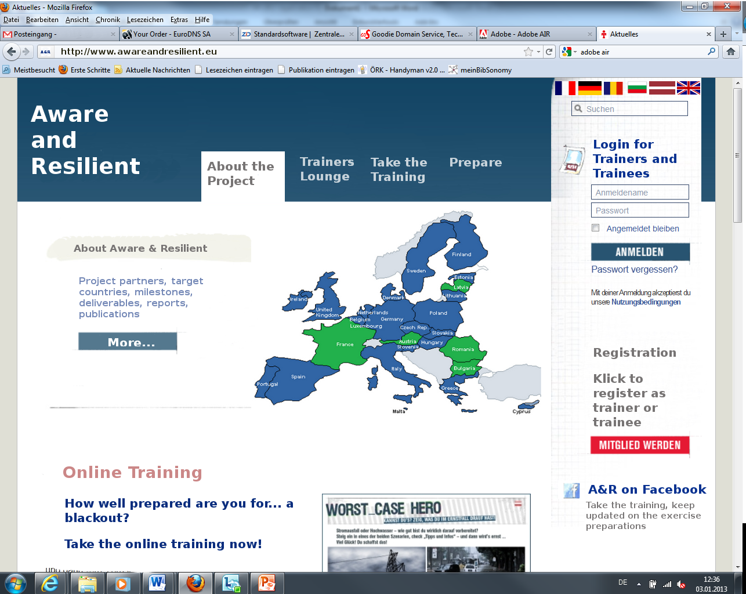
Social learning Platform - template

Slide 12
E – Community-based Exercises
Communities and/or schools will be chosen for model exercises with participation of relevant regional stakeholders (citizens, volunteers, authorities, media and response organisations and young adults who passed the online training module successfully).
Deliverables
Good practice and methodology reports (30.9.2013)
5 Community based exercises (31.10.2014)

Slide 13
F – Evaluation
Evaluate the level of preparedness of participants before a training or community based exercise and re-evaluate the level and be able to measure the improvement post training
Deliverables:
Base line evaluation report (31.7.2014)
Online training report (31.12.2014)
Exercise evaluation report (28.1.2015)

Slide 14
Outcome - expected results
A general preparedness curriculum for citizens
e-learning application in disaster prevention five languages (also running on social media platforms, i.e. Facebook)
Online training delivered in two communities for preparation to the community-based exercise
A curriculum (and relevant material) to train 15 trainers in five partner countries to deliver the mentioned trainings.
Five community-based emergency exercises in communities – one/country
Measurable increase in the awareness of disaster prevention for the reached target group
Headquaters
14

Slide 15
Follow up
Trained trainers will continue to deliver the training within partner organisations and in communities
Online training will stay available on website and social media networks. Since it covers three disaster scenarios in five languages it will be an important „on demand“ tool it case of increased media coverage following a disaster
Dissemination in thematic Red Cross and relevant Civil Protection networks

