Slide 1
Wrap-up and Proposals for Next Steps
Said El Khadraoui
Adviser, European Political Strategy Centre,
European Commission
Europe’s Response to Sustainability Challenges: Delivering The 2030 Agenda
20 December 2016

Slide 2
Sustainability Challenges
Worrying European Data
Almost every fourth person in the EU — 23.7 % of the population or close to 119 million people — is at risk of poverty or social exclusion;
15.8 % of young people aged 18 to 24 in the EU are neither in employment nor receiving further education and training;
More than 20 million Europeans were unemployed in October 2016;
1 out of 6 employees in the EU is a low-wage earner and nearly 1 in 10 is at risk of poverty;
The EU’s gender pay gap stands at 16.1%;
Around one in five fifteen year-old EU children show insufficient abilities in reading, mathematics and science;
9.4 % of the EU population is still unable to keep their home warm;
High-income earners in the EU earn about five times more than low-income earners;
When compared to pre-industrial times, the average temperature over the period 2006 to 2015 has risen by 0.84°C. This means that almost half of the warming towards the 2°C threshold has already taken place.
Source: Eurostat publication: Sustainable development: a glance at where the European Union stands
20 December 2016

Slide 3
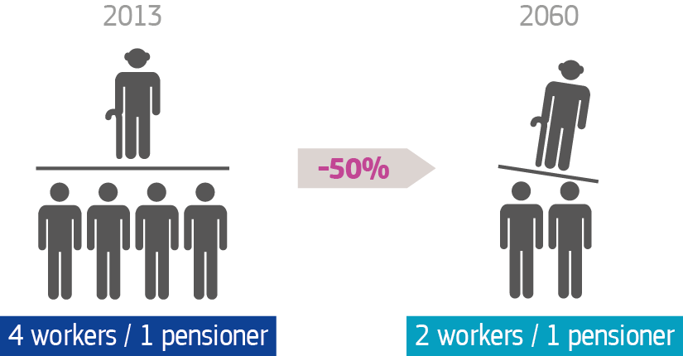
Sustainability Challenges
The Ratio of Workers to Pensioners Will Decrease
Source: European Commission, Ageing Report 2015
20 December 2016

Slide 4
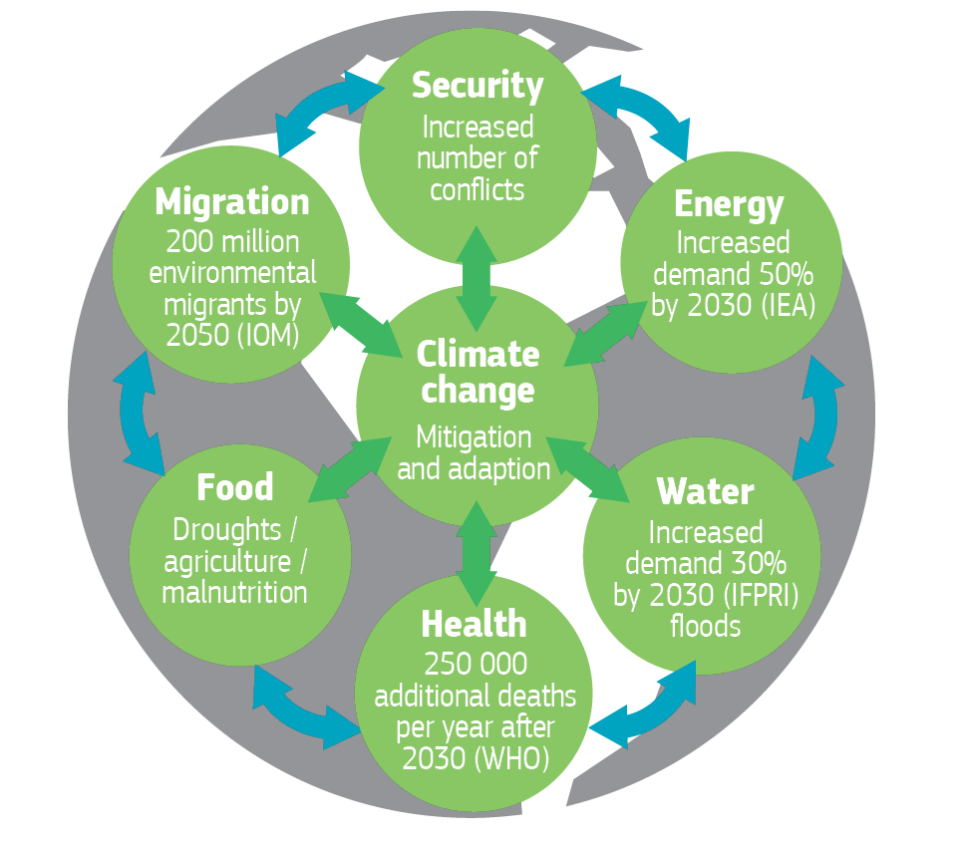
Sustainability Challenges
The 'Perfect Storm' Challenge
Source: European Political Strategy Centre and Oxford Martin Commission for Future Generations, University of Oxford
20 December 2016

Slide 5
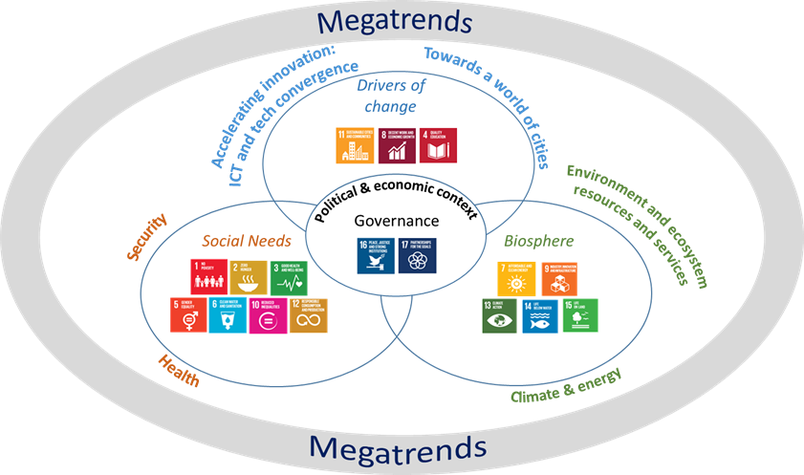
Opportunities
Overarching and Integrated Strategy
Source: DG RTD, The Bohemian Scenario
20 December 2016

Slide 6
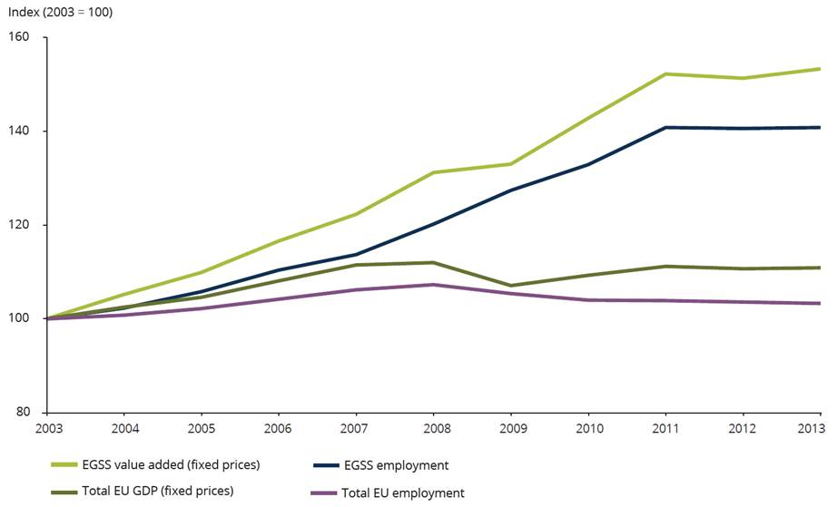
Opportunities
Eco-Industries Have Prospered Despite the Recession in Europe
Eco-industry value added
Eco-industry employment
Total EU GDP
Total EU employment
Source: EEA (2016) based on Eurostat data.
20 December 2016

